Slide 1
Spirituality in Healthcare
Focus on Advanced Nursing Practice
Linnea Axman, DrPH, MSN, FNP-BC, FAANP
Notes:
The major difficulties we run into when we discuss spirituality include the diversity
of opinions about the role of deity in human spirituality and the fact that spirituality is often associated with and
discussed from a Judeo-Christian perspective (McSherry & Draper, 1998).
Humankind is not homogeneous in beliefs and values, so neither nurses nor clients can be, either. I appreciate diversity
and believe we, as nurses, need to acknowledge and value differing perspectives on spirituality, especially
among those from different cultural and religious traditions. I do, however, hope that spirituality would be acknowledged
as a major concept of interest across all nursing theories and models, however defined and discussed.
The nursing theoretical base for spirituality would then embrace diverse views.
Spirituality, healing, and caring are intertwined human experiences for
both nurse and client. If we do not teach and demonstrate caring to our students, they will not be able to demonstrate
caring for clients. If we do not value and encourage diverse expression of students’ spirituality, they will have a difficult
time providing spiritually-relevant care for clients.

Slide 2
Anonymous
Do not stand at my grave and weep, I am not there, I do not sleep.
I am a thousand winds that blow; I am the diamond glints on snow;
I am the sunlight on ripened grain; I am the gentle autumn's rain.
When you awaken in the morning's hush, I am the swift uplifting rush
Of quiet birds in circled flight. I am the soft star that shines at night.
Do not stand at my grave and cry. I am not there; I did not die.

Slide 3
Definitions
Spirituality
An ontologically driven impulse toward union or relationship with God (or ultimate transcendent reality) (Barss, 2012)*
A motivating force that searches for meaning and purpose in life through connectedness (Sellers, 2001)
A personal search for meaning and purpose in life that brings faith, hope, peace,
empowerment
Notes:
No consensus on the definition of spirituality
* Joint Commission accepted definition
- Ontology is the philosophical study of the nature of being, existence, or reality

Slide 4
Definitions
Religion
An expression of the spiritual relationship that
unites an individual with a moral community that
shares similar experiences
World View
Mental maps we use to explain the world around
us; core beliefs and meanings that that
ultimately drive our behavior
Trust
State of confidence in and receptivity to
optimum healing

Slide 5
Definitions
Interspirituality
The sharing of ultimate experiences across
traditions
Healing
The process of moving towards wholeness in all dimensions of health: mental, emotional, physical, relational, cultural, spiritual.
May or may not be associated with “curing”

Slide 6
Spirituality and Healing in Nursing (Theory) Explored
Nightingale (1860): Presence of a Creator in the world
Rogers (1976): Choosing to actualize potentials that enhance what is perceived as beneficial interconnectedness with all life including a transcendent dimension or Being
Watson (1985): Health as balance among body, mind, spirit and/or soul

Slide 7
Martha Rogers
The Science of Unitary Human Beings:
Theoretical Basis for Nursing

Slide 8
Chakras
The Heart Chakra is the entryway to the spiritual.
Chakras 7-5 are earth-based, in the physical realm.
Chakras 3-1 are of the spiritual realm.
Notes:
Chakras are energy centers or spinning wheels of energy and are related in location to the nervous system

Slide 9
Spirituality and Healing in Nursing (Theory) Explored
Neuman (1989): “The 5th client variable”; spiritual development takes place throughout the lifecycle
Leininger (1991): In the “sunrise model”, both religious and philosophical factors give meaning to a culture group and both contributing to spirituality
Roy (1997): Focus on awareness, enlightenment, and faith

Slide 10
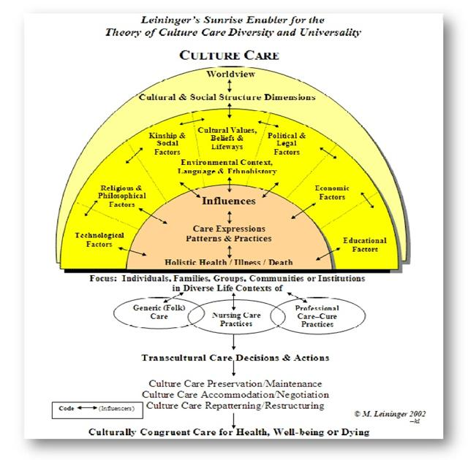
LEININGER'S THEORY OF CULTURE CARE
and
The
Sunrise Enabler

Slide 11
Significance to Nursing and Healthcare
Healing can be significantly enhanced when individuals trust in their healing process and relationships (up to 30%)
Psychoneuroimmunology has validated “the healing response”
Essential to patient safety
To neglect spirituality, or to fail to assess spiritual health places individuals at risk

Slide 12
T.R.U.S.T. Model of Inclusive Spiritual Care (Barss, 2012)
Notes:
Evidence-Based

Slide 13
T.R.U.S.T. Model of Inclusive Spiritual Care (Barss, 2012)
Rooted in evidence
Inclusive
Holistic
Allows spiritual matters of health to be defined by the individual
Informed by world wisdom traditions
Engenders trust
Asserts that trust links spirituality and health
Assumes nurses’ competence to assess, deliver, refer
Assumes nurse educators’ competence to mentor
Assists care providers to offer spiritual care

Slide 14
T. is for Traditions
Not all traditions enhance one’s well-being
Spiritual needs may be in conflict with doctrine
May be essential catalyst for coping, healing, and transformation
Spiritual practices include: Prayer, mediation, sacred readings, participation in ritual, music and chanting, yoga, martial arts, hiking, walking
Physical benefits include functional enhancement of the immune, cardiovascular, muskuloskeletal, and nervous systems

Slide 15
Arguments and the power of Prayer
It works!
Evidence is inconclusive
It does not work!
It is not possible to test the healing power of prayer through current methods of scientific enquiry

Slide 16
“I believe in miracles: Prayer works…it really works”
http://www.youtube.com/watch?v=PrSamBWmTSc

Slide 17
R. is for Reconciliation
Do explore:
any unresolved issues
Self-identified need for forgiveness
Do not rush or judge
Do use language appropriate to the tradition:
Western worldview: “sin, grace”
Indigenous worldview: “balance, harmony”
Eastern worldview: “nonattachment, letting go”

Slide 18
U. is for Understanding
Essential for clients and healthcare providers to understand which beliefs are sustaining, inspiring, and health promoting and which beliefs are distressing, disempowering, and health compromising

Slide 19
S. is for Searching
Explore faith questions (the need to make meaning out of suffering)
Challenge old beliefs and seek new ones that make sense out of the current situation
Explore natal beliefs and additional traditions (interspirituality)

Slide 20
T. is for Teachers
The spiritual, religious, and personal mentors and external resources individuals trust to help them through issues that are relevant to their healing process
Don’t forget traditional healers
Be deeply observant, humble, and utilize “deep listening”
http://www.youtube.com/watch?v=xAp9n3yBjyo&feature=fvwrel

Slide 21
Listening
“Listening is a far more difficult process than most people imagine. Really to listen is to let go utterly of ourselves, to let go of all the information, all the concepts, all the ideas and all the prejudices that our heads are stuffed with.” Sogyal Rinpoche
Deep Listening Training:
http://www.spcare.org/en/edu/events-ireland/234-deep-listening-ireland-201209.html

Slide 22
Initial Assessment: Yes/No

Slide 23
After the initial assessment
Yes questions followed by reflective questions
Refer appropriately
Follow-up
Document

Slide 24
References
Barss, K.S. (2012). T.R.U.S.T.: An affirming model for inclusive spiritual care. Journal of Holistic Nursing, 30(1), 24-34.
Hodge, D. (2006). A Template for Spiritual Assessment: A Review of the JCAHO Requirements and Guidelines for Implementation. Social Work, 51(4), 317-326.
Malinski, V.M. (2002). Developing a nursing perspective on spirituality and healing. Nursing Science Quarterly, 15(4), 281-287.
Tanyi, R.A. (2006). Spirituality and family nursing: spiritual assessment and interventions for families. The Author. Journal Compilation 2006, 287-294.
Wojnar, D., & Molinski, V.M. (2003). Developing a nursing perspective on spirituality and healing: Questions and Answers following a letter to the editor. Nursing Science Quarterly 16(4), 297-300.

Slide 25
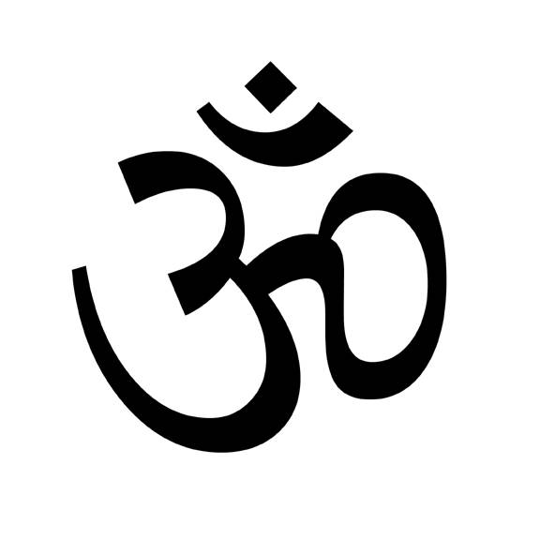
Questions?
Notes:
Shanti: Sanskrit for Peace

