Slide 1
GRE – Verbal Reasoning
Reading Comprehension

Slide 2
Reading Comprehension Text Completion Sentence Equivalence
Passages from physical sciences, biological sciences, social sciences, business, arts and humanities, and general topics
Both academic and non-academic books and periodicals
All questions can be answered based on the information provided in the passage
Tip:
-Read Science Daily, Newspaper (New York Times, The New Yorker)
-Take time to improve reading skills and focus

Slide 3
Reading Comprehension Questions
Designed to test ability to
Understand the meaning of individual words, sentences, bodies of text
Distinguish between major and minor points
Summarize
Infer
Understand structure of text
Identify perspective, underlying assumptions, evidence
Analyze text
Determine alternative explanations

Slide 4
It is active engagement with the text
Asking questions
Formulating and evaluating hypothesis
Relating information

Slide 5
Layout for the Reading Comprehension Section
The test contains ~10 passages
Most are one paragraph long
One or two are four to five paragraphs long
Balance across disciplines (humanities, social studies + business, and natural sciences)
Number of questions per passage will range 1-6
Half of the verbal reasoning questions will be based on passages
Three types of questions

Slide 6
Computer layout for the Reading Comprehension
The passage is on the left side and stays there while you work
Depending on the length, you may have to scroll down
The questions appear one at a time on the right side

Slide 7
How to digest a passage?
What is the main idea?
Introduction/topic sentence
What is the supporting information?
Body paragraphs/latter sentences
Key details
Try skimming, reading as little as you are able/comfortable to do
Glance at the questions first – they may clue you in to what you should look for in the passage

Slide 8
Tips and tricks!
Process of elimination
Test takers spend too much time trying to understand what they’ve read and not enough time working on the questions
Don’t spend your time solely trying to understand very little thing in the passage
Don’t keep everything in your head – Use your scratch paper
Practice summarizing the paragraphs/passage on scratch paper
Build a map of the paragraph/passage on your scratch paper

Slide 9
Refer to the passage once you’ve selected an answer
You should be able to find evidence/proof that your answer is correct

Slide 10
General Question Types:
“Fetch” Questions
Directly from the reading
Recalling a fact, opinion, statement etc.
Reasoning Questions
Analysis
WHO is the intended audience
WHAT inferences can you make
WHY would the author/speaker make that choice
Analysis of the argument/conclusions/assumptions

Slide 11
Multiple-choice: Select one answer choice
Traditional multiple-choice questions where you select only one answer choice
Five answer choices available
For each of Questions 1 to 10, “select one answer choice unless otherwise instructed.”
.
.
.

Slide 12
Tips for Answering “Select one”
Read all answer choices before selecting an answer
Do not be mislead by answer choices that are partially correct or that partially answer the question
Select the answer choice that most completely and accurately answers the question
Pay attention to the context
Especially important for questions that ask you about the meaning of a word

Slide 13
Multiple-choice: Select one or more answer choices
Three answer choices are provided, and you must select all the choices that are correct
No partial credit
“Consider each of the choices separately and select all that apply.”
.
.

Slide 14
Tips for Answering “Select one or more”
Evaluate each answer choice separately
Answer choices must accurately and completely answer question
Don’t fret if you think all three answer choices are correct

Slide 15
Multiple-choice: Select in passage
Select the sentence in the passage that meets specified criteria
In longer passages, the question will apply to 1-2 paragraphs
You will not be able to select a sentence outside of those
“In the # paragraph, “select the sentence that ...”

Slide 16
Tips for Answering “Select in passage”
Make sure you are referencing the relevant sections of the passage
Don’t select partial answers
The selection must address all points of the question

Slide 17
Beware
Extreme Statements
Certain words make choices extreme and, therefore, easy to dispute:
must
the first
each
every
all
the best
only
totally
always
no
Other words make choices moderate, more mushy, and therefore hard to dispute:
may
can
some
many
sometimes
often
Recycled Language
Be cautious of answer choices that are word for word from the passage
Correct answer choices are usually paraphrases of the information in the passage

Slide 18
Questions 1 to 3 are based on this passage.
Reviving the practice of using elements of popular music in classical composition, an approach that had been in hibernation in the United States during the 1960s, composer Philip Glass (born 1937) embraced the ethos of popular music in his compositions. Glass based two symphonies on music by rock musicians David Bowie and Brian Eno, but the symphonies' sound is distinctively his. Popular elements do not appear out of place in Glass's classical music, which from its early days has shared certain harmonies and rhythms with rock music. Yet this use of popular elements has not made Glass a composer of popular music. His music is not a version of popular music packaged to attract classical listeners; it is high art for listeners steeped in rock rather than the classics.
Select only one answer choice.
The passage addresses which of the following issues related to Glass's use of popular elements in his classical compositions?
How it is regarded by listeners who prefer rock to the classics
How it has affected the commercial success of Glass's music
Whether it has contributed to a revival of interest among other composers in using popular elements in their compositions
Whether it has had a detrimental effect on Glass's reputation as a composer of classical music
Whether it has caused certain of Glass's works to be derivative in quality

Slide 19
Questions 1 to 3 are based on this passage.
Reviving the practice of using elements of popular music in classical composition, an approach that had been in hibernation in the United States during the 1960s, composer Philip Glass (born 1937) embraced the ethos of popular music in his compositions. Glass based two symphonies on music by rock musicians David Bowie and Brian Eno, but the symphonies' sound is distinctively his. Popular elements do not appear out of place in Glass's classical music, which from its early days has shared certain harmonies and rhythms with rock music. Yet this use of popular elements has not made Glass a composer of popular music. His music is not a version of popular music packaged to attract classical listeners; it is high art for listeners steeped in rock rather than the classics.
Consider each of the three choices separately and select all that apply.
The passage suggests that Glass's work displays which of the following qualities?
A return to the use of popular music in classical compositions
An attempt to elevate rock music to an artistic status more closely approximating that of classical music
A long-standing tendency to incorporate elements from two apparently disparate musical styles

Slide 20
Questions 1 to 3 are based on this passage.
Reviving the practice of using elements of popular music in classical composition, an approach that had been in hibernation in the United States during the 1960s, composer Philip Glass (born 1937) embraced the ethos of popular music in his compositions. Glass based two symphonies on music by rock musicians David Bowie and Brian Eno, but the symphonies' sound is distinctively his. Popular elements do not appear out of place in Glass's classical music, which from its early days has shared certain harmonies and rhythms with rock music. Yet this use of popular elements has not made Glass a composer of popular music. His music is not a version of popular music packaged to attract classical listeners; it is high art for listeners steeped in rock rather than the classics.
3. Select the sentence that explains the relationship between Glass’ music and the two types of listeners/

Slide 21
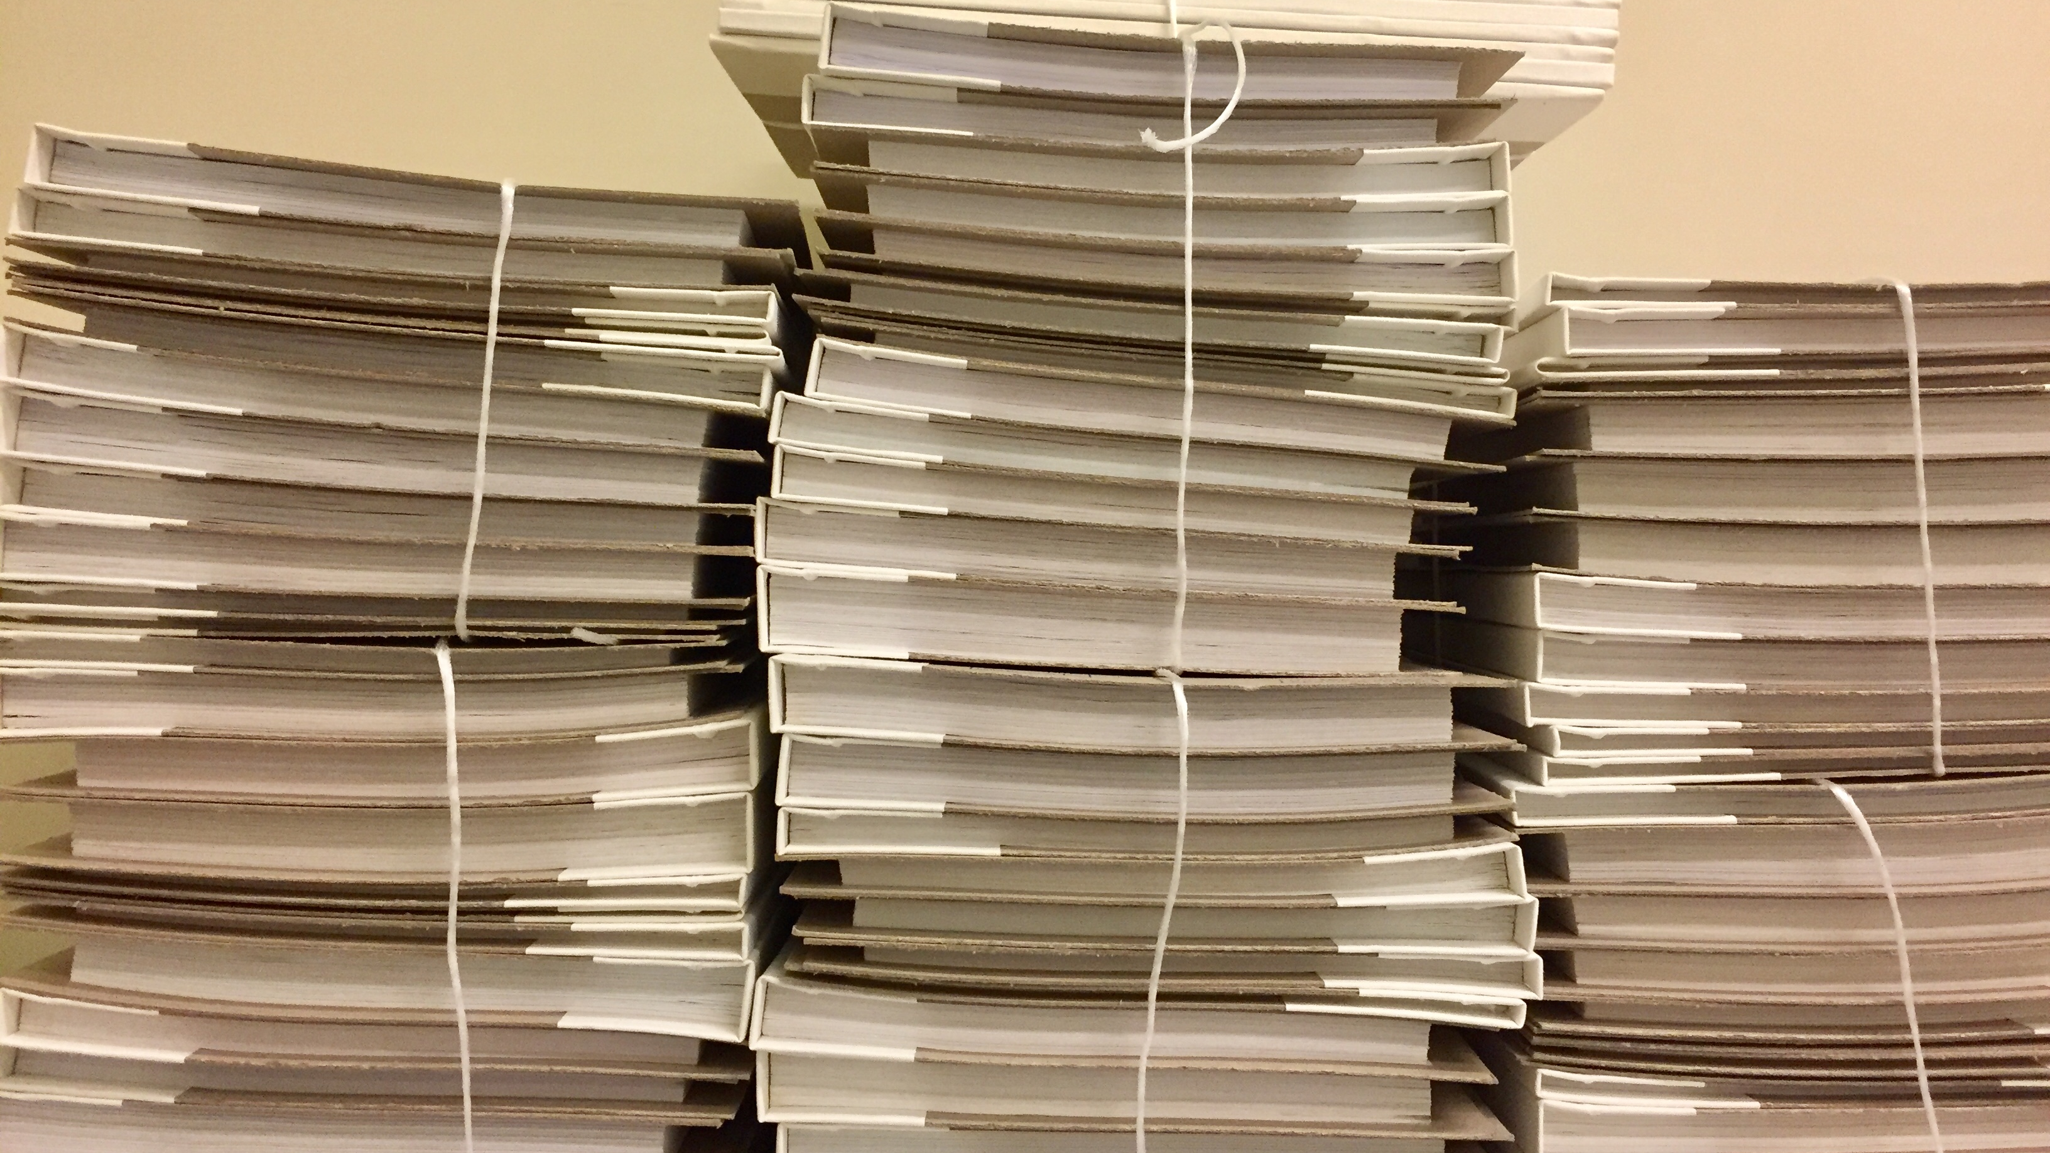
Keep on Keeping on

