Slide 1
Communication Skills Building: Impromptu Speaking
American Language & Culture Institute
CSU San Marcos
March 2022

Slide 2
Lesson Goals:
By the end of this presentation, you will have a better understanding of:
Different types of speech delivery, including impromptu.
Good use of voice while giving a speech.
Giving a short impromptu Speech.

Slide 3
Warm-up Questions:
What are some everyday situations when you must suddenly speak without much – or any – preparation? (Example: talking to an employee at a store)
What are some different ways people use to remember a speech while they are giving it?
What are some situations when you might be asked to give a formal speech with almost no time to prepare?
How would you feel (emotions) if someone asked you to suddenly give a speech when you were not expecting it?

Slide 4
Types of Delivery for Speeches
From Memory
Reading from a Manuscript
Extemporaneous
Impromptu

Slide 5
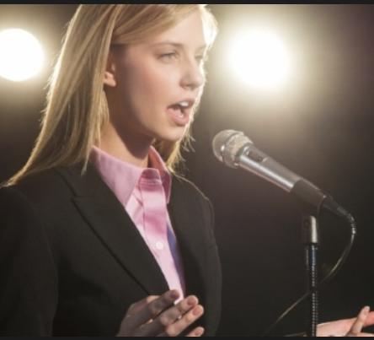
Types of Speech Delivery
Speaking from memory
Write out, then present speech by remembering all of it.
No notes!
Traditional
Memorizing entire speech is difficult for most.
Not often necessary.

Slide 6
Types of Speech Delivery
Reading from a manuscript
Write out, then read entire speech
Easier than memorization
Can reduce anxiety
BUT BE CAREFUL!
Staring at manuscript
No eye contact with audience
Might lose connection
Monotone voice

Slide 7
Types of Speech Delivery
Extemporaneous
Most common type of formal speaking
Make sentences in the moment
Each delivery of same speech is a little different
Preparation depends on individual
Some Limited notes
List of words
Outline

Slide 8
Types of Speech Delivery: Impromptu
Means to make speech content in the moment, with little or no preparation before.

Slide 9
The Most Challenging?

Slide 10
Impromptu “Natural Speech”
In our everyday lives, we have many opportunities to practice impromptu speaking skills through natural conversation and social situations.

Slide 11
Speaking “On the Spot”
Called on in class
Answering questions
After a prepared speech.
During a job interview
Asked to speak during a business meeting
Special events
Examples: weddings or birthday celebrations

Slide 12
Organize Your Thoughts
Even in a spontaneous speaking situation, you can still present from a mental outline that you draft quickly (in your head) and keep in mind as you speak.
Practice in the moment

Slide 13
General Tips “Mental Organization” Step 1
What is the question or topic?
To begin, think carefully about the precise nature of the question or topic.
Be sure you understand the topic or question.

Slide 14
General Tips “Mental Organization” Step 2
What is your answer or opinion about the topic?
Consider what you think about the topic or what you think the answer to the question is.
Develop a mental (or quickly written) outline.
Consider the beginning, middle, and end of your speech
Get to the point quickly when you begin speaking.

Slide 15
General Tips “Mental Organization” Step 3
How do I support my ideas?
Think of reasons that support your answer to the topic.
“Three” is a good number of examples to give.
End with a strong conclusion

Slide 16
Impromptu Speech Technique: P.R.E.P.

Slide 17
Review of P.R.E.P. Technique
POSITION
“Get to the point”
State your answer or opinion right away when you start to speak.
REASON
Give your reasons why
Reasons often start with “Because …”
EVIDENCE
Give examples
Three is a good number of examples
POSITION
Restate your position in the conclusion.

Slide 18
Delivery--Go for It!
Relax and try to enjoy giving the speech.
We are in this together!
Most everyone gets nervous giving a speech
Audience wants you to succeed
You can do it!
Nerves can make you a better speaker
You care!
Breathe!
Take fewer, but deeper breaths.
Breathe from the lower chest

Slide 19
Use Your Voice! Volume
How loudly are you speaking?
Audience must hear you!
Live audience
Size of room
Number of people
Zoom - virtual
Microphone

Slide 20
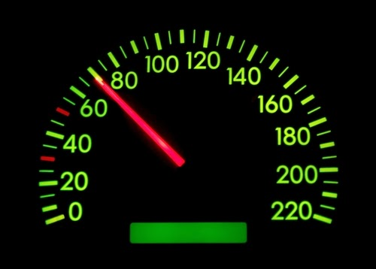
Use Your Voice! Speed
How quickly are you speaking?
Too slowly?
Ex.: Too many pauses
Can cause audience to become bored
Too quickly?
Can cause audience to misunderstand you
Find medium ground—depending on audience

Slide 21
Use Your Voice! Articulation
How clearly are you speaking?
Clear articulation
Helps audience understand
Pauses
Avoid “filler” words and sounds– Ex.: ah, um, er, like, you know, etc.
Be aware of pronunciation

Slide 22
Staying on Time
Staying within speech time limit is important!
Most speeches have a time limit.
An impromptu speech will probably be short.
Too short of speech may give bad impression.
Going over-time can bore audience.

Slide 23
ACTIVITY: Give an Impromptu Speech
**Facillitators assign ONE of the topics to each student.**
Students mentally organize (or quickly write down) your speech ideas.
Prepare briefly using the General Tips listed in the PowerPoint. (**Facilitators please review if necessary and discuss.**) If you wish to challenge yourself, you may also use the P.R.E.P. Technique (but it is optional).
Then, give a 30-second to 1-minute speech to your group.
Be aware of your vocal delivery (volume, speed, articulation). **Facilitators, please time.**
(Maybe present it to the class later.)
Choose one:

Slide 24
Activity: Give an Impromptu Speech Topics:
Why ____ is my best friend
A celebrity I want to meet and why
My favorite movie (and why)
The best tourist spot in the world (and why)
Choose one:

Slide 25
After presenting your Impromptu Speech, discuss the following questions:
How did you feel (emotions) before, during, and after your impromptu speech?
In what ways were you aware of using your voice while speaking?
In what ways do you feel you did a good job with the impromptu speech?
In what ways would you like to improve your impromptu speaking skills?

