Slide 1
Communication: Small Talk
Global Tourism & Communication
Spring 2021

Slide 2
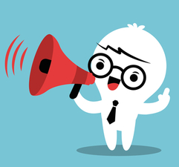
Agenda
Warm up
What is small talk?
Small talk norms
Topics for small talk
Tips for small talk
Small talk example
Small talk practice
Objectives: After this lesson you will be able to...
Describe small talk to someone who doesn't know about it
Start a small talk conversation in English
Recognize appropriate times to use small talk
Notes:
Time: 50” 6:0o-6:50 PM PDT
15” Warm up
10” Lecture
What is small talk?
Small talk norms
Topics for small talk
Tips for small talk
7-10” Small talk example
15-20” Small talk practice & Share
Additional Resources:
English Club: About Small Talk (LINK)
3 Tips for Small Talk (LINK)

Slide 3
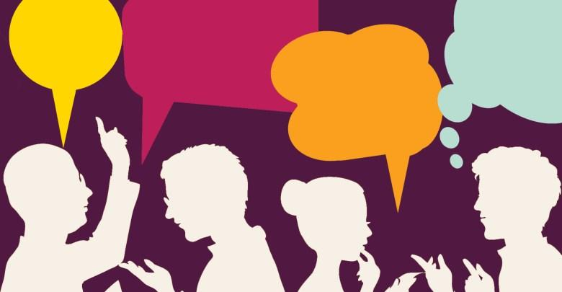
Warm-Up Questions
Discuss these questions in groups:
What is small talk?
When do we use it?
Is it normal to talk to strangers in your country?
Be prepared to share after with the class

Slide 4
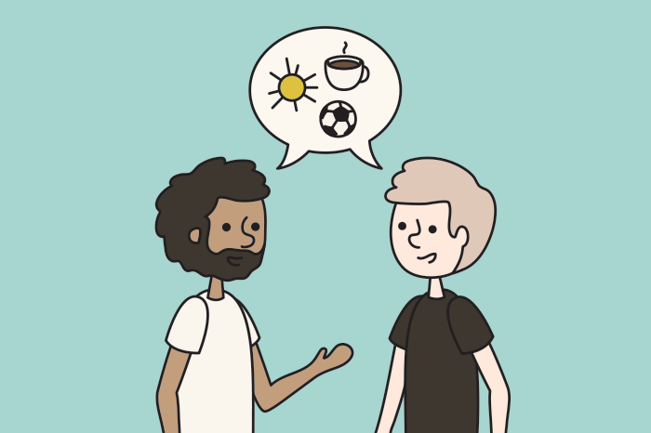
What is Small Talk?
Casual conversation
Before asking for something
To break the ice
To fill 'awkward' silences
Not speaking is sometimes considered rude
It's not uncommon for strangers to talk in the U.S. Often, we use small talk when we are waiting, or to fill a silence

Slide 5
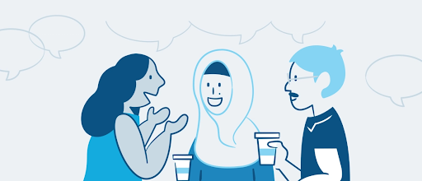
Norms Around Small Talk
Who:
Strangers
Acquaintances
Co-workers
Where:
In public
When waiting for something (line, elevator)
Social events
First day of class

Slide 6
Topics for Small Talk
Common topics:
Weather
Sports
Current events
Topics to avoid:
Politics
Religion
Personal information
Money
Body or appearance
Controversial topics
Light vs. Heavy topics:
Heavy = sad, serious, or intellectual
Light = Trivial, not serious, simple

Slide 7
Tips for Small Talk
These tips will help you make successful small talk:
Use it the first time you see someone in a day
Use it when things are quiet
Use it only when someone smiles or acknowledges you
Don't use it when someone is busy or unresponsive
It can be difficult to know how to begin. Try these conversation starters
Small talk doesn’t have to be hard. With practice, you can become a small-talk expert!

Slide 8
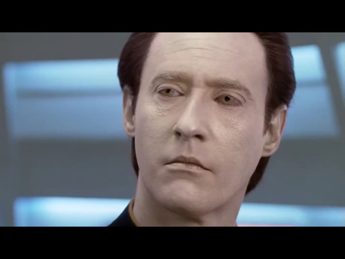
What did he do wrong?
Think of these questions as you watch the video:
Was this a successful use of small talk?
What did he do well?
What mistakes did he make?
[answer: good: he chose a light topic and picked an appropriate situation - when they were waiting/elevator, bad: The other person did not respond much, did not smile, and did not seem interested in the topics, but he continued to speak; he went into too much detail]
The character in the yellow shirt is learning ‘small talk’
Notes:
Suggested Video settings: Select CC and 75% speed
End at 1’ 22” (can watch second part - where the android learns how to make successful small talk by observing a ‘small talk guru’)
What the character did wrong: He continued to speak after the man in the red shirt did not smile, did not make sustained eye contact, and did not show interest.; He went into too much detail about the topic of weather and it was no longer considered ‘light’ conversation
What the character did right: He chose a light topic (weather); Picked an appropriate situation (elevator*)
For part after 1:22 (if time): Point out that small talk is a good ice breaker, but it is best used in limited quantities. It can move to a deeper conversation later. The ‘small talk guru’ is seen as ‘fake’ because he never interacts beyond small-talk.

Slide 9
Practice
Look at some conversation starters
Take turns asking and answering them with a partner
Switch partners
Share one thing you learned about your classmates
You can use conversation starters to help you make successful small-talk
Notes:
https://www.englishclub.com/speaking/small-talk_conversation-starters.htm
If time: Students share-out experience
Extra time: prep for the closing ceremony. Note: Make sure to emphasize that if they are asked to speak, only a few sentences are needed.

