Slide 1
Center for
Training,
Research, &
Educational
Excellence
The Road to Graduate School

Slide 2
What is Graduate School?
Advanced academic training beyond the bachelor’s degree
Focus on a specific discipline/profession
TIME
COST
TIME
COST
Master’s
Degree
Ph.D.
Financial
Package

Slide 3
Grad School Checklist
Notes:
https://www.salescoach.us/sales-qualifying-checklist/

Slide 4
Grad School Checklist
List of graduate schools you will apply to
List of faculty that you want to work with
Take the Graduate Record Exam (GRE)
Letters of recommendation (2 - 3 faculty letter writers)
Statement of purpose/Personal statement
Diversity Statement
Curriculum vitae (CV)/Resume
Transcripts
Notes:
https://www.salescoach.us/sales-qualifying-checklist/

Slide 5
Graduate School Application Timeline
Summer 2022
Fall 2022
Spring 2023
Participate in summer research programs & internships
Organize & build grad school application materials
Secure letter writers
Identify prospective grad school programs & mentors
Prepare for & successfully take GRE
Reach out to prospective grad mentors
Continue gaining research experience
Connect with grad program advisors/coordinators & secure application fee waivers
Formally request letters of recommendation
~2-3 months from application deadlines
Work with mentors & OTRES staff to revise application materials
Apply to graduate schools
December deadlines are common
Continue working with mentor and building up research experiences
Wait for acceptance letters
Visit graduate schools & participate in interviews
Review acceptance offers with mentors & OTRES staff
Accept/Decline accordingly
Graduate from CSUSM

Slide 6
Where Are You Going For Grad School?
Focus on faculty
Authors from research articles
Researchers named in research blogs, news sites, and podcasts
Notes:
https://sites.duke.edu/dukeidlab/

Slide 7
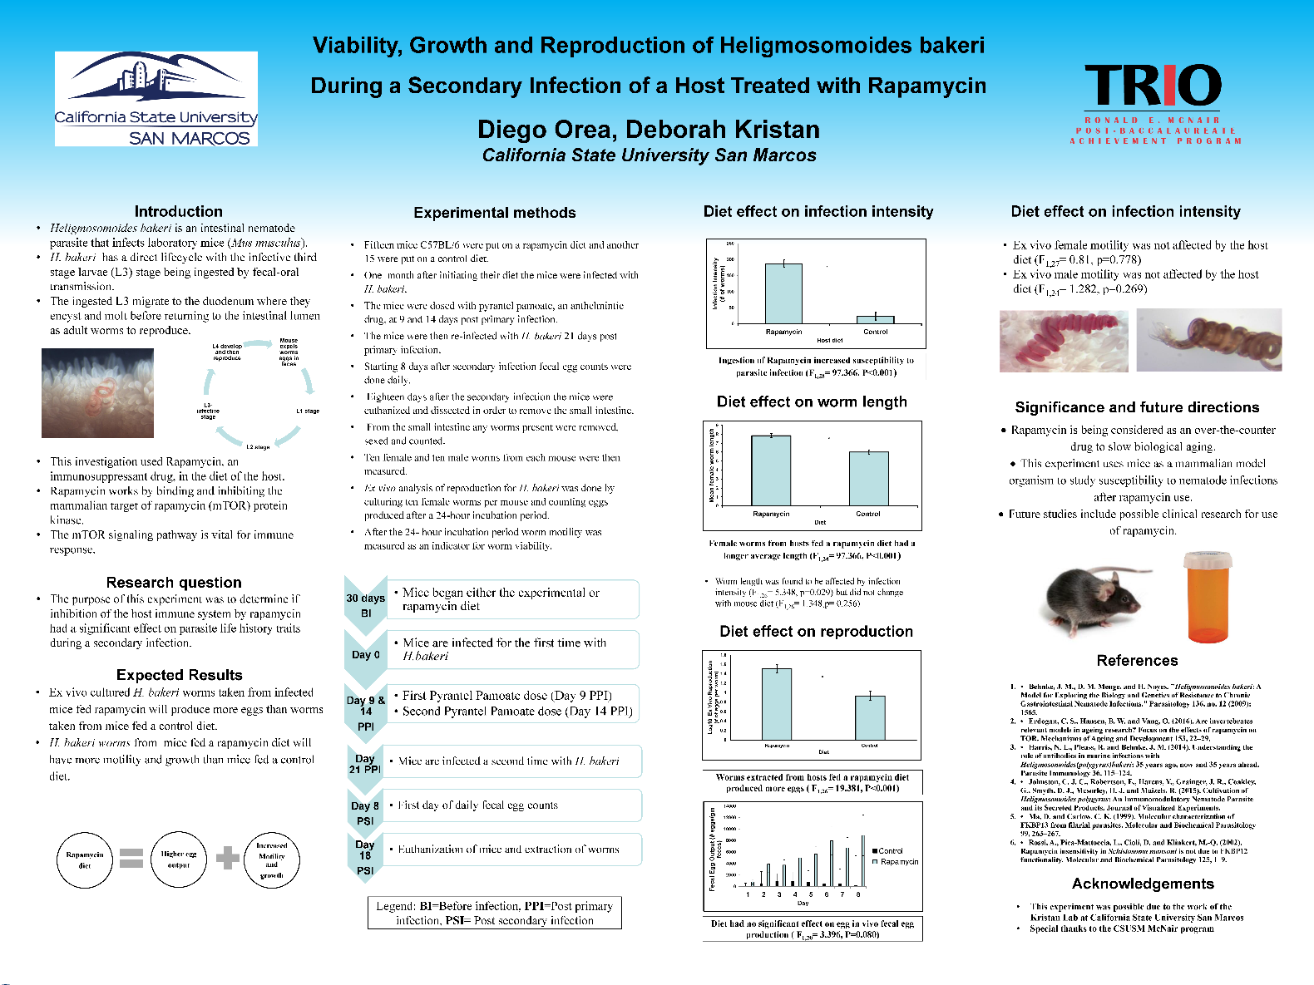
Where Are You Going For Grad School?
Focus on faculty
Authors from research articles
Researchers named in research blogs, news sites, and podcasts
Network at conferences
Attend talks and explore posters
Talk to faculty, current grads, and grad program advisors/coordinators
Notes:
https://sites.duke.edu/dukeidlab/

Slide 8
Selecting Graduate Programs
Ask your research mentor(s) and other mentors for suggestions and recommendations
Explore university/department websites
Identify faculty doing research you are interested in
Explore tangential interests
Prospective grad program must have 2+ faculty with tangential research interests

Slide 9
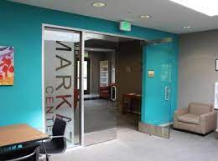
Other Early Considerations
Campus climate
Graduate student organizations
Equity/Community centers
Graduate student-specific support services
Grad student housing
University-specific graduate funding
Example: University of Utah McNair graduate fellowship
Grad health/wellness services

Slide 11
The Road to Graduate School…
Where do we start?

