Slide 1
Assessment for Service Learning Reflections and Rubrics
Melissa Simnitt
Academic Programs – CRA 5201 – x8880

Slide 2
Goals! At the end of this session, we will have…
Discussed what students should know and do by the end of a course/class and how it connects with SL
Discussed what “good” assessment looks like for SL
Reviewed how assessment can be used to guide learning
Reviewed resources

Slide 3
Quick Review So far, you’ve covered…
The definition of SL and the campus overview
Learning Outcome development & incorporating SL into your course
Critical SL
Which brings us to…ASSESSMENT

Slide 4
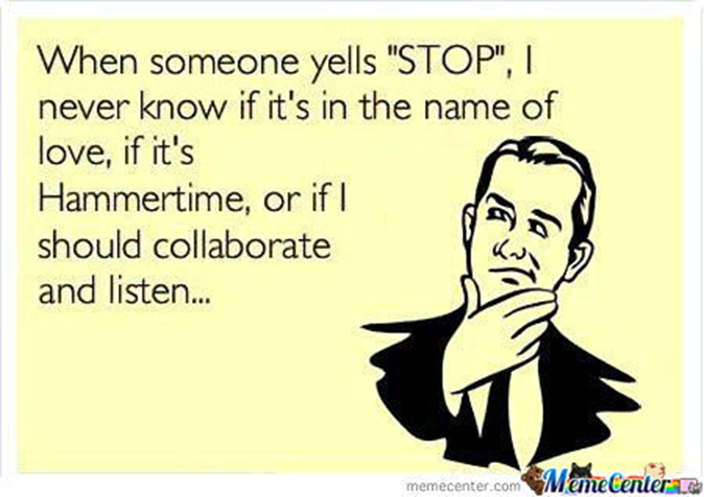
Assessment of Learning begins with Outcomes
What should your students know or be able to do at the end of the course/class/SL?

Slide 5
Discussion time!
After brainstorming “homework,” consider:
Are LOs solid, simply stated, and measurable?
What type of SL is incorporated? How much of the course is devoted to SL?
Are the LOs tied to the SL and course content?
Do the LOs connect the experience to the learning?
Course activities (assignment weight, speakers, projects, etc.)

Slide 6
“Good” Assessment
Connects learning to activity
On-going and woven throughout course
Designed to help students do well
Does more than measures “whether they got it”
Enhances learning, itself (revisits the point, concept, etc. throughout the lesson and others)
Simple and appropriate for the assignment
Wiggins, G. P., & McTighe, J. (2008). Understanding by design (2nd ed.). Alexandria, VA: Association for Supervision and Curriculum Development

Slide 7
Good assessment tools
Formative vs. Summative; Graded vs. Ungraded
Checking for understanding
Quizzes & Exams (multiple-guess vs. fill-in the blank)
Self-reporting (reflections, surveys)
Rubrics
Connects to learning Woven throughout course
Helps students do well Simple

Slide 8
Discussion time!
What are some examples you already use?

Slide 9
Guided Learning
Focusing on Self-Reflection & Rubrics
Things to keep in mind:
Best times to use students’ self-reflections (self-reporting)
Writing assignment(s) & grading them
Be specific about what you will and will not be grading
Develop a GOOD rubric that can be used across all (or most) assignments

Slide 10
What goes into a “good” reflection?
Choose a grading method; stick with it
Provide the rubric(s) up-front
Check for understanding
Allow students to offer opinions, answer questions with facts, or compare/contrast topics in the reflections
Reflect on the application, not the skill
Avoid leading the answer
Continuous – ongoing component of course, happening before, during, and after the experience
Activity is meaningful in relation to the experience (connected)
Kolb’s Experiential Learning Cycle (What? So what? Now what?)
Kolb, D. A. (1984). Experiential learning: Experience as the source of learning and development. Englewood Cliffs: Prentice-Hall.
Notes:
Sharing time, again
Worksheet for Backward Design

Slide 11
Providing Feedback
What kind of feedback, if any, will you incorporate?
Purpose
Teaching students how to provide feedback
Reflect – Inquire – Suggest – Elevate (RISE)
Growth-oriented – Real – Empathetic – Asked for – Timely (GREAT)

Slide 12
What goes into a good rubric?
Criteria
Specific & one-dimensional so students and raters can clearly identify the expectations
Use words directly from LOs
Levels of performance
3-5 levels is the norm; 4-levels is common; 3-levels is simple!
Does not meet/Meets/Exceeds
Gradations of quality
Clear and specific descriptions of what constitutes each level
Items missing = does not meet
Required elements included = meets
Required elements plus additional supporting information included = exceeds

Slide 13
Good rubric – continued…
Continuity
Difference in quality should be equal between each level
Distance between Exceeds and Meets = distance between Meets and Does not meet
Reliability
A variety of raters should be able to use the rubric and arrive at similar scores
Validity
Rates what is intended to rate
Scores what is central to the assignment

Slide 14
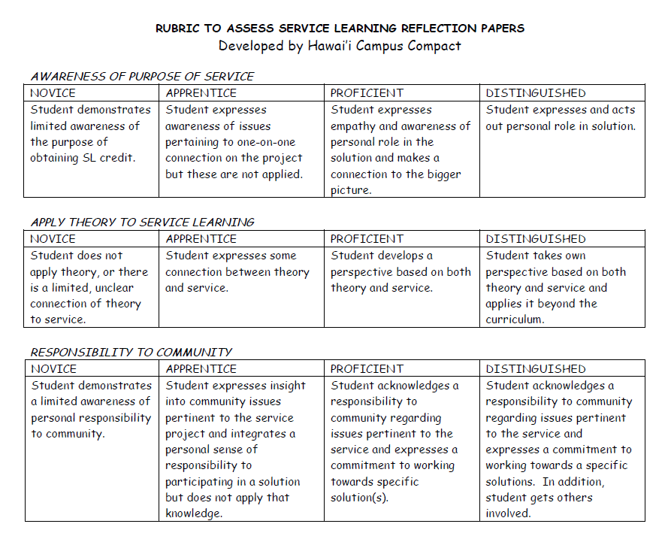
SAMPLE

Slide 15
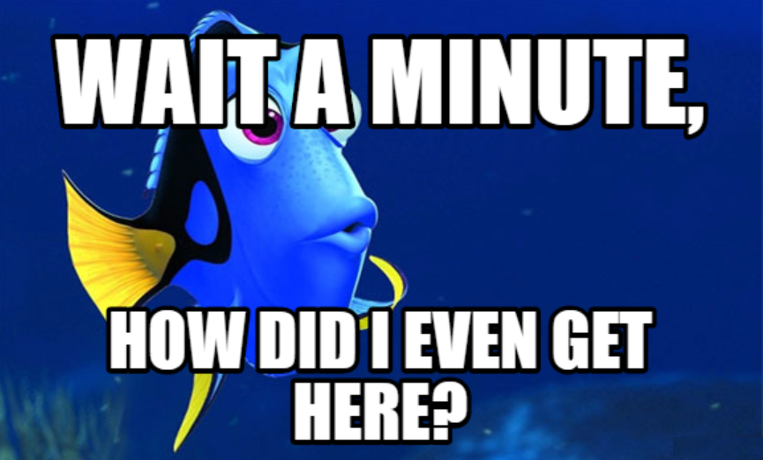
Practice time!
Notes:
Practice creating a rubric on the blank form

Slide 16
Recap, Brainstorm, and Design
What is/are your LO(s) for SL?
How will you assess the LOs? When? Where?
What types of assignments/activities will help students do well?
Informative to them and you
Essentials (LOs) What will students take from my class? SWBAT... | Assessments What would students need to have or be able to do to convince me (and themselves) that they have achieved the LO? | Activities What would students need to DO in order to do well on the assessment?

Slide 17
Designing Activity
Column #1
Learning Outcomes (SWBAT)
Walk-out-the-door skills/knowledge
Be/Have vs. Make/Do
Simple statements
Measurable

Slide 18
Designing Activity - Continued
Column #2
Assessments
Best way to measure
Be prepared to change stuff
Ok to change your LO(s)
How can students convince me (and themselves) that they have achieved the skill?

Slide 19
Designing Activity - Continued
Column #3
Activities
How can I help students do well on the assessment?
Best way to teach topic & measure it
Be prepared to change stuff
What would students need to DO in order to do well in my class?
Get students talking about their learning!

