Slide 1
The Use of Botanicals in Integrative Healthcare
Linnea M. Axman
NURS 604

Slide 2
Potential for Interactions
Botanicals
Pharmaceuticals
Garlic
Ginkgo
Golden seal
Green tea
Kava
St John's wort
Valerian
Anti thrombotics
Sedatives
Antidepressants
Anti diabetics

Slide 3
Garlic (Allium sativum)
Garlic is the edible bulb from a plant in the lily family
Most common folk or traditional uses as a dietary supplement are for high cholesterol, heart disease, and high blood pressure.
© Stephen Foster
https://nccih.nih.gov/health/garlic/ataglance.htm

Slide 4
Garlic
Other folk or traditional uses include prevention of certain types of cancer, including stomach and colon cancers.
Garlic cloves can be eaten raw or cooked. They may also be dried or powdered and used in tablets and capsules. Raw garlic cloves can be used to make oils and liquid extracts.

Slide 5
Side Effects and Cautions
Side effects include breath and body odor, heartburn, upset stomach, and allergic reactions. These side effects are more common with raw garlic.
Garlic can thin the blood (reduce the ability of blood to clot) in a manner similar to aspirin.
Garlic has been found to interfere with the effectiveness of saquinavir, a drug used to treat HIV infection.
Garlic’s effect on other drugs has not been well studied.

Slide 6
Garlic: What the Evidence Says
According to NCCIH:
Preliminary research suggests that taking garlic may slow the development of atherosclerosis (hardening of the arteries), a condition that can lead to heart disease or stroke.
Evidence suggests that taking garlic may slightly lower blood pressure, particularly in people with high blood pressure.
Some evidence indicates that taking garlic can slightly lower blood cholesterol levels; studies have shown positive effects for short-term (1 to 3 months) use. A recent NCCIH-funded study found no effect on cholesterol levels.

Slide 7
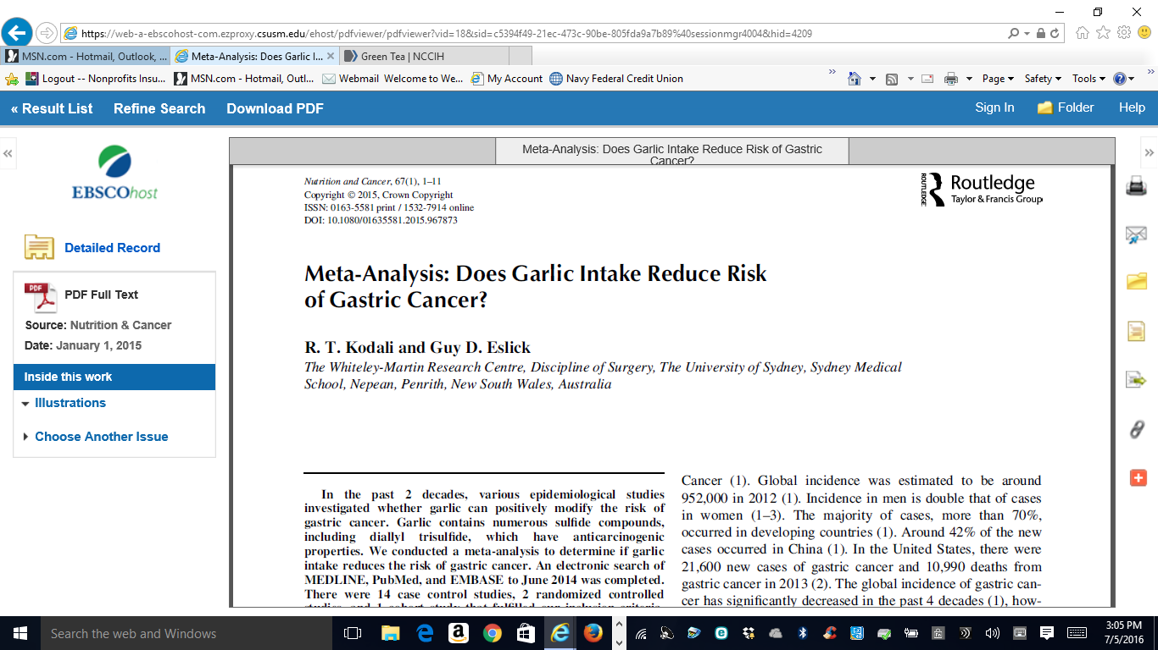

Slide 8
Garlic References
Agency for Healthcare Research and Quality. Garlic: Effects on Cardiovascular Risks and Disease, Protective Effects Against Cancer, and Clinical Adverse Effects. Evidence Report/Technology Assessment no. 20. Rockville, MD: Agency for Healthcare Research and Quality; 2000. AHRQ publication no. 01-E023.
Gardner CD, Lawson LD, Block E, et al. Effect of raw garlic vs. commercial garlic supplements on plasma lipid concentrations in adults with moderate hypercholesterolemia: a randomized clinical trial. Archives of Internal Medicine. 2007;167(4):346–353.
Garlic. In: Blumenthal M, Goldberg A, Brinckman J, eds. Herbal Medicine: Expanded Commission E Monographs. Newton, MA: Lippincott Williams & Wilkins; 2000:139–148.
Garlic. Natural Medicines Comprehensive Database Web site. Accessed at www.naturaldatabase.com on June 16, 2009.
Garlic (Allium sativum L.). Natural Standard Database Web site. Accessed at www.naturalstandard.com on June 16, 2009.
Milner JA. Garlic (Allium sativum). In: Coates P, Blackman M, Cragg G, et al., eds. Encyclopedia of Dietary Supplements. New York: NY: Marcel Dekker; 2005:229–240.
National Cancer Institute. Garlic and Cancer Prevention. National Cancer Institute Web site. Accessed at www.cancer.gov/cancertopics/factsheet/Prevention/garlic-and-cancer-prevention on June 3, 2010.

Slide 9
Ginko (Ginko biloba) Also known as fossil tree, maidenhair tree, Japanese silver apricot, baiguo, bai guo ye, kew tree, yinhsing (yin-hsing)
The ginkgo tree is one of the oldest types of trees in the world.
Extracts from ginkgo leaves are used to make tablets, capsules, or teas.
Ginkgo leaf extract has a variety of folk or traditional uses for health purposes.
© Stephen Foster
https://nccih.nih.gov/health/ginkgo

Slide 10
Ginko
Historically, ginkgo leaf extract has been used to treat asthma, bronchitis, fatigue, and tinnitus (ringing or roaring sounds in the ears).
By EecherplazGinkgo06.jpg: Cayambederivative work: Ginkgotree (talk) - EecherplazGinkgo06.jpg, CC BY-SA 3.0, https://commons.wikimedia.org/w/index.php?curid=16362112

Slide 11
Ginko
Today, folk uses include attempts to improve memory; to treat or help prevent Alzheimer’s disease and other types of dementia; to decrease intermittent claudication; and to treat sexual dysfunction, multiple sclerosis, tinnitus, and other health conditions.
Extracts are usually taken from the ginkgo leaf and are used to make tablets, capsules, or teas.
Occasionally, ginkgo extracts are used in skin products.

Slide 12
Ginko: What the Evidence Shows
According to NCCIH:
Numerous studies of ginkgo have been done for a variety of conditions. Among the most widely researched are dementia, memory impairment, intermittent claudication, and tinnitus.
Some smaller studies of ginkgo for memory enhancement have had promising results, but a trial sponsored by the National Institute on Aging of more than 200 healthy adults over age 60 found that ginkgo taken for 6 weeks did not improve memory.

Slide 13
What the Evidence Shows
Overall, the evidence on ginkgo for symptoms of intermittent claudication has not yet shown a significant benefit for this condition, although several small studies have found modest improvements.
There is conflicting evidence on the efficacy of ginkgo for tinnitus.

Slide 14
Side Effects and Cautions
Side effects may include headache, nausea, gastrointestinal upset, diarrhea, dizziness, or allergic skin reactions. More severe allergic reactions have occasionally been reported.
There are some data to suggest that ginkgo can increase bleeding risk.
Fresh (raw) ginkgo seeds contain large amounts of a chemical called ginkgotoxin, which can cause serious adverse reactions—even seizures and death. Roasted seeds can also be dangerous.
Products made from standardized ginkgo leaf extracts contain little ginkgotoxin and appear to be safe when used orally and appropriately.

Slide 15
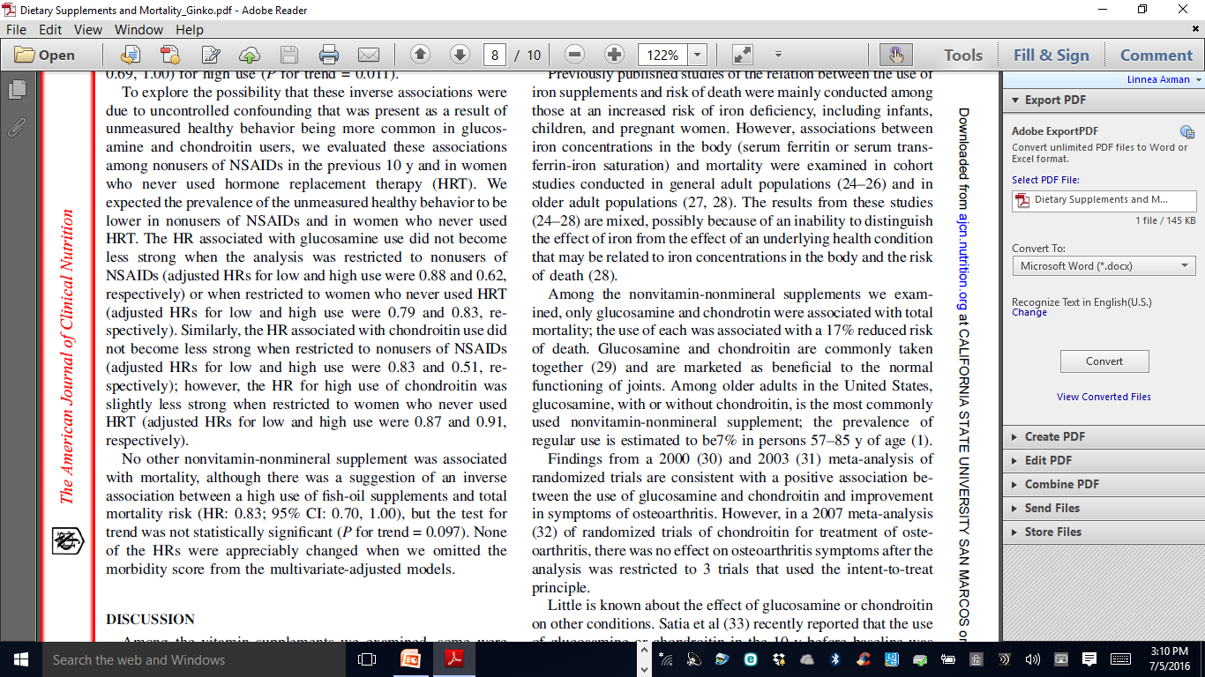

Slide 16
Ginko References
Brinkley TE, Lovato JF, Arnold AM, et al. Effect of Ginkgo biloba on blood pressure and incidence of hypertension in elderly men and women. American Journal of Hypertension. 2010;23(5):528–533.
DeKosky ST, Williamson JD, Fitzpatrick AL, et al. Ginkgo biloba for prevention of dementia: a randomized controlled trial. Journal of the American Medical Association. 2008;300(19):2253–2262.
Ginkgo. Natural Medicines Comprehensive Database Web site. Accessed at www.naturaldatabase.com on August 20, 2009.
Ginkgo (Ginkgo biloba L.). Natural Standard Database Web site. Accessed at www.naturalstandard.com on August 20, 2009.
Ginkgo biloba leaf extract. In: Blumenthal M, Goldberg A, Brinckman J, eds. Herbal Medicine: Expanded Commission E Monographs. Newton, MA: Lippincott Williams & Wilkins; 2000:359–366.
Snitz BE, O'Meara ES, Carlson MC, et al. Ginkgo biloba for preventing cognitive decline in older adults: a randomized trial. Journal of the American Medical Association. 2009;302(24):2663–2670.
Solomon PR, Adams F, Silver A, et al. Ginkgo for memory enhancement: a randomized controlled trial. Journal of the American Medical Association. 2002;288(7):835–840.
Strømgaard K, Vogensen SB, Nakanishi K. Ginkgo biloba. In: Coates P, Blackman M, Cragg G, et al., eds. Encyclopedia of Dietary Supplements. New York, NY: Marcel Dekker; 2005:249–257.
National Toxicology Program. NTP technical report on the toxicology and carcinogenesis studies of Ginkgo biloba extract (CAS No. 90045–36–6) in F344/N rats and B6C3F1/N mice (gavage studies) (4.3MB PDF). Research Triangle Park, NC: National Toxicology Program; 2013. NIH Publication No. 13–5920.

Slide 17
Goldenseal (Hydrastis canadensis L)
Goldenseal is a plant that grows wild in parts of the United States.
It is grown commercially, especially in the Blue Ridge Mountains.
Historically, Native Americans have used goldenseal for various health conditions such as skin diseases, ulcers, and gonorrhea.
© Stephen Foster
https://nccih.nih.gov/health/goldenseal

Slide 18
Goldenseal
Currently, folk or traditional uses of goldenseal include colds and other respiratory tract infections, infectious diarrhea, eye infections, vaginitis (inflammation or infection of the vagina), and occasionally, cancer.
It is also applied to wounds and canker sores and is used as a mouthwash for sore gums, mouth, and throat.
The underground stems or roots of goldenseal are dried and used to make teas, liquid extracts, and solid extracts that may be made into tablets and capsules.
Goldenseal is often combined with echinacea in preparations that are intended to be used for colds.

Slide 19
What the Evidence Shows
According to NCCIH:
Few studies have been published on goldenseal’s safety and effectiveness, and there is little scientific evidence to support using it for any health problem.
NCCIH is funding research on goldenseal, including studies of antibacterial mechanisms and potential cholesterol-lowering effects.

Slide 20
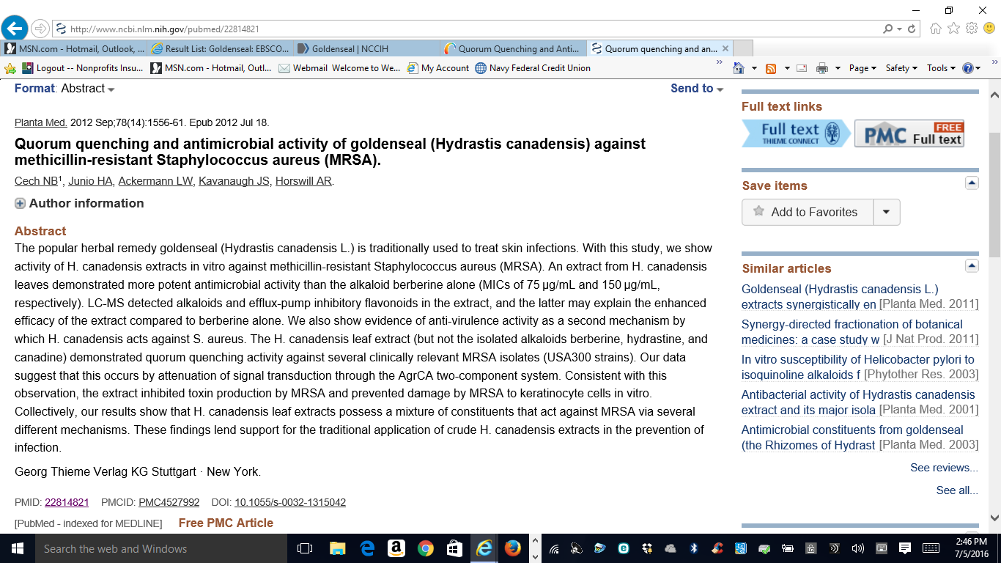

Slide 21
Side Effects and Cautions
Rare side effects may include nausea and vomiting.
Women who are pregnant or breastfeeding should avoid using goldenseal. Berberine, a chemical in goldenseal, can cause or worsen jaundice in newborns and could lead to a life-threatening problem called kernicterus.
Goldenseal should not be given to infants and young children.

Slide 22
Goldenseal References
Goldenseal. Natural Medicines Comprehensive Database Web site. Accessed at www.naturaldatabase.com on July 21, 2009.
Goldenseal (Hydrastis canadensis L.), Berberine. Natural Standard Database Web site. Accessed at www.naturalstandard.com on July 14, 2009.
McKenna DJ, Plotnikoff GA. Goldenseal (Hydrastis canadensis). In: Coates P, Blackman M, Cragg G, et al., eds. Encyclopedia of Dietary Supplements. New York, NY: Marcel Dekker; 2005:297–308.

Slide 23
Green Tea (Camellia sinensis)
All types of tea (green, black, and oolong) are produced from the Camellia sinensis plant using different methods.
Fresh leaves from the plant are steamed to produce green tea.
© Stephen Foster
https://nccih.nih.gov/health/greentea

Slide 24
Green Tea
Green tea is usually brewed and drunk as a beverage. Green tea extracts can be taken in capsules and are sometimes used in skin products.
Green tea and green tea extracts, such as its component EGCG, have traditionally been used to prevent and treat a variety of cancers, including breast, stomach, and skin cancers, and for mental alertness, weight loss, lowering cholesterol levels, and protecting skin from sun damage.

Slide 25
Green Tea: What the Evidence Shows
According to NCCIH:
Laboratory studies suggest that green tea may help protect against or slow the growth of certain cancers, but studies in people have shown mixed results.
Some evidence suggests that the use of green tea preparations improves mental alertness, most likely because of its caffeine content.
There are not enough reliable data to determine whether green tea can aid in weight loss, lower blood cholesterol levels, or protect the skin from sun damage.
NCCIH supports studies to learn more about the components in green tea and their effects on conditions such as cancer, diabetes, and heart disease.

Slide 26
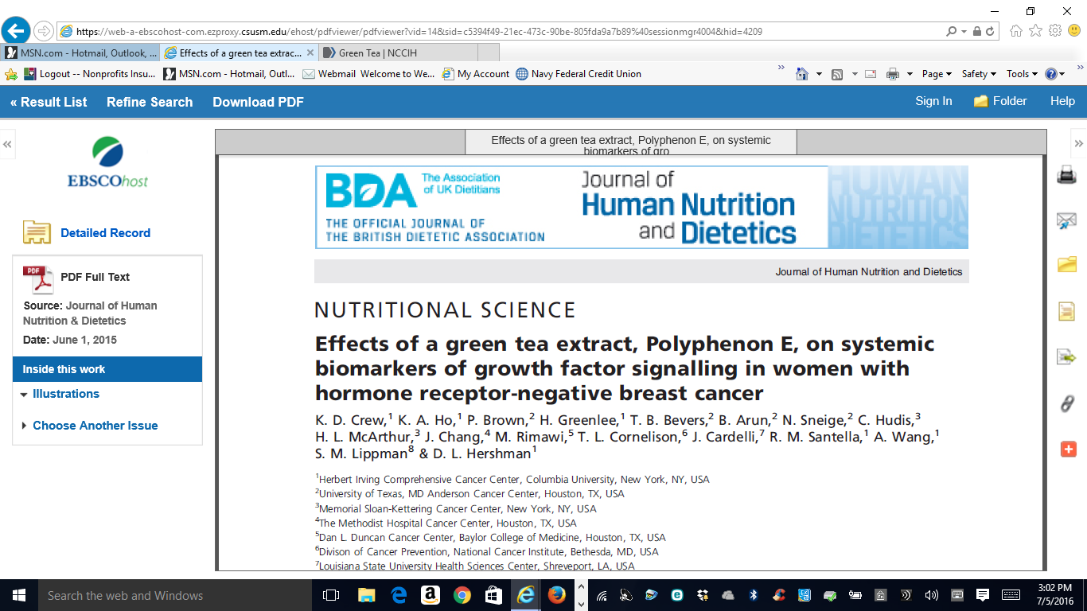

Slide 27
Side Effects and Cautions
There have been some case reports of liver problems.
Concentrated green tea extracts should be taken with food and discontinued if jaundice or other symptoms of liver trouble.
Green tea and green tea extracts contain caffeine, which can cause insomnia, anxiety, irritability, upset stomach, nausea, diarrhea, or frequent urination in some people.
Green tea contains small amounts of vitamin K, which can make anticoagulant drugs, such as warfarin, less effective.

Slide 28
Green Tea References
Green tea. Natural Medicines Comprehensive Database Web site. Accessed at www.naturaldatabase.com on July 8, 2009.
Green tea (Camellia sinensis). Natural Standard Database Web site. Accessed at www.naturalstandard.com on July 8, 2009.
National Cancer Institute. Tea and Cancer Prevention. Strengths and Limits of the Evidence. National Cancer Institute Web site. Accessed at www.cancer.gov/cancertopics/factsheet/prevention/tea on June 3, 2010.
Sarma DN, Barrett ML, Chavez ML, et al. Safety of green tea extracts: a systematic review by the US Pharmacopeia. Drug Safety. 2008;31(6):469–484.

Slide 29
Kava
Kava is native to the islands of the South Pacific and is a member of the pepper family.
Kava has been used as a ceremonial beverage in the South Pacific for centuries.
The root and rhizome (underground stem) of kava are used to prepare beverages, extracts, capsules, tablets, and topical solutions.
© Stephen Foster
https://nccih.nih.gov/health/kava

Slide 30
Kava
Historically, kava was used for insomnia and to fight fatigue, and to treat asthma and urinary tract infections. It also had a topical use as a numbing agent.
More recent folk or traditional uses include anxiety, insomnia, and menopausal symptoms.

Slide 31
Kava: What the Evidence Shows
Kava may be beneficial for the management of anxiety.
NCCIH-funded studies on kava were suspended after the FDA issued a warning about the link to severe liver damage.

Slide 32
Side Effects and Cautions
Kava may cause drowsiness.
Several cases of dystonia (abnormal muscle spasm or involuntary muscle movements) have been reported.
Long-term and/or heavy use of kava may result in scaly, yellowed skin.
Kava has been reported to cause severe liver damage including liver failure.
Kava may interact with drugs used for Parkinson’s disease.

Slide 33
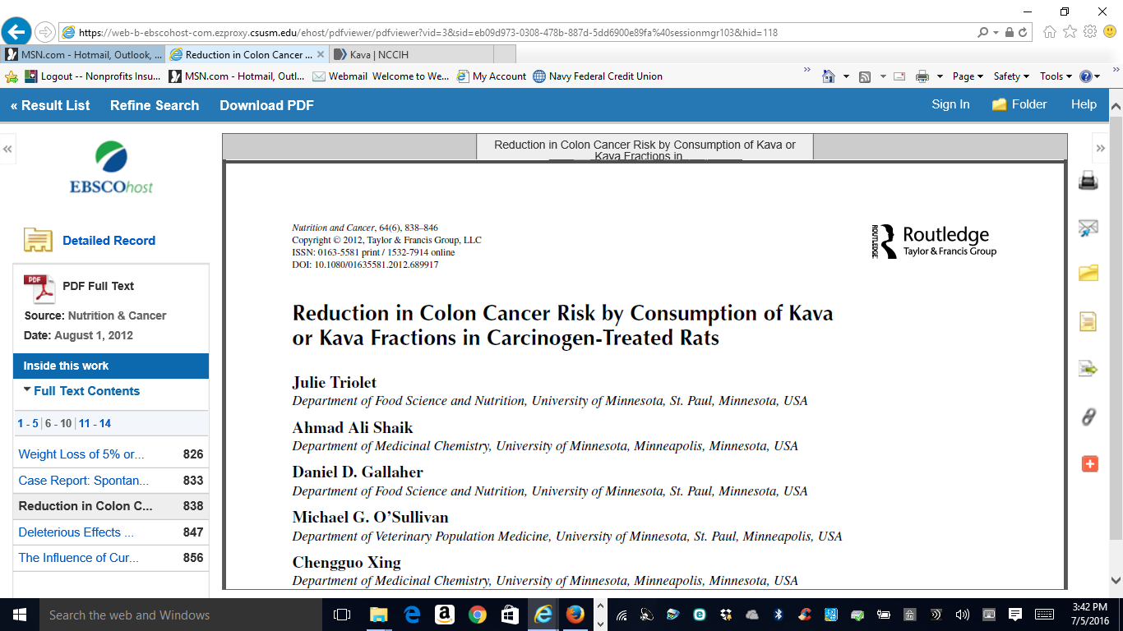

Slide 34
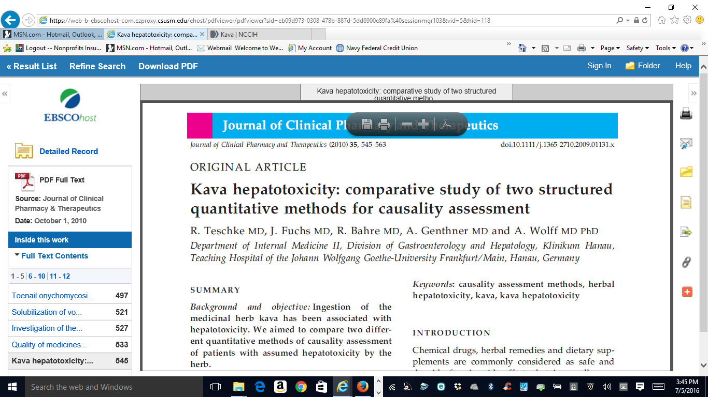

Slide 35
Kava References
Kava. Natural Medicines Comprehensive Database Web site. Accessed at www.naturaldatabase.com on July 14, 2009.
Kava (Piper methysticum G. Forst). Natural Standard Database Web site. Accessed at www.naturalstandard.com on July 14, 2009.
Kava kava rhizome (root). In: Blumenthal M, Goldberg A, Brinckman J, eds. Herbal Medicine: Expanded Commission E Monographs. Newton, MA: Lippincott Williams & Wilkins; 2000:221–225.
Musser SM. Kava (Piper methysticum). In: Coates P, Blackman M, Cragg G, et al., eds. Encyclopedia of Dietary Supplements. New York, NY. Marcel Dekker; 2005:373–380.
National Center for Complementary and Integrative Health. Kava Linked to Liver Damage. Consumer Advisory. National Center for Complementary and Integrative Health Web site. Accessed at nccih.nih.gov/news/alerts/kava/ on June 3, 2010.
U.S. Food and Drug Administration. Consumer Advisory: Kava-Containing Dietary Supplements May Be Associated With Severe Liver Injury. U.S. Food and Drug Administration Web site. Accessed at www.fda.gov/Food/ResourcesForYou/Consumers/ucm085482.htm on June 3, 2010.

Slide 36
St. John’s Wort (Herb) (Hypericum perforatum)
Refers to John the Baptist, as the plant blooms around the time of the feast of St. John the Baptist in late June.
Has been used for centuries to treat mental disorders and nerve pain.
© Stephen Foster
https://nccih.nih.gov/health/stjohnswort

Slide 37
St. John’s Wort
St. John’s wort has also been used for malaria, as a sedative, and as a balm for wounds, burns, and insect bites.
Today, St. John’s wort is used as a folk or traditional remedy for depression, anxiety, and/or sleep disorders.
The flowering tops of St. John’s wort are used to prepare teas, tablets, and capsules containing concentrated extracts.
Liquid extracts and topical preparations are also used.

Slide 38
St. John’s Wort: Evidence
According to NCCIH:
Although some studies of St. John’s wort have reported benefits for depression, others have not.
A large study sponsored by NCCIH found that the herb was no more effective than placebo in treating major depression of moderate severity.
A study co-funded by NCCIH and the National Institute of Mental Health found that neither St. John’s wort nor a standard antidepressant medication relieved symptoms of minor depression better than a placebo.

Slide 39
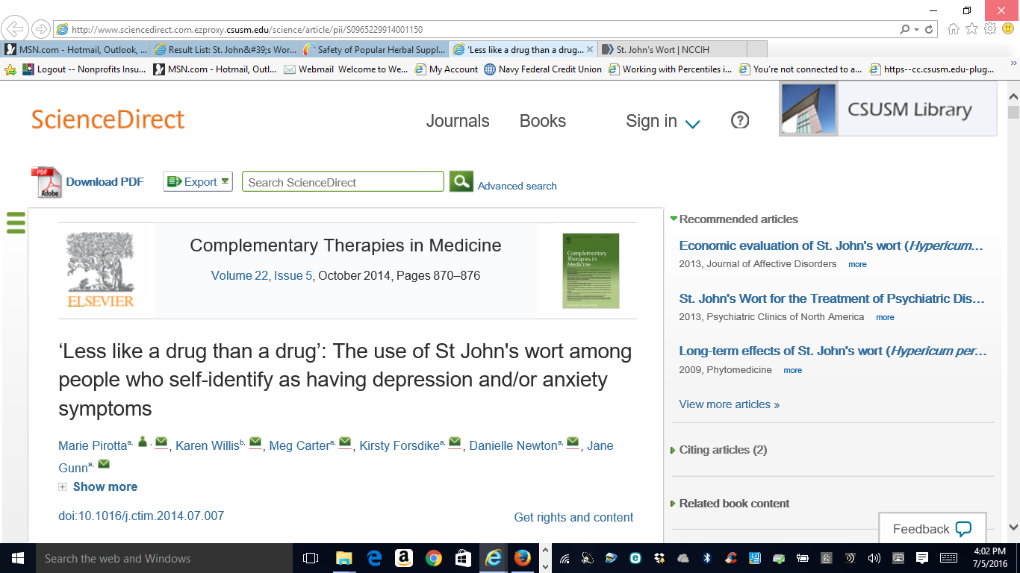

Slide 40
Interactions
Research has shown that St. John’s wort interacts with many medications in ways that can interfere with their intended effects. Examples of medications that can be affected include:
Antidepressants
Birth control pills
Cyclosporine
Digoxin
Indinavir and possibly other drugs used to control HIV infection
Irinotecan and possibly other drugs used to treat cancer
Seizure-control drugs, such as phenytoin and phenobarbital
Warfarin and related anticoagulants.

Slide 41
Side Effects and Cautions
May cause increased sensitivity to sunlight.
Other side effects can include:
anxiety, dry mouth, dizziness, gastrointestinal symptoms, fatigue, headache, or sexual dysfunction.
Taking St. John’s wort with certain antidepressants may lead to increased serotonin-related side effects, which may be potentially serious.
Play:
https://www.youtube.com/watch?v=k8-4FJvQe6s

Slide 42
St. John’s Wort References
De Smet PA. Herbal remedies. New England Journal of Medicine. 2002;347(25):2046–2056.
Hypericum Depression Trial Study Group. Effect of Hypericum perforatum (St. John's wort) in major depressive disorder: a randomized controlled trial. Journal of the American Medical Association. 2002;287(14):1807–1814.
National Center for Complementary and Integrative Health. St. John's Wort and Depression. National Center for Complementary and Integrative Health Web site. Accessed at nccih.nih.gov/health/stjohnswort/sjw-and-depression.htm on June 3, 2010.
Rapaport MH, Nierenberg AA, Howland R, et al. The treatment of minor depression with St. John's wort or citalopram: Failure to show benefit over placebo. Journal of Psychiatric Research. 2011;45:931–941.
St. John's wort. In: Blumenthal M, Goldberg A, Brinckman J, eds. Herbal Medicine: Expanded Commission E Monographs. Newton, MA: Lippincott Williams & Wilkins; 2000:359–366.
St. John's wort. Natural Medicines Comprehensive Database Web site. Accessed at www.naturaldatabase.com on February 15, 2010.
St. John's wort (Hypericum perforatum L.). Natural Standard Database Web site. Accessed at www.naturalstandard.com on February 15, 2010.

Slide 43
Valarian (Valeriana officinalis)
Valerian is a plant native to Europe and Asia; it is also found in North America.
Valerian has been used as a medicinal herb since at least the time of ancient Greece and Rome. Its therapeutic uses were described by Hippocrates, and in the 2nd century, Galen prescribed valerian for insomnia.
© Stephen Foster
https://nccih.nih.gov/health/valerian

Slide 44
Valerian
Today, valerian is used as a traditional remedy for sleep disorders and anxiety, as well as headaches, depression, irregular heartbeat, and trembling.
The roots and rhizomes (underground stems) of valerian are typically used to make supplements, including capsules, tablets, and liquid extracts, as well as teas.

Slide 45
Valerian
According to NCCIH:
Research suggests that valerian may be helpful for insomnia, but there is not enough evidence from well-designed studies to confirm this.
There is not enough scientific evidence to determine whether valerian works for other conditions, such as anxiety or depression.
NCCIH-funded research on valerian includes studies on the herb’s effects on sleep in healthy older adults and in people with Parkinson’s disease.
NCCIH-funded researchers are also studying the potential of valerian and other herbal products to relieve menopausal symptoms.

Slide 46
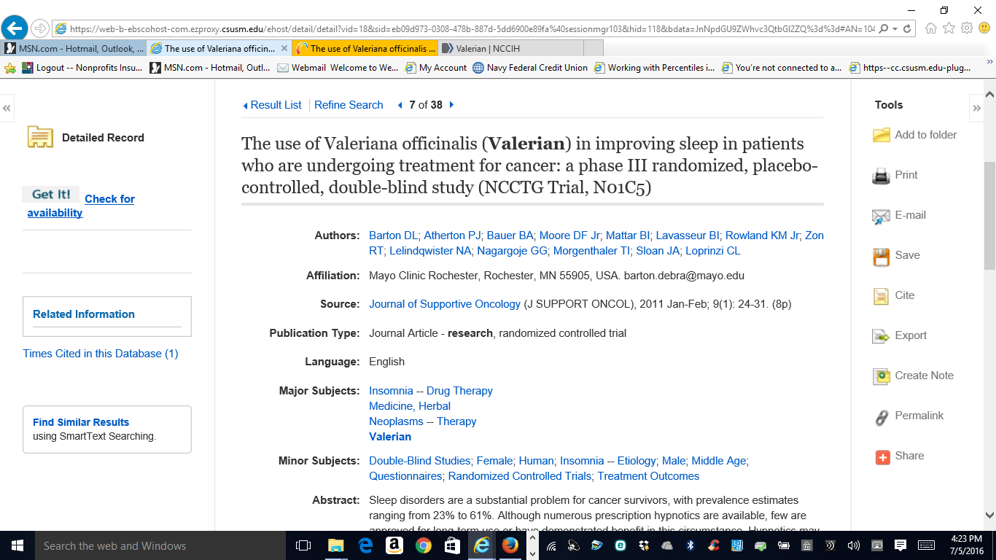

Slide 47
Side Effects and Cautions
Studies suggest that valerian is generally safe to use for short periods of time (for example, 4 to 6 weeks).
No information is available about the long-term safety of valerian.
Valerian can cause mild side effects such as tiredness the morning after its use, headaches, dizziness, and upset stomach.

Slide 48
Valerian References
Awang DVC, Leung AY. Valerian. In: Coates P, Blackman M, Cragg G, et al., eds. Encyclopedia of Dietary Supplements. New York, NY: Marcel Dekker; 2005:687–700.
Office of Dietary Supplements and National Center for Complementary and Alternative Medicine. Questions and Answers About Valerian for Insomnia and Other Sleep Disorders. Office of Dietary Supplements Web site. Accessed at ods.od.nih.gov/factsheets/valerian/ on June 3, 2010.
Valerian. Natural Medicines Comprehensive Database Web site. Accessed at www.naturaldatabase.com on August 11, 2009.
Valerian (Valeriana officinalis L.). Natural Standard Database Web site. Accessed at www.naturalstandard.com on August 4, 2009.
Valerian root (Valeriana officinalis). In: Blumenthal M, Goldberg A, Brinckman J, eds. Herbal Medicine: Expanded Commission E Monographs. Newton, MA: Lippincott Williams & Wilkins; 2000:394–400.

