Slide 1
Preparing Students for an Engaged Learning Experience

Slide 2
Service Learning Modalities
The Case for Critical Service Learning
Notes:
For an More Engaged and Transformative Learning Experience

Slide 3
Traditional Service-Learning
Social service focused
Short-term help to those being served
Students feel good about service provided
Promotes cultural awareness and social responsibilities (civic engagement)
Volunteer as individual to complete direct service hours
Notes:
General service-learning model

Slide 4
Mitchell, T. D. (2008). Traditional vs. critical service-learning: Engaging the literature to differentiate two models. Michigan Journal of Community Service Learning, 14, 50-65.

Slide 5
Critical Service-Learning
Focused on social change/social justice
Students participate in ongoing social change in community through sustained faculty-community partner collaboration
Examines institutional, societal and political barriers to systemic change
Incorporates discussions about race, class, and privilege in class and community context
Notes:
Intentionality of curriculum, partnership with community and scaffolded assignments and discussions.
Aims to deconstruct systems of power so the need for service and the inequalities that create and sustain them are dismantled.
Key components: Social Change Orientation – Redistribute Power – Develop Authentic Relationships

Slide 6
Mitchell, T. D. (2008). Traditional vs. critical service-learning: Engaging the literature to differentiate two models. Michigan Journal of Community Service Learning, 14, 50-65.

Slide 7
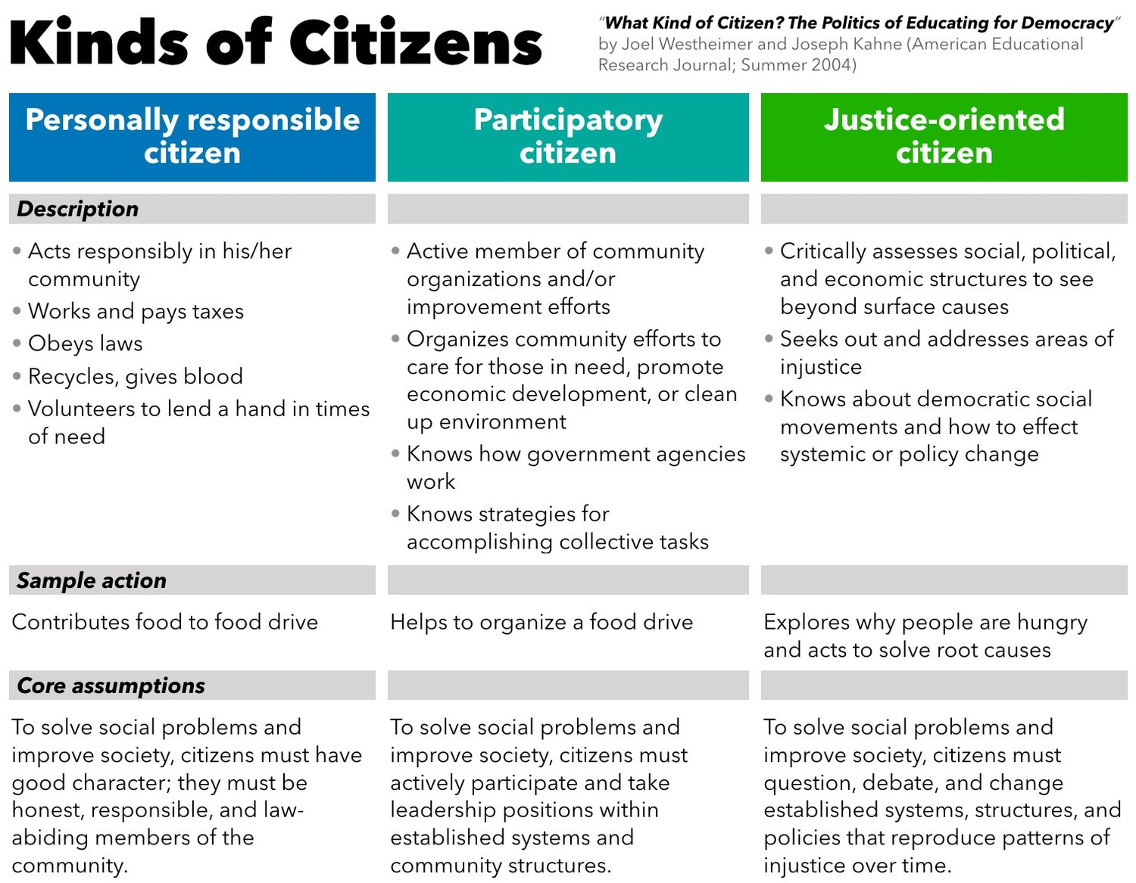
Notes:
Pre- and Post- Self assessment activity for students to rate where they are at the start of the semester, where they aim to be at the end of the semester. Then at end of semester reflect on the citizenship progress.
Social action aims to change policies and is a core strategy for the “justice oriented citizen” described in “What Kind of Citizen? The Politics of Educating for Democracy” by Joel Westheimer and Joseph Kahne (American Educational Research Journal; Summer 2004). The other two models of good citizen — personally responsible and participatory — are mirrored in the direct service and service leadership approaches.

Slide 8
How do we teach it?
Discussion and assignments that directly address issues of inequality, power and marginalization.
Include learning objectives related to understanding personal, social and structural inequalities within the course.
Adapted from Carolina Center for Public Service, Service Learning Toolkit for Preparing Students

Slide 9
Preparing Students for Meaningful Engagement
Pre-, During, and Post-Engagement Activities

Slide 10
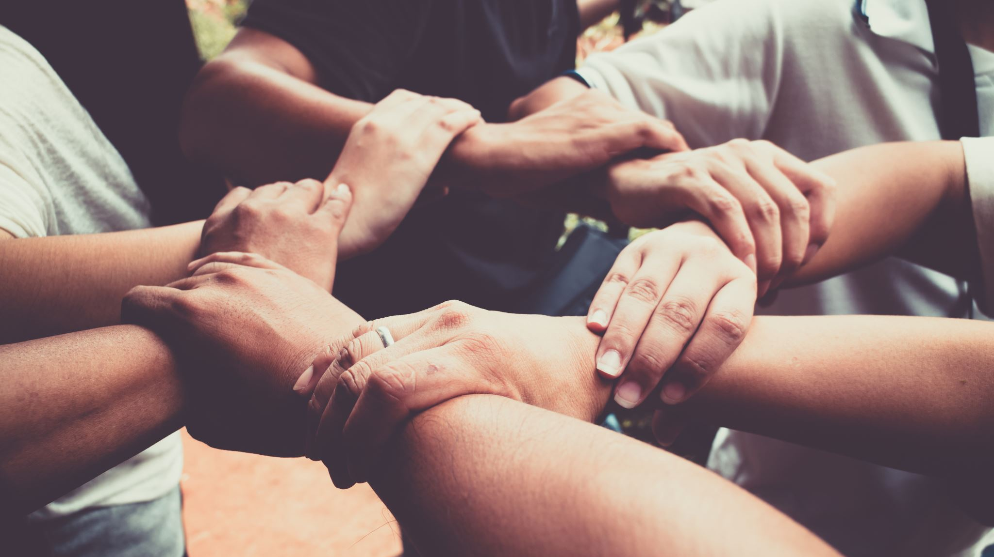
Pre-Engagement Activities
Students examine their identities, biases, and assumptions prior to start of service and build a shared community amongst other peers. Include a Community Partner orientation to the site and community.
First 2-3 weeks of the semester
Establishing SL purpose, social justice lens

Slide 11
Why is it important to critically reflect on our identities?

Slide 12
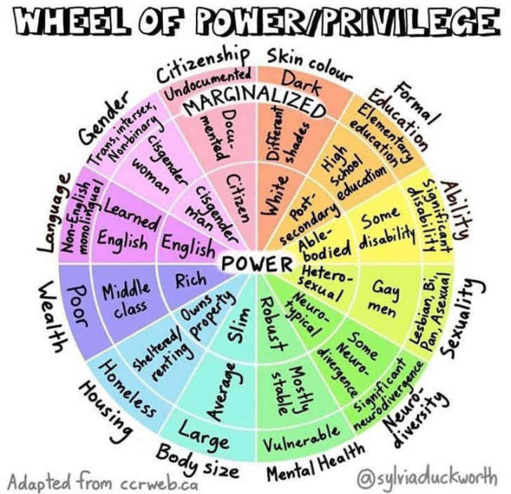

Slide 13
Identity Starburst
Arrows point outward: How do you view YOURSELF?
Arrows pointing inward: How do others view YOU?
Categories to consider:
Gender, race, sexual orientation, age, ability, socioeconomic status, religion, education, etc.
Notes:
To build a community, it is important to understand our individual cultural identities and see where our similarities and difference might be as we work together.
Identity shapes our preconceptions and affects how we respond to new environments. In this activity, we are going to discuss the identities that are important to us and how they affect how we interact with the world.
What are some of the components of your identity which you think will affect how you interact with your community during the engagement experience. Segment them out on the handout given.

Slide 14
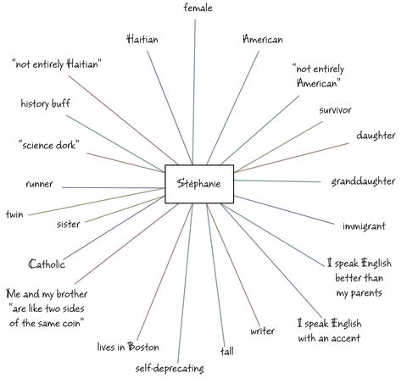
Notes:
From FacingHistory.org
Here is what a sample Identity Starburst/Chart can look like.
Identity Starburst Activity/Cultural Pie
We are building a community amongst ourselves and in order to do so it is important to understand our individual cultural identities and see where our similarities and difference might be as we work together in the upcoming semester. Plus it is good for all of us to model the activities that we will ask our students to complete.
Identity shapes our preconceptions and affects how we respond to new environments. In this activity, we are going to discuss the identities that are important to us and how they affect how we interact with the world.
What are some of the components of your identity which you think will affect how you interact with your community during the engagement experience. Segment them out on the handout given.

Slide 15
Complete the Social Identity Wheel
Checkmark: what part of your identity do you feel you receive privilege most often?
Checkmark: what part of your identity do you face oppression most often?
Discuss
How does it feel to do these activities?
How do your social identities play a role in who you are as an individual?
How do your identities influence how you interact with others /with people at your service site?

Slide 16
Boys & Girls Club Vista
“Even before COVID-19, 83% of Vista families are classified by HUD as having extremely low, very low or low incomes. School districts with primarily disadvantaged students such as the Vista Unified School District suffer from wide funding gaps. In 2018, only 34% of Vista Unified students meet or exceed the state standards and are 11% lower than the state average. COVID-19 has shined a bright light on inequity as more than 12 million students nationwide lacked an opportunity to learn online without access to wi-fi. Those students most in need of support will undoubtedly fall further behind, requiring more assistance from places like the Boys & Girls Club of Vista to catch up.”

Slide 17
Pre-Service Reflection on Stereotypes
Brainstorm a list of words that comes to mind when you think of underserved/under-resourced children in North County. Include stereotypes—whether or not you believe them to be true. Don’t censor yourself!

Slide 18
Share and discuss with your group
Where did these ideas and notions from? Who has a stake in them?
Is the list largely positive, negative or neutral? What historical events or recent current events helped shape these ideas?
How do you benefit from these stereotypes? How do they contrast with ideas about yourself, your nation or your culture?
How could we collectively find out more about these topics and areas? What would be the most effective ways to interrogate and challenge our ideas while in the community?
Developed for Building a Better World: The Pedagogy and Practice of Global Service-Learning (Hartman, E., Kiely, R., Friedrichs, J., and Boettcher, C. 2013) and available at criticalservicelearning.org.

Slide 19
“Empathy fuels connection. Sympathy drives disconnection.”― Dr. Brené Brown
Notes:
https://twentyonetoys.com/blogs/teaching-empathy/brene-brown-empathy-vs-sympathy
Valuing empathy over sympathy
Focus on offering kindness, having an open mind to new ideas and possibilities to know and understand.
What is the best way to ease someone's pain and suffering? In this beautifully animated RSA Short, Dr Brené Brown reminds us that we can only create a genuine empathic connection if we are brave enough to really get in touch with our own fragilities.
“Empathy fuels connection. Sympathy drives disconnection.”

Slide 20
Root Cause Analysis
Social Change to Social Action: Deep dive Into a social issue impacting that community and create action WITH the community.
Notes:
Root cause analysis is an approach to problem solving that uses data analysis and discussion to dig deeper than the surface symptoms of a problem to uncover the underlying causes.

Slide 21
Discuss: Root Cause Analysis and Action
Ways to work toward social change (Univ. of Kansas)
What are the root causes of the issue your organization addresses? How can you and your students find this out?
In what ways does your organization or its programming address the root causes?
How can you and your students partner with an organization to help address these issues in a lasting way?
Notes:
Incorporate this into a reflective prompt or a mid-semester assignment to present what they are learning during the service so far.

