Slide 1
A Guide to Presentations and Short Talks
Informative Title Here
Deliberate and Useful Text
Related Points
More Related Points
This Text Helps Explain My Figure
Related Points
More Related Points

Slide 2
Who’s Excited for Public Speaking?
Glossophobia is…

Slide 3
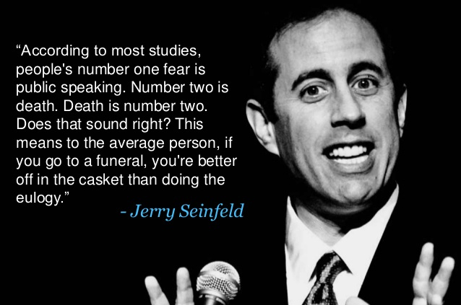
Who’s Excited for Public Speaking?
Glossophobia (a.k.a. Speech Anxiety) is the severe, debilitating fear of public speaking
What is scary about public speaking?
How to prepare and feel better about public speaking:
Learn as much as you can about the topic
Think about who your audience is
Work on and finish your presentation EARLY
PRACTICE your presentation OUT LOUD
Get feedback (Even if it is from yourself)
Memorizing is okay, but don’t be afraid to go off script
Find friendly faces in the audience
Speak slowly
Don’t be afraid of silent moments

Slide 4
What Makes A Good Title?
A good title will help the audience to understand the significance of the slide
A good title is the takeaway message for that slide

Slide 5
RESULTS
100 comedians surveyed
99 identified Jerry Seinfeld as a peer that excels at public speaking
How to prepare and feel better about public speaking:
Learn as much as you can about the topic
Think about who your audience is
Work on and finish your presentation EARLY
PRACTICE your presentation OUT LOUD
Get feedback (Even if it is from yourself)
Memorizing is okay, but don’t be afraid to go off script
Find friendly faces in the audience
Speak slowly
Don’t be afraid of silent moments

Slide 6
Majority of Professional Comedians Agree Jerry Seinfeld is an Expert at Public Speaking
100 comedians surveyed
99 identified Jerry Seinfeld as a peer that excels at public speaking
How to prepare and feel better about public speaking:
Learn as much as you can about the topic
Think about who your audience is
Work on and finish your presentation EARLY
PRACTICE your presentation OUT LOUD
Get feedback (Even if it is from yourself)
Memorizing is okay, but don’t be afraid to go off script
Find friendly faces in the audience
Speak slowly
Don’t be afraid of silent moments

Slide 7
What Makes A Good Title?
A good title will help the audience to understand the significance of the slide
A good title is the takeaway message for that slide

Slide 8
Help Yourself (And Your Audience) With Text

Slide 9
I Know You Can’t Read This, But…
TRIM gene | M7vsM8 (2lnl) | dN/dS | p-value | % of sites with dN/dS >1 | # of species used for comparison
TRIM1 | 0.000494 | 3.03875 | 0.999753031 | 0 | 14
TRIML1 | 0.000966 | 1 | 0.999517117 | 0.317 | 10
TRIM2 | 7.306736 | 1.54007 | 0.025903738 | 0.645 | 12
TRIML2 | 6.030616 | 3.63563 | 0.049030732 | 8.736 | 8
TRIM3 | 0.000494 | 1 | 0.999753031 | 0 | 12
TRIM4 | 0.077986 | 1.05949 | 0.961757441 | 46.13 | 11
TRIM5 | 73.47338 | 3.29159 | <0.005 | 20.464 | 22
TRIM6 | 1.048762 | 2.15362 | 0.59192165 | 6.692 | 8
TRIM7 | 9.924556 | 11.03782 | 0.006996971 | 0.364 | 10
TRIM8 | 0.256808 | 1 | 0.87949799 | 0.59 | 10
TRIM9 | 0.739358 | 1.19118 | 0.690956092 | 0.808 | 10
TRIM10 | 6.060552 | 3.61613 | 0.048302305 | 1.999 | 11
TRIM11 | 0.000168 | 1 | 0.999916004 | 0 | 10
TRIM13 | 0.000244 | 1 | 0.999878007 | 0.001 | 13
TRIM14 | 3.288158 | 3.46711 | 0.193190409 | 0.888 | 10
TRIM15 | 10.736928 | 2.24534 | <0.005 | 5.835 | 11
TRIM16 | 9E-05 | 1 | 0.999955001 | 0.001 | 9
TRIM16L | 2.214132 | 5.08523 | 0.330527307 | 0.813 | 7
TRIM17 | 7E-05 | 1 | 0.999965001 | 0 | 11
TRIM18 | 0.00215 | 1 | 0.998925578 | 0.001 | 11
TRIM19 | 1.59525 | 1 | 0.450397389 | 8.707 | 15
TRIM20 | 18.130102 | 2.11592 | <0.005 | 9.399 | 12
TRIM21 | 7.01864 | 4.81422 | 0.029917251 | 3.378 | 10
TRIM22 | 10.195488 | 6.16845 | <0.005 | 4.887 | 13
TRIM23 | 0.001684 | 1 | 0.999158354 | 0.001 | 11
TRIM24 | 4.4E-05 | 1 | 0.999978 | 0.001 | 10
TRIM25 | 19.270786 | 2.40224 | <0.005 | 9.368 | 10
TRIM26 | 0.279598 | 1 | 0.869532994 | 1.96 | 10
TRIM27 | 1.003224 | 1.96443 | 0.60555372 | 0.597 | 10
TRIM28 | 0.638646 | 1 | 0.726640806 | 0.001 | 10
TRIM29 | 3.221622 | 1 | 0.199725571 | 4.253 | 12
TRIM31 | 15.056244 | 8.68452 | <0.005 | 5.265 | 7
TRIM32 | 0.000986 | 1 | 0.999507122 | 0.001 | 13
TRIM33 | 0.51926 | 8.91641 | 0.771336928 | 0.433 | 6
TRIM34 | 0.214692 | 1.13003 | 0.898214837 | 47.274 | 9
TRIM35 | 0.179814 | 1.09917 | 0.914016185 | 0.441 | 10
TRIM gene | M7vsM8 (2lnl) | dN/dS | p-value | % of sites with dN/dS >1 | # of species used for comparison
TRIM36 | 4.547232 | 2.81258 | 0.102939278 | 0.638 | 11
TRIM37 | 6E-06 | 1 | 0.999997 | 0.001 | 9
TRIM38 | 6.511954 | 2.94482 | 0.038543146 | 3.655 | 12
TRIM39 | 0.000164 | 1 | 0.999918003 | 0.001 | 12
TRIM40 | 0.311058 | 2.16548 | 0.855962254 | 3.312 | 11
TRIM41 | 1.245814 | 1.89168 | 0.536382904 | 0.488 | 11
TRIM42 | 1.741774 | 3.29941 | 0.418580104 | 0.35 | 12
TRIM44 | 0.000664 | 55.66386 | 0.999668055 | 0 | 11
TRIM45 | 5.224212 | 1.65382 | 0.073379843 | 8.933 | 11
TRIM46 | 0.46835 | 2.053 | 0.79122334 | 0.232 | 10
TRIM47 | 0.000216 | 1 | 0.999892006 | 0.001 | 8
TRIM50 | 9.416224 | 1 | <0.005 | 2.795 | 10
TRIM52 | 16.514108 | 5.8355 | <0.005 | 6.635 | 7
TRIM52* | 11.500758 | 6.88558 | <0.005 | 3.615 | 14
TRIM54 | 6.694138 | 6.83348 | 0.035187337 | 0.396 | 12
TRIM55 | 0.000304 | 1 | 0.999848012 | 0.001 | 13
TRIM56 | 0.481694 | 2.3723 | 0.785961869 | 0.316 | 10
TRIM57 | 3.430678 | 10.98607 | 0.179902723 | 0.619 | 10
TRIM58 | 17.753758 | 2.33532 | <0.005 | 4.24 | 10
TRIM60 | 8.00201 | 2.14558 | 0.018297241 | 20.431 | 11
TRIM61 | 2E-06 | 1 | 0.999999 | 0.001 | 8
TRIM62 | 0.25935 | 1 | 0.878380858 | 0.001 | 8
TRIM63 | 0.17628 | 1 | 0.915632679 | 6.116 | 11
TRIM65 | 0.727386 | 1.84989 | 0.695104559 | 1.107 | 8
TRIM66 | 0.661946 | 3.06609 | 0.718224561 | 1.279 | 11
TRIM67 | 2.803318 | 1.00472 | 0.246188199 | 2.704 | 8
TRIM68 | 1.4E-05 | 1 | 0.999993 | 0.001 | 10
TRIM69 | 6.650254 | 2.46053 | 0.035967951 | 19.156 | 10
TRIM71 | 0.000606 | 1 | 0.999697046 | 0.001 | 8
TRIM72 | 0.000804 | 1 | 0.999598081 | 0.001 | 10
TRIM75 | 10.614008 | 12.23692 | <0.005 | 0.665 | 10
TRIM76 | 42.288758 | 7.94347 | <0.005 | 1.711 | 10

Slide 10
Avoid Overloading Your Audience With Text And Animations
Four score and seven years ago our fathers brought forth on this continent, a new nation, conceived in Liberty, and dedicated to the proposition that all men are created equal.
Now we are engaged in a great civil war, testing whether that nation, or any nation so conceived and so dedicated, can long endure. We are met on a great battle-field of that war. We have come to dedicate a portion of that field, as a final resting place for those who here gave their lives that that nation might live. It is altogether fitting and proper that we should do this.
But, in a larger sense, we can not dedicate -- we can not consecrate -- we can not hallow -- this ground. The brave men, living and dead, who struggled here, have consecrated it, far above our poor power to add or detract. The world will little note, nor long remember what we say here, but it can never forget what they did here. It is for us the living, rather, to be dedicated here to the unfinished work which they who fought here have thus far so nobly advanced. It is rather for us to be here dedicated to the great task remaining before us -- that from these honored dead we take increased devotion to that cause for which they gave the last full measure of devotion -- that we here highly resolve that these dead shall not have died in vain -- that this nation, under God, shall have a new birth of freedom -- and that government of the people, by the people, for the people, shall not perish from the earth.
Abraham Lincoln
November 19, 1863

Slide 11
Tips on Slide Design and Pacing
Avoid excessive empty space & busy slides
You do not need full sentences
Make short, direct statements
NO Paragraphs
You do not even need punctuation
But punctuation can help!
Right?
Figures/Images can be helpful, as long as they are used properly
Figures/Images should help the story along
Do not assume your audience knows how to read your figure or how to interpret your image
Be courteous of the color blind
You generally need 1-2 minutes for each slide
A 5-minute talk will have about 2 - 4 content slides

Slide 12
Design of a 5 Minute Talk
How do you use your 5 minutes?

Slide 13
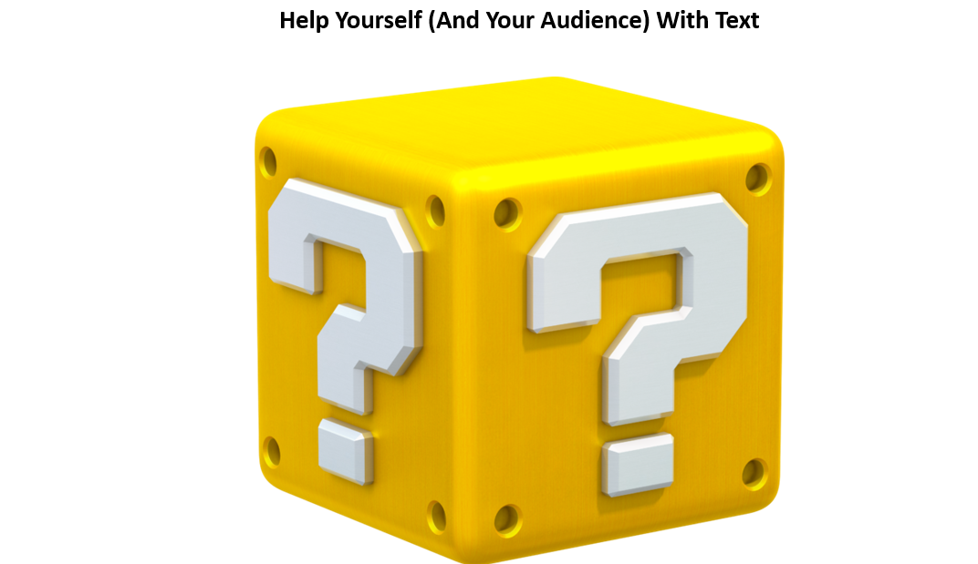
Design of a 5 Minute Talk
Title Slide
Intro Slide:
What is the problem/topic?
Why should people care?
Research Question/Hypothesis Slide:
What are you specifically investigating?
Methods/Results Slide:
How is the work going to be done? And/or…
What have observed – what data do you have?
Conclusions Slide
If you have results, then tell audience what you learned (conclusions) from results
Remind audience about the significance of the problem/topic and how your work contributes to it
Acknowledgments Slide

Slide 14
Audiences Should Leave A Presentation with Key Takeaways
The beginning of your presentation is just as important as the end
A bad ending can spoil a great presentation
The ending is likely the last thing the audience will remember
It is okay to recap the main points from your story and list out key takeaways
Key takeaways to giving a presentation
Practice your presentation out loud
The story you are telling should be complete
Transitions between the different slides/parts should make sense and be smooth
Be in the moment and enjoy your presentation (Avoid Autopilot)
Do NOT be afraid to go off script
The audience does NOT know what words you are specifically going to say
It is okay to pay attention to your audience and the things around you
Notes:
5 Key Takeaways:
1) Be comfortable with your slides and script
Avoid autopilot
2) Have informative titles
3) Be mindful of your slide content
Avoid excessive content
Avoid too little content
4) Have a solid conclusion/summary
5) Enjoy your presentation

