Slide 1
Adding Service Learning to your Syllabus

Slide 2
Backwards Design
Begin with the end in mind. -Stephen Covey

Slide 3
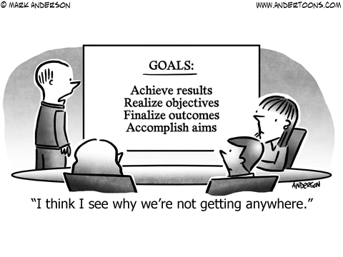
#1: What am I trying to accomplish? (Don’t measure what you don’t want or need to know.)
#2: What will my students have/be by the end of my course?
#3: What will my students be able to do/make by the end of my course? (Bloom’s)

Slide 5
Developing LOs: Solid, Simple, Measurable
Solid
Reflect the learning & the content
Clearly articulated
Simple
Each focuses on only ONE action: the most important one (analyze OR interpret vs. analyze AND interpret)
Applicable in a variety of learning situations (vs. task-specific)
Measurable
How will you assess it?

Slide 6
Learning Objectives
How might learning objectives be met by working with specific community partners?
Service learning objectives can be formulated as: "Students will do [X] by doing [Y].”
OBJECTIVE (intended outcome): Students will examine the strengths and weaknesses of educational policy arguments BY (means) tutoring in local public schools.
Source: http://www.loyno.edu/engage/learning-objectives

Slide 7
Example Human Development: Child and Youth Applications
Identify the main principles of cognitive development, information processing, and sociocultural theory by working with children at your SL site.
Use the service experience to explain how academic theory contributes to understanding observed differences in socially, culturally, and linguistically diverse children and youth.
Evaluate the ways in which academic theory is applied within the realms of your SL site.
Apply knowledge gained from the field experience to identify influences such as environment, culture, family/sibling/friend relationships on the development of thought and reasoning.

Slide 8
Your turn!
Use the worksheet to identify a few potential SWBAT (students will be able to...) from your SL course.
What activities and assessments will support this objective?

Slide 9
Syllabus Recommendations
State that this is a service-learning course in the course description.
Include a definition of service-learning.
Course objectives should link to the service. The syllabus should explicitly tell students how the assigned service work meets course learning objectives and fulfills a need in the community.
State the number of service hours required of each student. (Always delineate direct service hours, or contact hours with the community partner, versus time spent onboarding, working on reflection assignments, etc.)
Adapted from: https://servicelearning.duke.edu/sites/servicelearning.duke.edu/files/documents/constructing-sl-syllabi.original.pdf

Slide 10
Another model is to require completion of a certain product for the community partner, irrespective of the time it takes to complete. Consider which option is best for your course, students and community partners.
Carefully consider adjusting the workload of students. It is crucial that service work and related assignments are not an add-on to existing course work, but rather, in place of existing course work.
Include due dates for onboarding with the community partner, completing reflections and related assignments.
Determine the worth and weight of SL assignments. Make the service a mandatory part of the class and make related assignments worth at least 15% of the final grade. Remember that students make judgments about the value of an assignment based on its contribution to their final grade.
Include contact information for our office and perhaps an FAQ list!
Adapted from: https://servicelearning.duke.edu/sites/servicelearning.duke.edu/files/documents/constructing-sl-syllabi.original.pdf

Slide 11
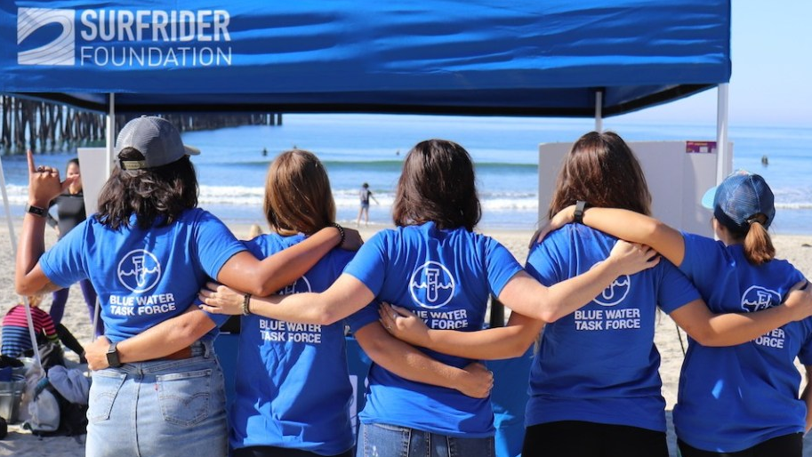
How many hours should I require?

Slide 12
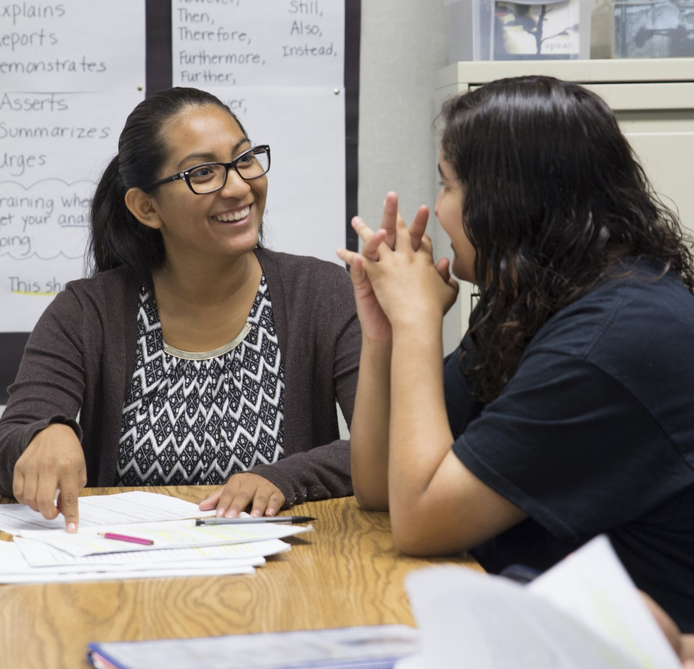
Three stages of progression¹ :
Shock—provides a “jolt” to their perception of reality; they are confronting preconceived notions
Normalization—students adapt to their new circumstances, begin to feel committed to the organization
Engagement—students connect the experience to course learning; motivation and learning increase.²
Mentoring at-risk teens at Alta Vista High School
1. (Rockquemore & Schaffer, 2000)
2. (Warren & Sellnow, 2021)
Notes:
Warren & Sellnow (2021), Journal of Higher Education Outreach and Engagement, Volume 25, Number 1, p.25. “During the engagement stage, students begin to apply what they are learning in class to the real-life examples they are experiencing at their service location. In other words, students become truly engaged and start to make connections between their experiences and what they are learning in class. As a result, students may begin to recognize course relevance, which may then lead to increased motivation to study and, ultimately, to better cognitive learning…when students participate in and apply course material to real-life experiences, perceptions about content relevance increase (e.g., Flournoy, 2007; Moely et al., 2002). When perceptions of relevance increase, motivation to study also increases (e.g., Frymier & Schulman, 1995; Liem & Martin, 2012). Moreover, as student motivation to study increases, cognitive learning tends to increase as well. ” (Warren & Sellnow, 2021)
Rockquemore, K. A. & Schaffer, R. H. (2000). Toward a Theory of Engagement: A Cognitive Mapping of Service-Learning Experiences. Michigan Journal of Community Service Learning, 7, p. 14-24.

Slide 13
Poorly done, Service Learning risks…
Reinforcing stereotypes
Leaving students with the impression that it was time wasted
Overburdening the Community Partner

Slide 14
How many hours should I require?
“Service Learning had a positive outcome on values and attitudes when students contributed at least 15-20 hours of service…participated in weekly in-class reflection, completed ongoing and summative written reflection activities…” (Marby, 1998)

Slide 15
Mandatory service learning at university: Do less-inclined students learn from it?
There is a need to examine whether and to what extent students' learning and development from completing a mandatory service learning subject are influenced by their initial inclination. Data described in this article were collected from 756 students via an online post-experience survey. Results show that students' total learning experience from service learning had a much stronger impact on their learning and development than their initial inclination or even interest in the subject.
Chan, S. C., Ngai, G., & Kwan, K. (2019). Mandatory service learning at university: Do less-inclined students learn from it? Active Learning in Higher Education, 20(3), 189–202. https://doi-org.ezproxy.csusm.edu/10.1177/1469787417742019

Slide 16
Your turn!
With your group, evaluate 1-2 sample syllabi.
Are Service Learning goals and expectations clearly stated?
What elements support students’ Service Learning?
What revisions might you suggest?

