Slide 1
Common Core
Faculty Learning Community

Slide 2
Thank you to…
The Linden Root Dickson Foundation, the Alliance and Patricia Prado-Olmos, AVP Community Engagement for funding this FLC
The intent of the donation is to support understanding of the new California standards so that faculty as CSUSM are better prepared to meet the learning needs and experiences of K-12 students when they enter CSUSM. The bigger goal is to move students through the university to graduation – one way to do that is to make sure we know their preparation and meet them where they are.

Slide 3
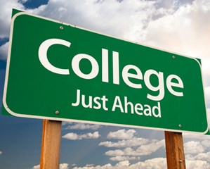
Goals for the day
Explore what it means to be college and career ready
And if students aren’t ready, what does that mean for them and for us?

Slide 4
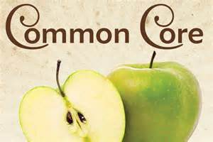
Introductions
What is your teaching area?
What skills do you want for your students to have before coming to your class?
Why are you interested in finding out more about the Common Core?
Notes:
30min.

Slide 5
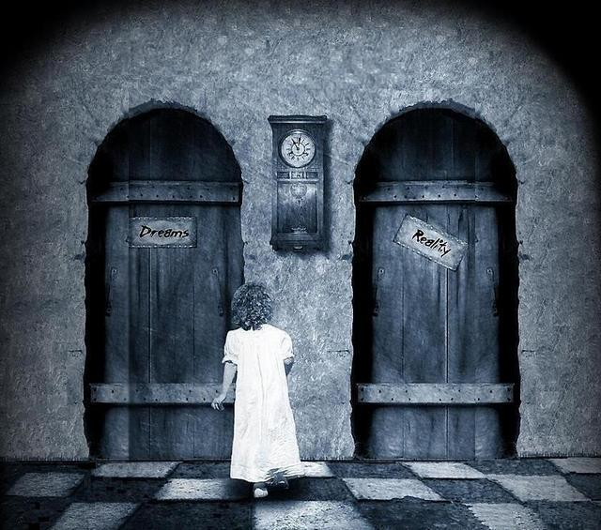
Common Core
What have you heard about the Common Core State Standards?

Slide 6
Common Core should lead to College and Career Readiness
The sky is the limit!?
OR
The bridge to nowhere!?

Slide 8
Challenges in the Educational Pipeline
Nationally over 30% of high school freshmen drop out before earning their high school diploma
Of the 70% of high school students who do earn high school diplomas, only 32% graduate prepared to be successful in college
In Fall 2012, 33.6% of CSU students needed English remediation and 30.5% need Math remediation
In CA community colleges, remediation rates are 70-90%.

Slide 9
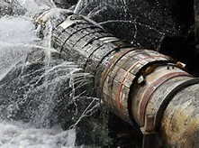
What are the costs of a damaged pipeline?
Personal: Students who enter college with a need for remediation must pay for classes that do not earn credits toward graduation. This lowers persistence rates.
Institutional: $3.7 billion per year=Cost estimate of need for college remediation
Economic: The Public Policy Institute of California argues that CA needs to produce 1 million more graduates to maintain the state economy.

Slide 10
Who gets to go to college?

Slide 11
We all went to college!
Were you prepared for college? How were you prepared?
What do your students seem to lack in preparation for college?

Slide 12
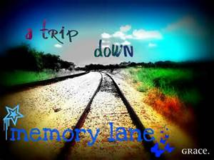
And if they are not ready…. History of College Remediation
Kahootit
https://kahoot.it/#/

Slide 13
Are they Ready?
A report from ACT found that “the clearest differentiation in reading between students who are college-ready and those who are not is the ability to comprehend complex text” (ACT, 2007, p. 25 ).
CCSS standards devote more focus on understanding and analyzing written materials and higher order thinking skills.

Slide 14
Are they ready?

Slide 15
CSUSM LAMP Report, 2015
“Soft skills” was a repeated topic in LAMP discussions. Task Force members attended numerous off campus meetings where the importance of skills such as interpersonal communication, writing, problem-solving, and organization were discussed. Employers who work with the Career Center indicate that CSUSM graduates are getting excellent academic preparation, but may lack the soft skills needed to be competitive in the job search process. While this is not a specific degree program recommendation, the Task Force determined that it warrants further campus discussion. For example, a cross-college conversation could be initiated to investigate integrating soft skills into academic curricula.

Slide 16
Why we need some changes
https://www.youtube.com/watch?v=dY2mRM4i6tY

Slide 17
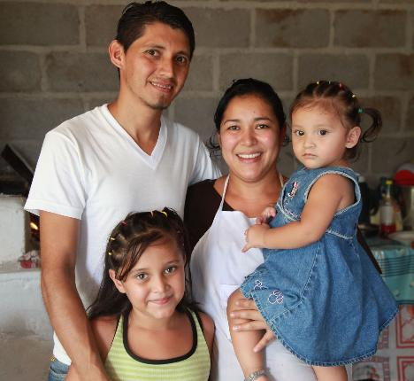
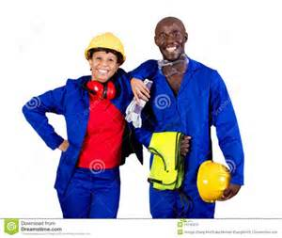
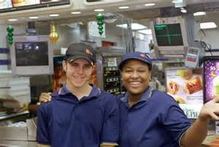
What we all want
HS and College graduates
Happy, successful people

Slide 18
How do we get there?

Slide 19
Quick Draw
Think of a high school math class. Make a fast drawing on a piece of scrap paper. You have 40 seconds. Go.

Slide 20
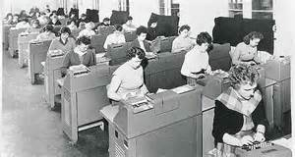
Does your drawing look anything like this? What do these classrooms and workplaces value?

Slide 21
Empty Vessel and Conduit Metaphors for teaching and learning (aka NCLB)

Slide 22
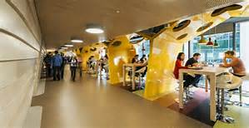
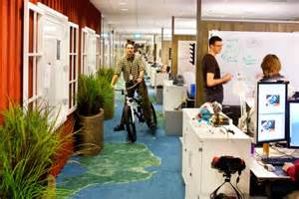
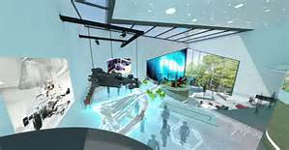
What do these classrooms and workplaces value? (aka CCSS)

Slide 23
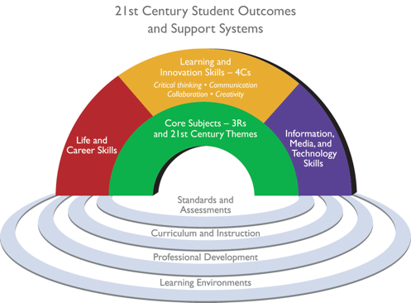
How we might get there…

Slide 24
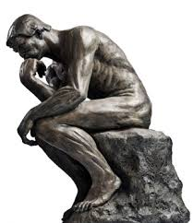
What does it take……
To access the common
core/California Standards?
To read and fully comprehend
expository text?
To think critically about text, media, the world?
To be competent and confident learners?

Slide 25
Academic Literacy: ICAS (2003)
Report from the Intersegmental (California system) Committee of the Academic Senate Report:
Academic Literacy: Reading, writing and thinking critically.
The inseparable skills of critical reading, writing listening and thinking depend upon students’ ability to postpone judgment and tolerate ambiguity as they honor the dance between passionate assertion and patient inquiry.

Slide 26
Academic Literacy
According to the Intersegmental Committee of the Academic Senates of the California Community College, the California State University, and the University of California, 2003, academic literacy is:
the dispositions, habits of mind, and abilities that enable students to enter the ongoing conversations appropriate to college thinking, reading, writing, and speaking.
Have a quick look at the handout on your table.

Slide 27
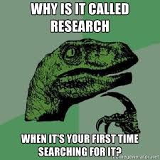
Research Skills to Access the Common Core and think
Students need to be able to:
Create research questions and
then use these to seek out relevant information.
Evaluate website validity.
Be able to find credible academic sources.
Use knowledge-building websites to build context for understanding
Cross-reference information from multiple sources
Synthesize research findings in a research paper.
Cite sources accurately in the expected format.
Understand the purpose and necessity of citation.

Slide 28
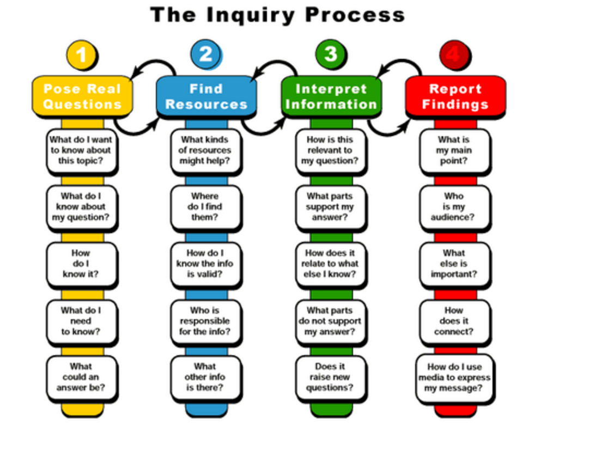

Slide 29
CSU Efforts
The Intersegmental Report updated in 2002
http://senate.universityofcalifornia.edu/reports/acadlit.pdf
Early Assessment Program
http://www.calstate.edu/EAP/
Expository Reading and Writing Course
http://www.calstate.edu/eap/englishcourse/

Slide 30
CCSS-type Curriculum Results indicate Promise
Evaluation of Expository Reading and Writing Course (ERWC) for over 10 years indicates students who take ERWC as seniors are more college ready than those who do not take it.
Students generally receive lower essay scores on the New ACT essay section, which is aligned with CCSS, than they do on the multiple choice section. (I wonder if/when we will see a shift?)

Slide 31
Next time we meet…
We will dig a little deeper into the language of the Common Core Standards. Bring an electronic device.
Guest participants
Feb. 26: Brian Lawler, SOE Math Educator
March 18: Rong-Ji Chen, SOE Math Educator
April 22: Joe Keating and Ingrid Flores, SOE Science Educators

Slide 32
Continuing Goals for our FLC
Explore the relationships between pedagogy of the Common Core and High Impact Practices.
In a seminar in May or August, revise portions of a course or assignments in a course that reflect what a Common Core educated person should be able to do.
Commit to implementing those revisions in fall 2016.
Reflect on the curriculum changes in a fall 2016 meeting.
Present our curriculum/pedagogy at campus symposia and workshops including the Faculty Center Teaching Expo, and through a year-end summary for the Faculty Center website or newsletter.

