Slide 1
Communication Skills Building: Body Language
American Language & Culture Institute
CSU San Marcos
March 2022

Slide 2
Lesson goals:
By the end of this presentation, you will have a better understanding of:
What body language is.
The importance of body language in public speaking.
How to control nerves.
How to connect with an audience through personal story-telling.

Slide 3
Effective speaking
Good speaking style includes:
Well chosen words– well-prepared speech
AND
Lively delivery
Good use of voice
Good use of body language
Nervousness management

Slide 4
Body Language Vocabulary
Nonverbal communication:
Gestures (a hand, head, or facial movement)
Posture (how a person holds the body)
Facial expression (emotion expressed on the face)
Gaze (where the eyes are looking)

Slide 5
Basic Body Language
Body posture (in-person, on-camera)
Stand / sit-up straight
Hold the body confidently
Appropriate use of hand and other gestures
Good use of facial expression
Self-presentation
Professional look (Exs. clothing, accessories)

Slide 6
Warm-up Questions: Think about these questions, then discuss with your group:
What can a speaker’s body and face expressions tell an audience about the speaker’s feelings?
When a person is calm and confident, how does it show in his/her body language?
When a person is nervous, what might happen with his/her body language?
What are some examples of good “body language” when a person gives a speech?
What are some examples of “body language” that needs improvement when a person gives a speech?

Slide 7
Lively Delivery
Just go for it!
Confidence = authority
You know your topic
Energy
Shows enthusiasm for your topic
Controlling nervousness
Demonstrates preparation

Slide 8
Managing nerves
Stage fright can affect body language
Remember to BREATHE!
Take fewer, but deeper breaths.
Breathe from the lower chest
Practice breathing while preparing for a speech.
https://www.youtube.com/watch?v=d1u7THOudfw

Slide 9
“The ‘Eyes’ Have It!”
Be sure to make eye contact
With the audience in a room
“Sweep the room”
With computer camera on Zoom
Notes:
One of the most important aspects Establishes connection with audience

Slide 10
Facial Expressions
Smile!
Good “icebreaker” for start of speech
How much depends on speech type
Overly serious expressions (non-smiling)
Can have negative effect on audience
Notes:
Types of emotion: anger, disgust, happiness, sadness, surprise, fear

Slide 11
Good Body Language Tips
Face the audience as much as possible
Smile
Stand up straight with shoulders back
Use gestures to emphasize words
Keep feet shoulder-width apart
Take deep relaxed breaths to help your voice project
Hold eye contact with audience members

Slide 12
What to Do with Your Arms & Hands
Hands can be at sides OR
In front between shoulders and waist
Let arms hang naturally—do not fold!
Hold notecards about chest high.
Do not put hands in pockets!
Avoid nervous habits like wringing hands or shifting weight back and forth.

Slide 13
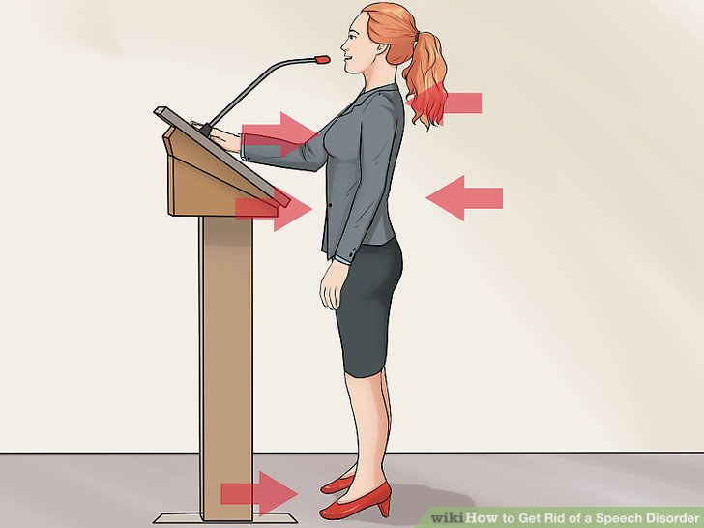
NO!
YES!

Slide 14
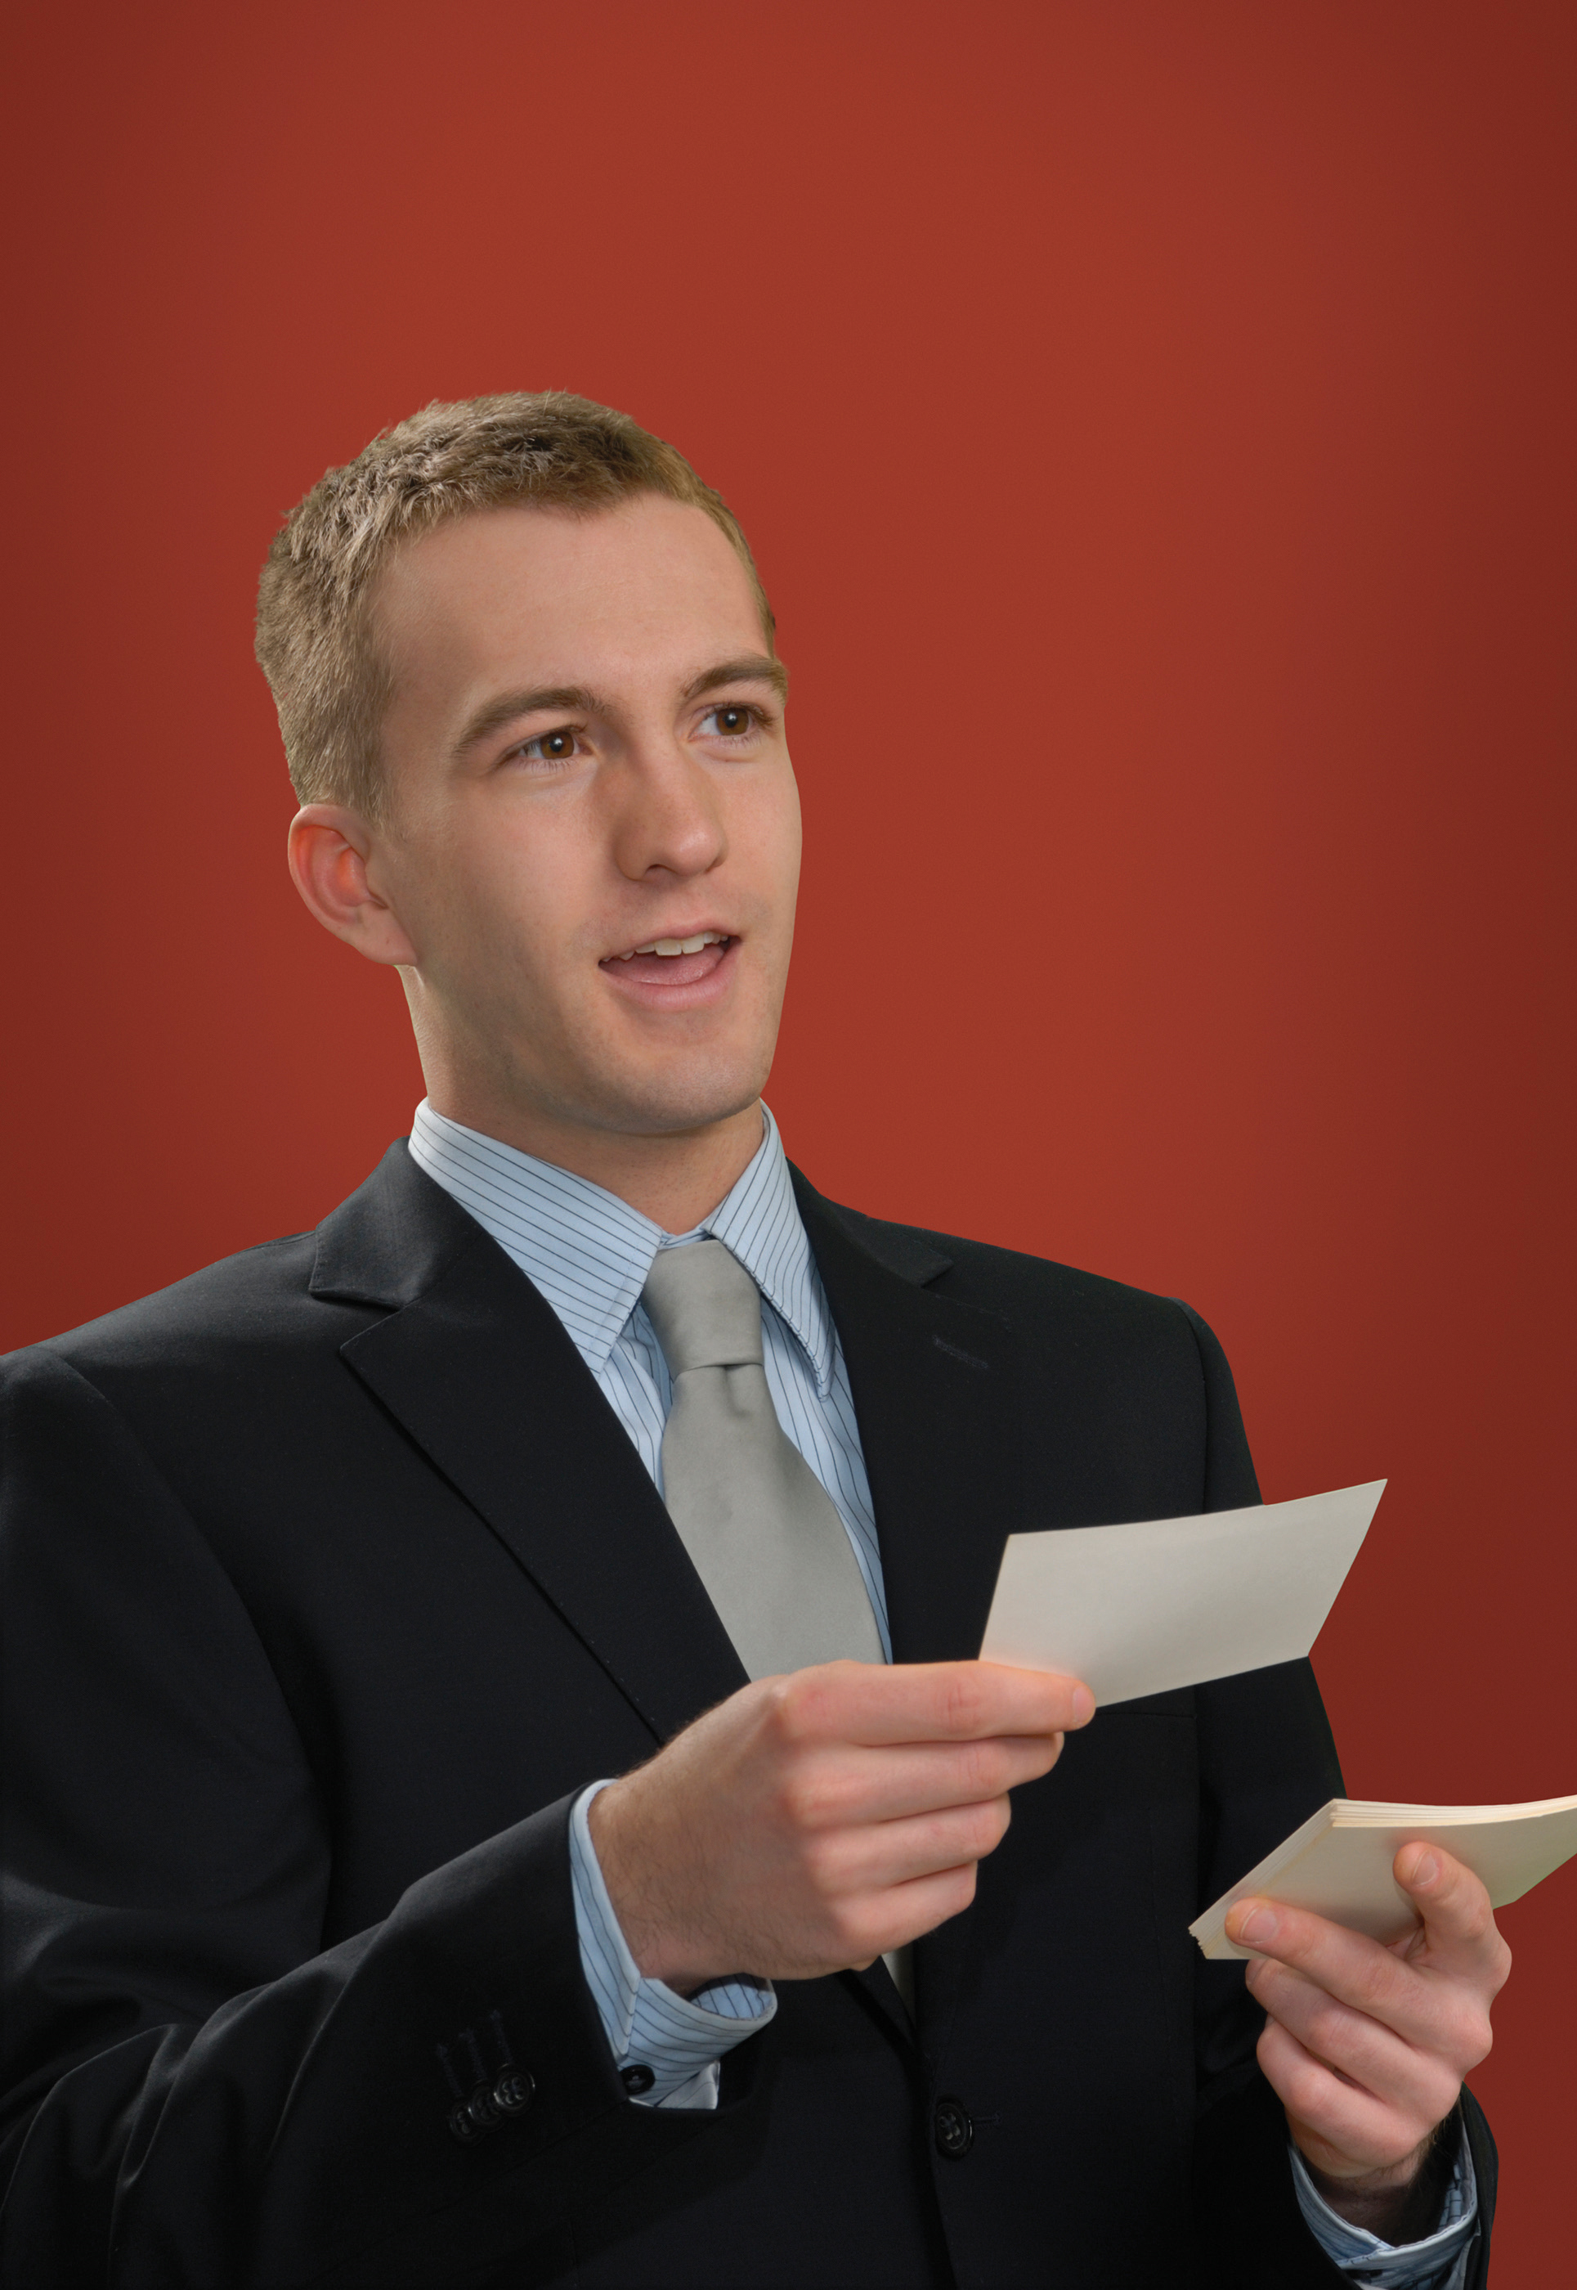
NO!
YES!

Slide 15
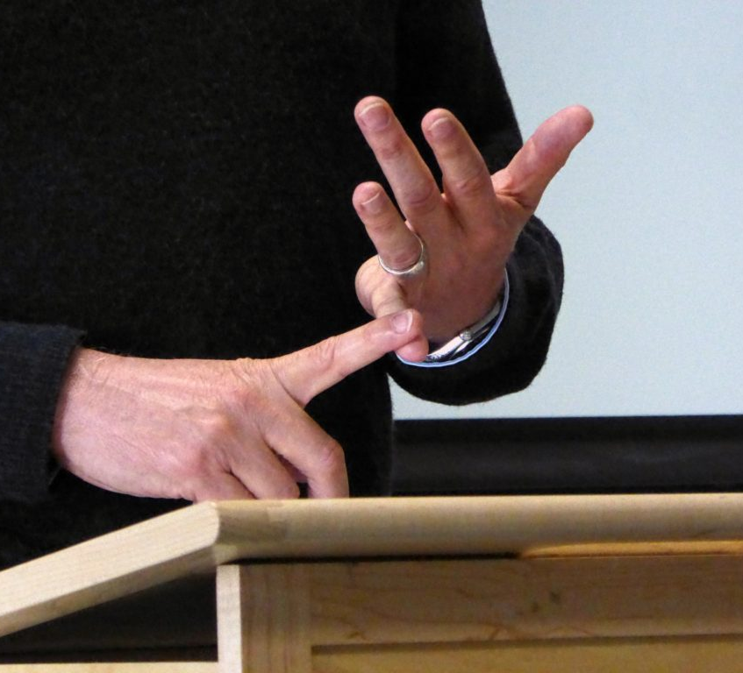
Using Appropriate Hand Gestures
Add more description or emphasis to words.
Example: Holding up fingers to count, “First,” “Second,” etc.
Notes:
Some people use hands more
Create even more connection with audience

Slide 16
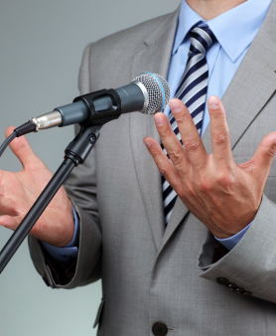
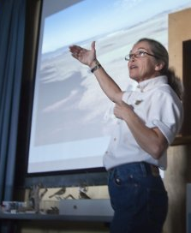
Good Hand Gestures

Slide 17
Body language needs improvement!
LEFT:
Standing with back to audience detracts from speech
Visual aid blocked by body
RIGHT:
Eye contact lost when looking at podium
Speaking into podium muffles voice
Slouching looks unprofessional
Crossing legs makes stance less stable and shows lack of authority.

Slide 18
Good Speech Delivery: What did the speaker do wrong? What did he do right?
https://youtu.be/V8eLdbKXGzk
After watching the video, answer the following questions about Ranjit’s speeches:
What are some things Ranjit did during his first speech which were not effective?
What are some things Ranjit did during his second speech which were effective?
How did Ranjit’s classmates react after he improved his speech techniques?

Slide 19
Telling a Personal Story to Connect to the Audience
In your groups, brainstorm the following questions to generate ideas:
What is the most beautiful sound you have ever heard?
What makes you happy -- even when you are sad?
What was the best vacation you ever had?
Then, choose ONE of the topics to prepare a 30-second to 1-minute speech during which you will be aware of your body language. Try to practice good body language (including eye contact, facial expression, posture, and hand gestures).
Present your short speech to your group. Facilitators, please time.
(Maybe present it to the class later.)
Before presenting, practice breathing deeply (through the nose) and stretching.

Slide 20
Telling a Personal Story to Connect to the Audience
After presenting to the class, discuss the following questions:
How did you feel (emotions) while you were presenting your short speech to your classmates?
In what ways were you aware of your body language while speaking?
What are some techniques you could use to help avoid nervousness?
In what ways do you feel you did a good job with body language?
In what ways would you like to improve your speaking skills?

Slide 21
Group Discussion: True or False?
Smiling while giving a speech can be a good way to connect with an audience.
When giving a speech, it is not important to make eye contact with your audience.
It is not polite to use hand gestures for emphasis while giving a speech.
You should stand (or sit) up straight when presenting in front of a group.
If you are not using note cards, your arms may fall naturally at your sides or in front between shoulder and waist.
You should always stand in one place when giving a speech--that is, no walking while speaking.
If you do not know what to do with your hands during the speech and have pockets, it is good body language to put your hands in your pockets to hold them still.

