Slide 1
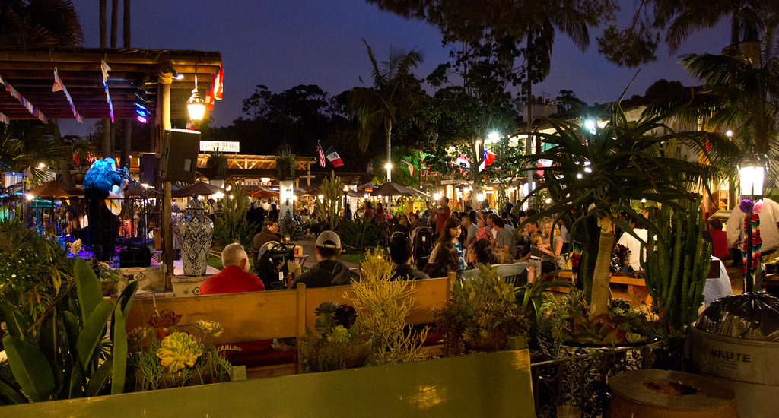
Area Studies: History of Old Town American Language & Culture Institute CSU San Marcos March 2022

Slide 2
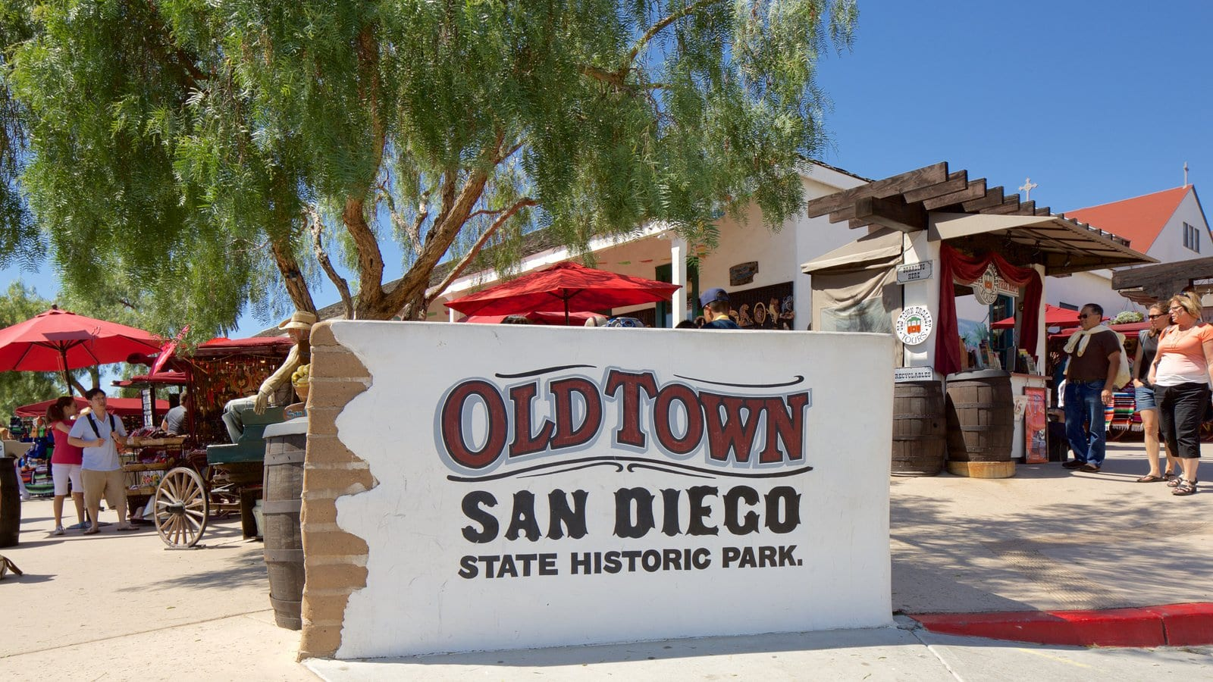
Agenda
Warm-Up Conversations
Old Town—Then and Now
Group Discussion (and Activity)
Notes:
Class Time 60” CCSD 75” GT&C
12” Warm up - 7 mins group time. 5 minutes share out
28” Lecture - 4 x 7 minutes per slide (4 minutes to explanation + 3 minutes for audience participation)
15” Group Discussion (7 mins group time. 7 minutes share out)
5-7” Bonus activity, if finished early
Note: Make the breakout rooms as people come in. Take a screenshot of the group roster that pops up in case you need it
Additional Resources:
https://www.oldtownsandiego.org/
https://www.oldtownsandiego.org/historyofoldtown/

Slide 3
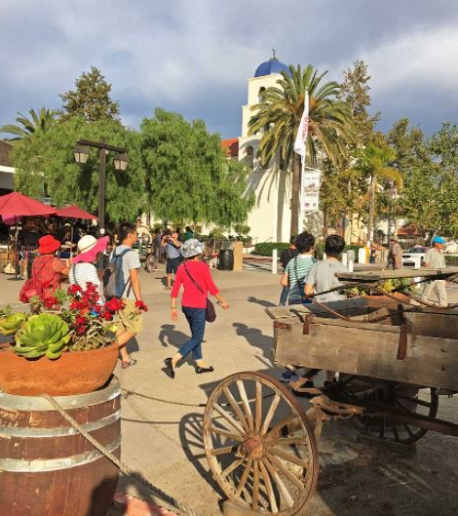
Lesson Goals:
After this lesson you will better know:
Where Old Town is
Some of Old Town’s past
What visitors can see and do in Old Town
Describing an historic Tourist Spot

Slide 4
Warm-Up Questions
Take a screenshot, think about these questions, then discuss with your group:
What are some of the historic places in Japan? Have you been to any of those places? Are they popular?
What time period are those sites from? Why is that time period important to the history of the area?
What do you know about California history?
Do you enjoy visiting historic places when you travel? Can you tell us about any places like that which you have been to in other countries?
Notes:
Divide ss into groups of 4-6 (including 1 facilitator per group)

Slide 5
Share with the class
Now, it’s your turn! Please tell us about…
What your group knows about California history
OR
An interesting place you talked about. Where is it? Is it popular? Why is it interesting to your group?

Slide 6
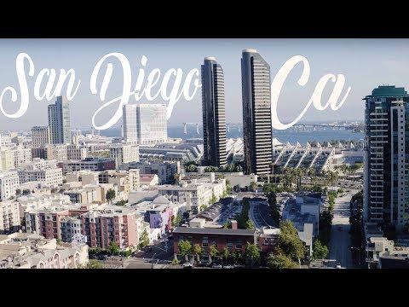
Modern San Diego
Today, San Diego is California’s 2nd largest city.
Can you guess its current population? (say or write in chat)
Notes:
Answer: 1.5 million people live in San Diego.
Comparison - Show modern San Diego, then contrast it with Old Town

Slide 7
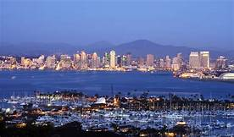
Modern San Diego
1.4 million people currently live in San Diego!
Notes:
Answer: 1.5 million people live in San Diego.
Comparison - Show modern San Diego, then contrast it with Old Town

Slide 8
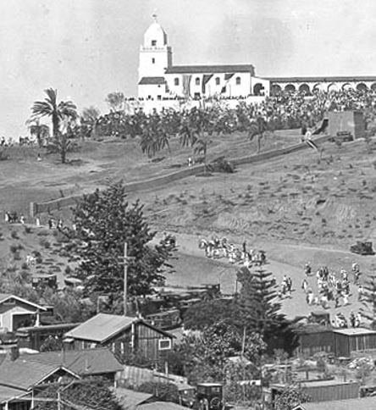
Old Town, San Diego, California
San Diego is California’s 1st European settlement.
In the 1820s, Old Town was the only neighborhood!
In 1850, the population was only 650!

Slide 9
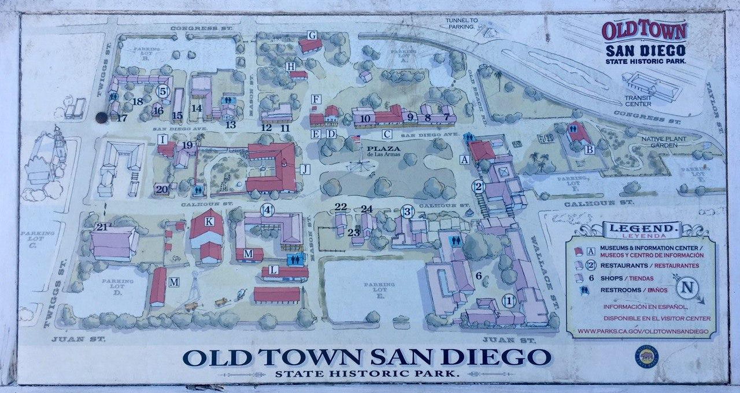
Map of Old Town

Slide 10
The First San Diegans
The earliest known people to live in the area now called San Diego were the Kumeyaay Native American people.
They started living here 9,000 years ago.

Slide 11
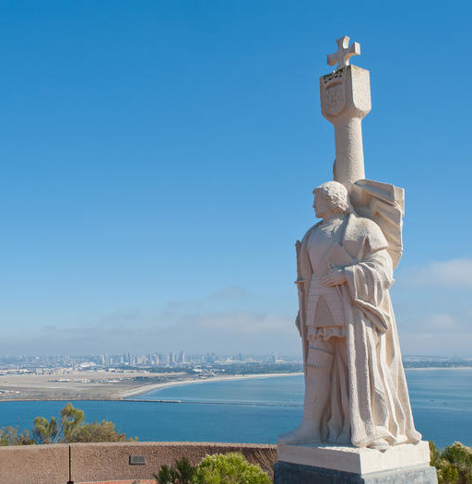
European Contact
First European to visit California:
Spanish explorer Juan Rodríguez Cabrillo in 1542.
Cabrillo Point, San Diego, CA

Slide 12
Colonization
1769: Spain began colonizing San Diego
Mission Basilica San Diego de Alcalá, the first Franciscan mission in Alta California.
Today, Presidio Park can still be seen and visited above old town.

Slide 13
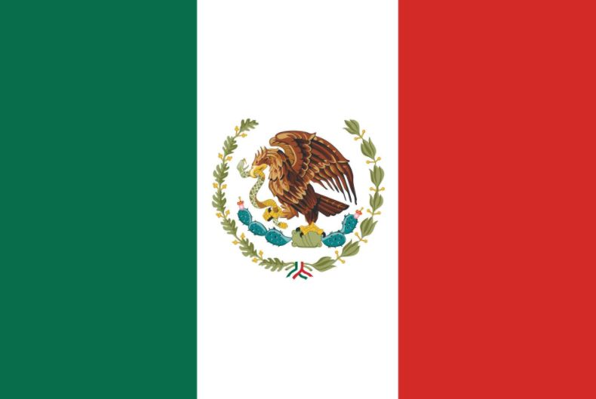
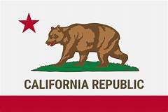
California was also a part of Mexico for a short time.
California became one of the United States of America in 1848.

Slide 14
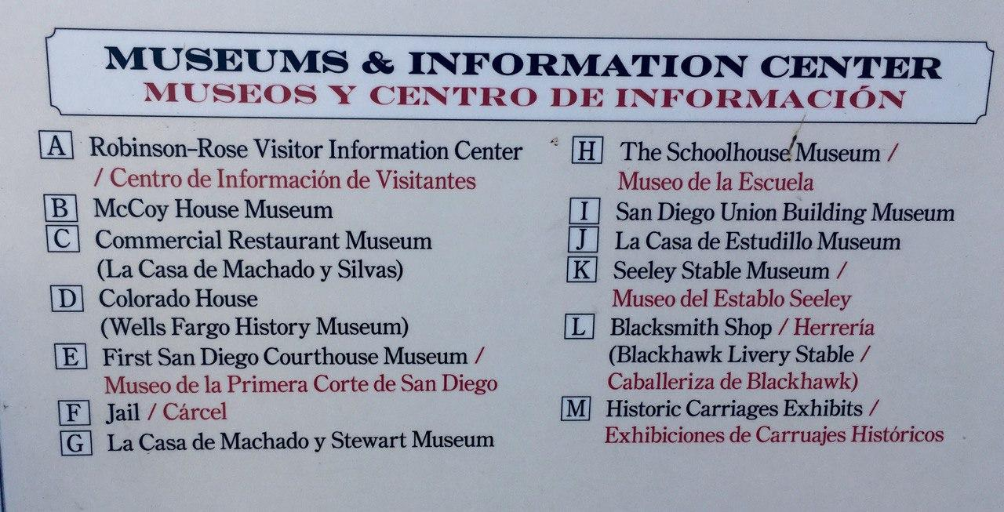
What Do You Notice?
Notes:
Notice that the sign is in English and Spanish. Spanish has always been a major language in California.

Slide 15
Old Town, San Diego, California
People don’t live there now.
It is now a “living history” museum.
Traditional Mexican- and U.S. Western-style buildings, food, crafts and people in costumes.

Slide 16
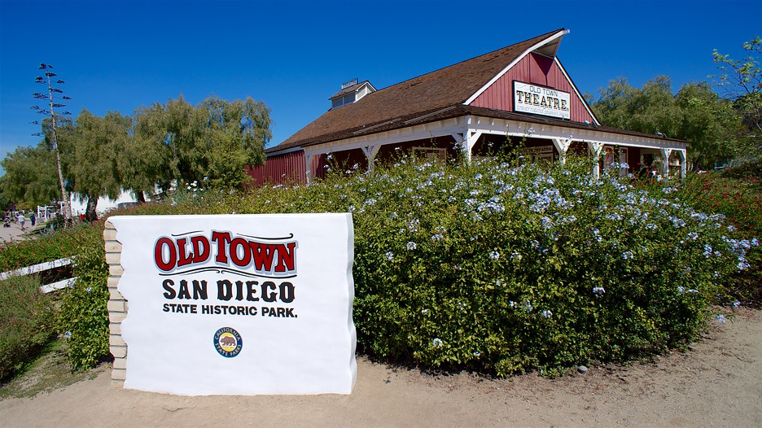
Old Town San Diego State Historic Park
Established in 1968.
Commemorates and preserves historic buildings from the 1800s.
Numerous museums—many free to visit!
Notes:
Video 1 Shops: https://www.youtube.com/watch?v=AIx08Lh3Hd4&t=1227s
Video 2 Museums: https://www.youtube.com/watch?v=L5U6rlWuiGE
Video 3 with market: https://www.youtube.com/watch?v=_gSYXlkqmN8

Slide 17
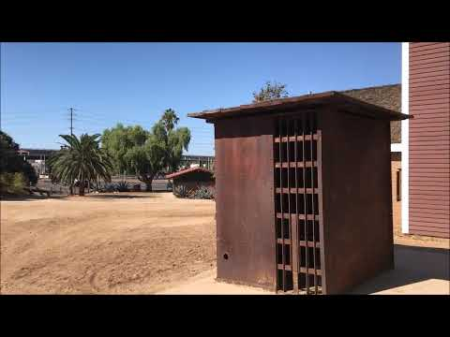
San Diego bought a cage and put its first escape-proof jail in the Old Town Plaza in the 1850s.
Notes:
Jail & Other Builidngs: https://www.youtube.com/watch?v=WVTLKr123u0
School House: https://www.youtube.com/watch?v=CUf8lGR0QoM

Slide 18
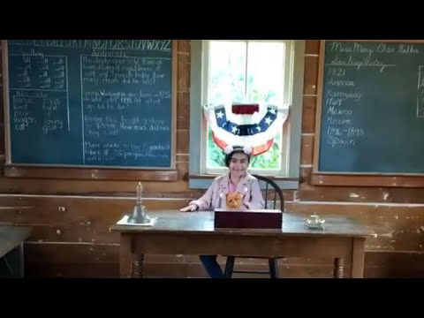
San Diego’s 1st Public School
Wood-frame building from 1865
Notes:
Jail & Other Builidngs: https://www.youtube.com/watch?v=WVTLKr123u0
School House: https://www.youtube.com/watch?v=CUf8lGR0QoM

Slide 19
La Casa de Estudillo
An original adobe mansion.
Adobe means “brick made of mud” and was the name given to houses built from this material.

Slide 20
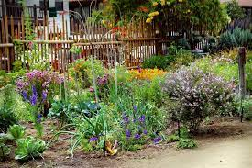
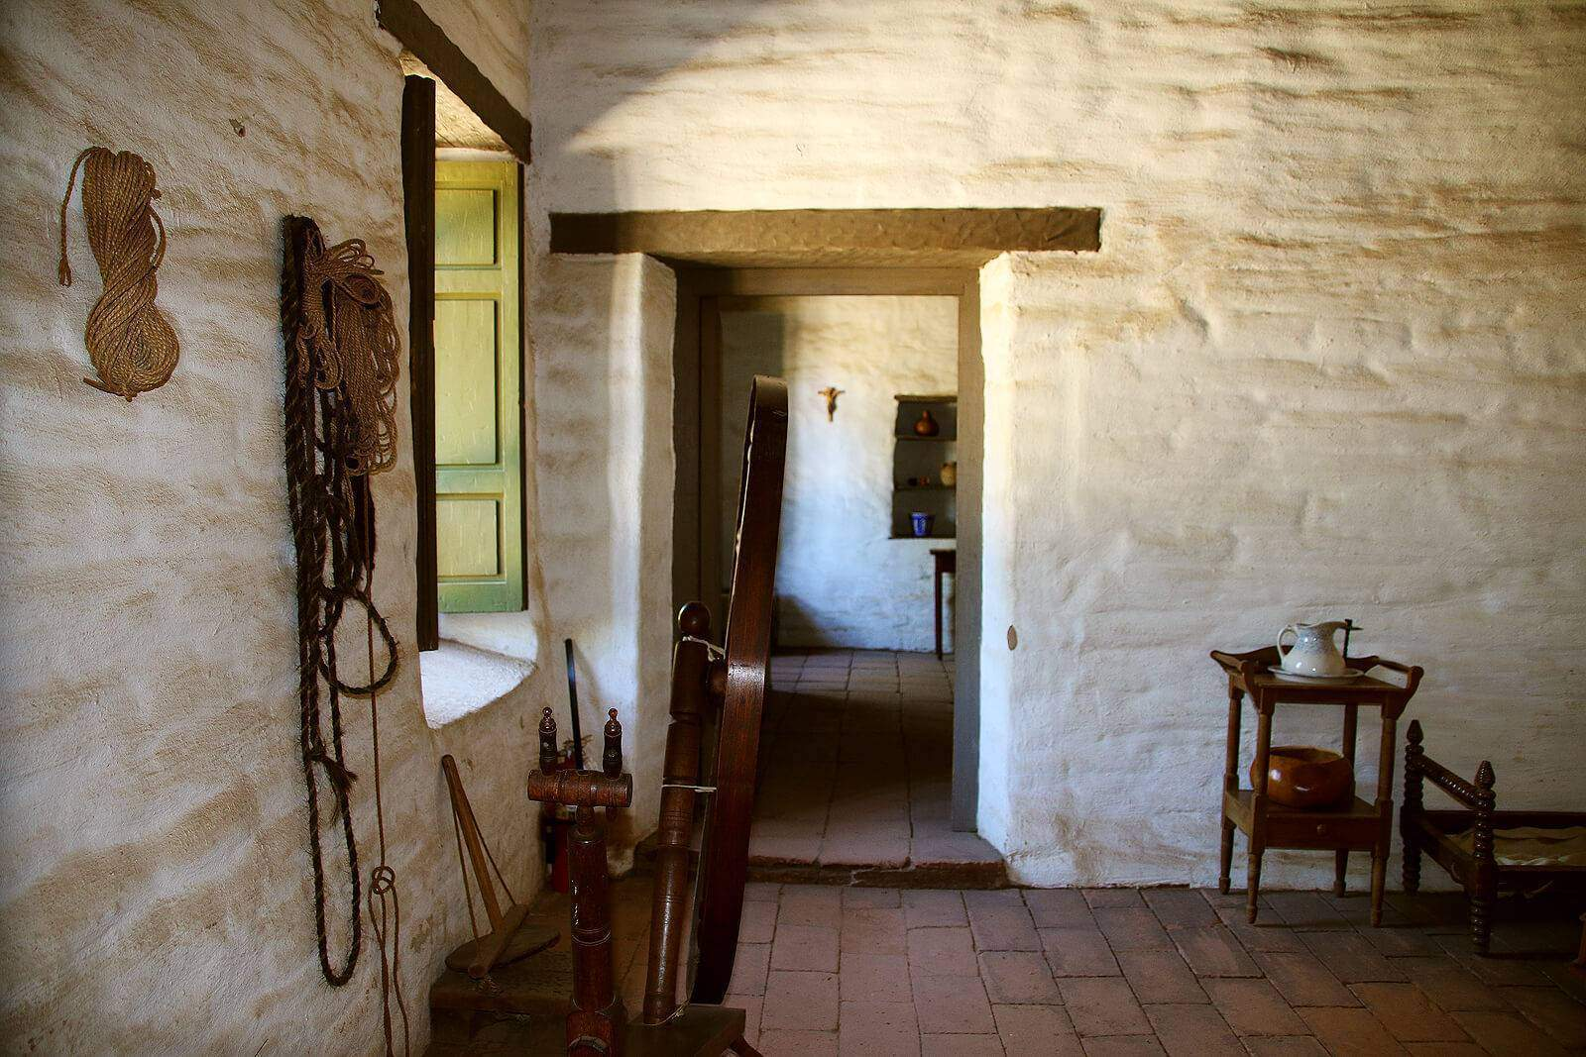
La Casa de Machado y Stewart
An original adobe from the 1830s

Slide 21
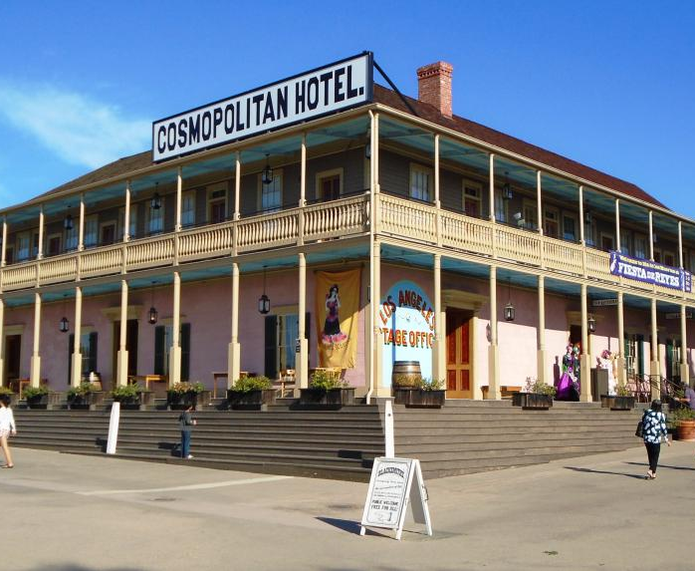
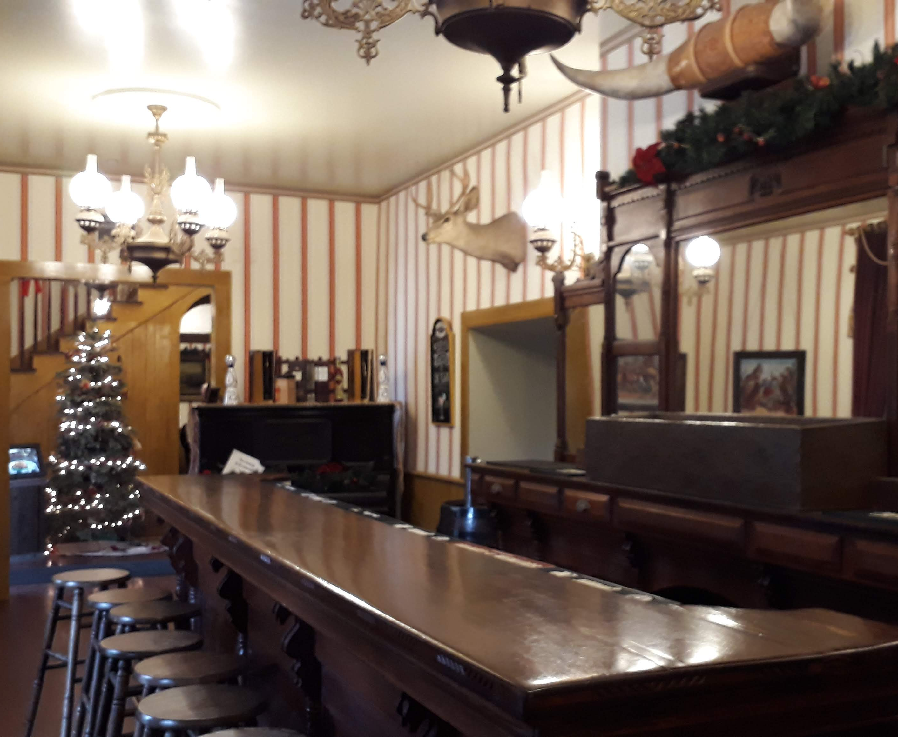
The Cosmopolitan Hotel
Restored original adobe mansion from 1869.
Still operating as a hotel.

Slide 22
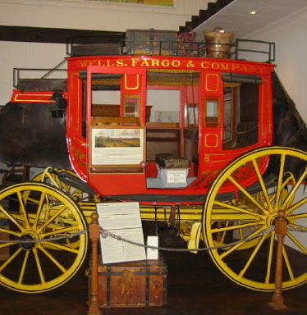
Bank Stagecoach Wells Fargo Museum
In early California, people had to transport everything by horse or by a horse-drawn vehicle like this one.
There was no faster land transportation, and they traveled on dirt roads.

Slide 23
Old Town Tour

Slide 24
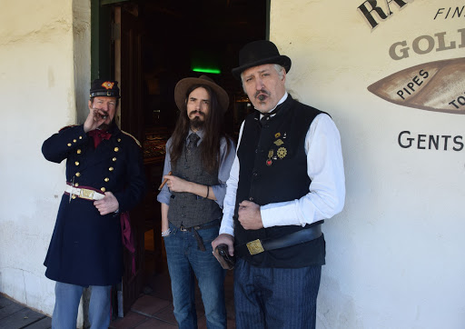
Old Town Employees
People who work here often dress in costumes like people from the 1800s.
Notes:
Video 1 Shops: https://www.youtube.com/watch?v=AIx08Lh3Hd4&t=1227s
Video 2 Museums: https://www.youtube.com/watch?v=L5U6rlWuiGE
Video 3 with market: https://www.youtube.com/watch?v=_gSYXlkqmN8

Slide 25
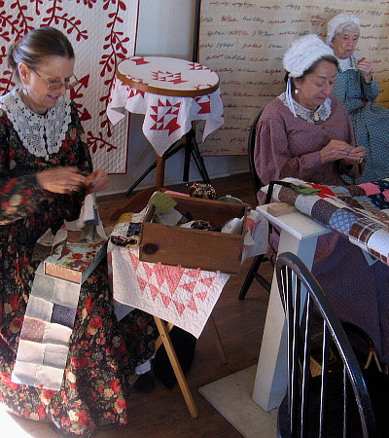
Old Town Employees
Staff demonstrate activities that would have taken place in the 1800s.
These women are “quilting.”
Notes:
Video 1 Shops: https://www.youtube.com/watch?v=AIx08Lh3Hd4&t=1227s
Video 2 Museums: https://www.youtube.com/watch?v=L5U6rlWuiGE
Video 3 with market: https://www.youtube.com/watch?v=_gSYXlkqmN8

Slide 26
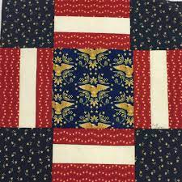
Traditional American Quilt
Notes:
Video 1 Shops: https://www.youtube.com/watch?v=AIx08Lh3Hd4&t=1227s
Video 2 Museums: https://www.youtube.com/watch?v=L5U6rlWuiGE
Video 3 with market: https://www.youtube.com/watch?v=_gSYXlkqmN8

Slide 27
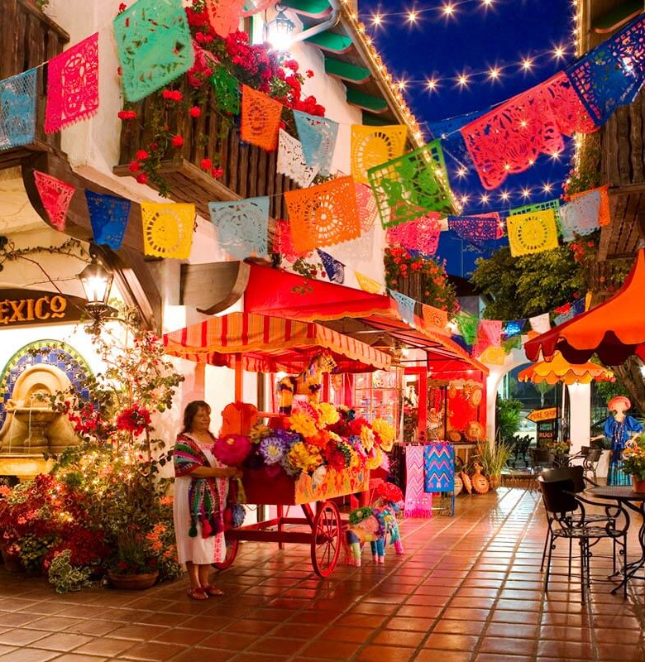
Shopping and Dining
More than 100 shops and restaurants can be found in the park and its surrounding streets.
Souvenir shops, art galleries, crafts, pottery, silver jewelry—and much more!

Slide 28
Old town is full of shops, restaurants, and entertainment.

Slide 29
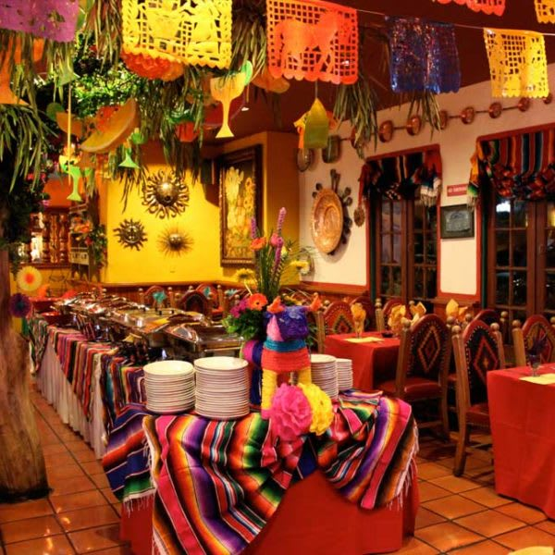
Food!
A Mexican- style restaurant

Slide 30
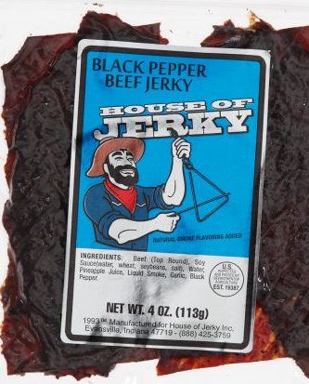
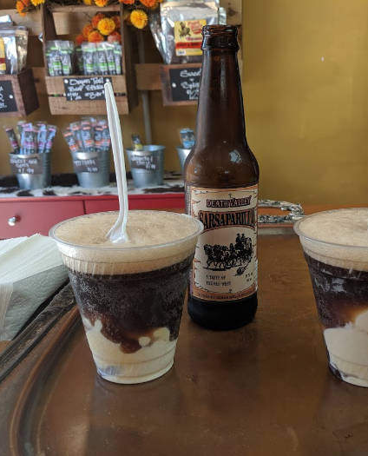
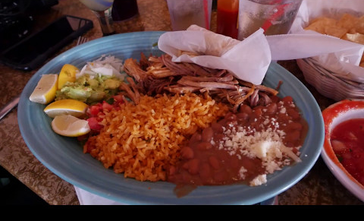
Many restaurants and shops have traditional Western American and Mexican foods.
Notes:
Mexican Food - https://www.youtube.com/watch?v=Iod73yGrm0g
Root Beer - a delicious drink invented in the 1800s
Jerky - Dried meat that was long lasting and easy to transport in a time before refrigerated trucks

Slide 31
Making Hand-made Tortillas

Slide 32
Traditional Mexican Dancers

Slide 33
Traditional Mariachi Musicians

Slide 34
Baile Folklorico

Slide 35
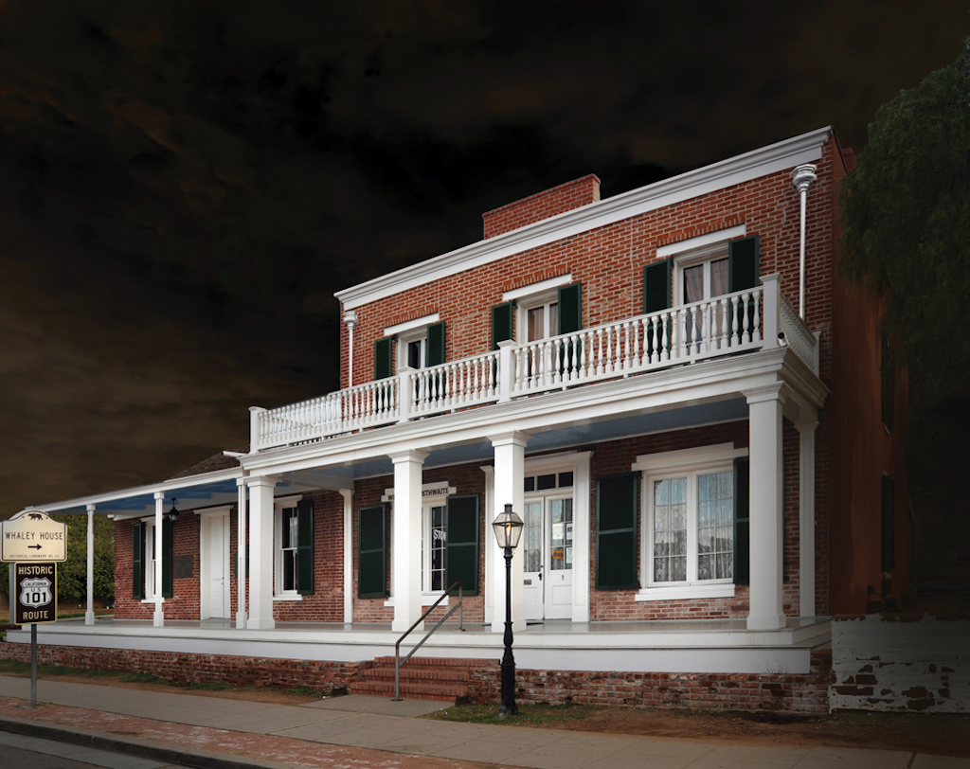
The “Haunted” Whaley House
The Whaley house is said to be one of America’s most haunted homes.
Criminals were executed here before the house was built. That is why people believe it is haunted.
California State Registered Landmark

Slide 36
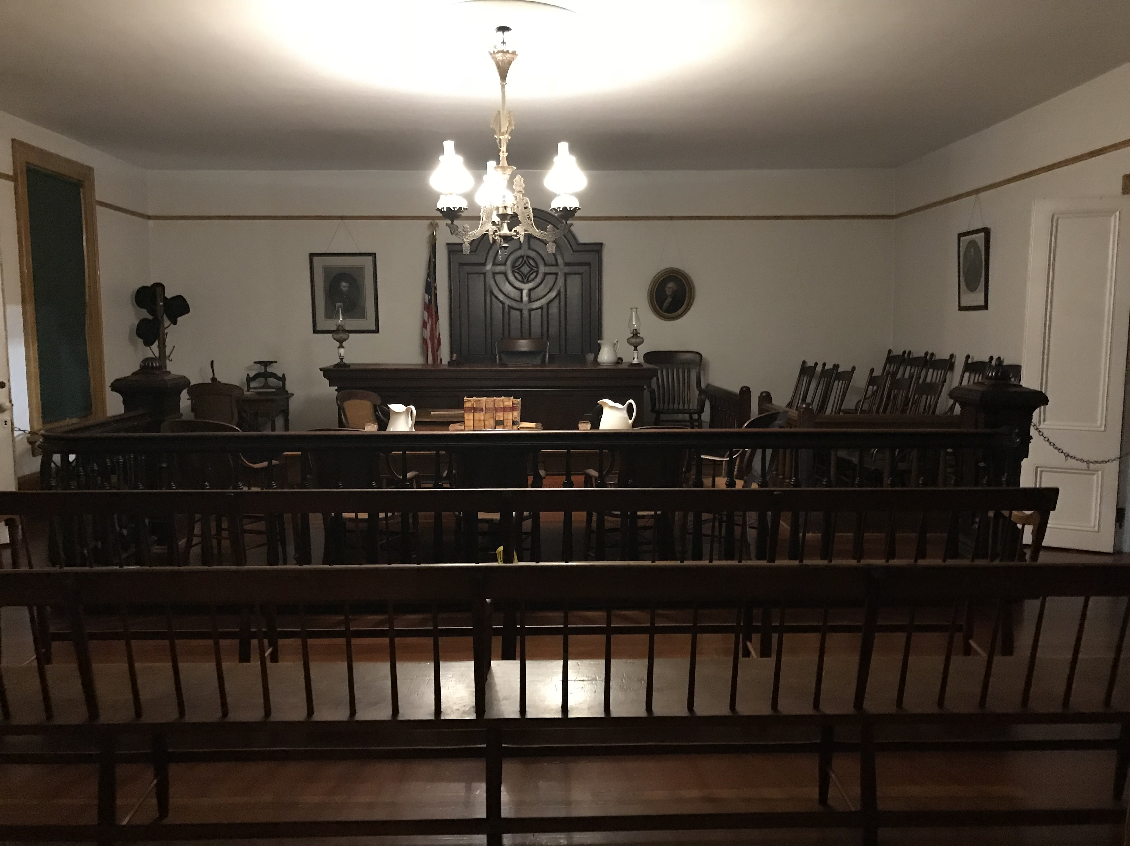
Whaley House (my pictures) San Diego’s 1st Courthouse

Slide 37
Whaley House (my pictures) Dining room

Slide 38
Whaley House (my pictures) San Diego’s first theater

Slide 39
Group Discussion
Think about these questions and talk with your group:
If you visited Old Town, what would you like to see and do most?
What is one thing you learned about San Diego and/or Old Town today?
What other historic places can you find in California? (Google it.)
San Diego allegedly has other “haunted” places - can you find out what some of them are? Do you have similar stories in Japan?

Slide 40
Extra Questions:
How many people live in San Diego Today?
How many people lived in San Diego in 1850?
What is one famous landmark in San Diego?
Why does exist (who lived there, etc.)?
Aside from English, what is the main language of this area?
In early California, people transported things by _____.
What types of food can be found in Old Town?
What types of buildings can you see in Japan’s historic places?
Are there special shops and restaurants in Japan’s historic places? If yes, what kinds of things can be found?
Is there special entertainment in Japan’s historic places (Example: traditional dancers)?
Notes:
Kahoot or they can try to answer questions in groups
Student view: https://kahoot.it/challenge/03168031?challenge-id=29cc76d0-97d8-4716-a18a-b61ca2f04a4d_1606169085445
Teacher View: https://create.kahoot.it/share/old-town-comprehension-questions/8990727e-9bcd-4611-9820-974221164ba8
What is one famous landmark in San Diego?
Old Town, The Jail, The Schoolhouse, The Bank Stagecoach, The Whaley House
1.5 million people live in San Diego today
650 people lived in old town in 1850
Old town is preserved for our education and appreciation
Old town was a complete town
English and Spanish are the main languages
The population of early san diego was small
In early california, people transported things by horse
Some traditional foods are root beer, jerky, and tortillas.

Slide 41
ACTIVITY: A GREAT PLACE TO VISIT HISTORY
Create a post about an historic place your in your hometown (or another part of Japan).
What is it famous for?
If we visit, what should we see and do?
Any other important information?
Post to Forum on the Cougar Course.
Include illustrations if possible

