Slide 1
Quantitative Reasoning & Math Review Geometry Focus
By Enrique Garcia

Slide 2
Important Notes
You can assume,
All numbers are real numbers
All figures are assumed to lie in a plane unless otherwise stated
Geometric figures such as lines, circles, triangles, and quadrilaterals are not necessarily drawn to scale.
Lines clearly drawn straight are actually straight.
Points on a line are in the order as shown
Geometric objects are relatively in the positions they are shown.
Coordinate Systems are drawn to scale
Graphical data presentations, such as bar graphs, circle graphs, and line graphs are drawn to scale.

Slide 3
Geometry
Lines and Angles
Polygons
Triangles
Quadrilaterals
Circles
Three Dimensional Figures

Slide 4
Lines and Angles
Line Segments
Endpoints
Congruent Line Segments
Midpoint
Length
Angles
Vertex
Opposite Angles
Right Angles
Acute and Obtuse

Slide 5
Polygons
Defined
Sides
Vertices
Triangle
Quadrilateral
Pentagon
Hexagon
Octagon
Perimeter

Slide 6
Triangles
Equilateral Triangle
Isosceles Triangle
Right Triangle
Hypotenuse
Legs
Pythagorean Theorem
Area of a Triangle

Slide 7
Triangles Continued…
Congruent and Similar Triangles
Prop 1: If three sides of one triangle are congruent to the three sides of another triangle, then those triangles are congruent by Side-Side-Side (SSS)
Prop 2: If two sides and the included angle of one triangle are congruent to two sides and the included angle of another triangle then they are congruent by Side-Angle-Side (SAS)
Prop 3: If two angles and the included side of one triangle are congruent to two angles and the included side of another triangle, then they are congruent by Angle-Side-Angle.
Similarly, since 2 angles are the same, then it must follow that all three angles are congruent, thus AAS is also possible.

Slide 8
Quadrilaterals
Special Types of Quadrilaterals (Types)
Rectangle
Square
Parallelogram
Trapezoid
The Areas of the Special Types of Quadrilaterals
Area for all Parallelograms $A=bh$
Area of a Trapezoid $A=\frac{1}{2}\left(b_{1}+b_{2}\right)∗h$

Slide 9
Circles
Center, Radius, Diameter
Congruent Circles
Circumference
Central Angle, Measure of an Arc
Length of an Arc
Area, Sector, and Area of a Sector
Inscribed and Circumscribed

Slide 10
Three-Dimensional Figures
Rectangular Solid or Prisms, and Cubes
Faces, Edges, and Vertex
Volume $V=l∗w∗h$
Surface Area $A=2\left(lw+lh+wh\right)$
Circular Cylinder
Lateral Surface, Axis, and Right Circular Cylinder
Volume $V=πr^{2}h$
Surface Area $A=2\left(πr^{2}\right)+2πrh$

Slide 11
O is the center of the circle in the figure.
The circumference of the circle above is $30π$
Quantity A
The length of AB
Quantity B
30
Quantity A is larger
Quantity B is Larger
The Two Quantities are equal
The relationship cannot be determined
Notes:
Now, we know that the circumference of a circle is:
C=2πr or C=πd
This means that the diameter of our circle is must be 30. Given this, we know that the AB must be shorter than 30, for the diameter is the longer than any chord that does not pass through the center of the circle. Quantity B is larger than quantity A.

Slide 12
Quantity A
Area of a circle with radius r
Quantity B
Perimeter of a circle with radius r
Quantity A is greater
Quantity B is greater
The two quantities are equal
The relationship cannot be determined from the information given
Notes:
Try different values for the radius to see if a pattern emerges. The formulas needed are Area = πr² and Perimeter = 2πr.
If r = 1, then the Area = π and the Perimeter = 2π, so the perimeter is larger.
If r = 4, then the area = 16π and the perimeter = 8π, so the area is larger.
Therefore the relationship cannot be determined from the information given.

Slide 13
If a circular monument with a radius of 30ft is surrounded by a circular garden that is 20ft wide, what is the area of the garden?
$1600π$
$900π$
$200π$
$400π$
$2500π$
Notes:
To find the area of the garden, you need to find the entire area and subtract that by the area of the inner circle, or the monument. The radius of the larger circle is 50, which makes its area 2500π. The radius of the inner circle is 30, which makes its area 900π. The difference is 1600π.

Slide 14
A circle of radius 5, for an angle x, has an arc length of $3π$. What is the angle x?
$144°$
$108°$
$54°$
$43.2°$
$216°$
Notes:
The formula for an arc length, l, of a circle of a given radius, r, and a given angle, x is:
l=2πr(x/360)
Note that 2πr is the circumference of the circle.
Conversely, for a known arc length and unknown angle, this equation can be rewritten as follows:
x=360(l/2πr)
Plugging in the given values, it is therefore possible to find the missing angle:
x=360(3π/2π(5))=108∘

Slide 15
In Triangle ABC, the measure of angle B is $90°$, the length of side AB is 4, and the length of side BC is x. If the length of hypotenuse AC is between 4 and 8, which of the following could be the value of x? Indicate all such values
1
2
3
4
5
6
Notes:
You can try to figure out the problem just by looking at it, but it’s better to take a few seconds to draw a triangle.
This triangle should stand out to you right away because it’s a right triangle with a leg of 4. Remember our Pythagorean triples? One of those is 3:4:5. If x equals 3 (answer choice C), then the hypotenuse must be 5 — which is more than 4 and less than 8. Immediately, we know C is a correct answer choice.
For the other answer choices, however, we’ll have to plug in each of the possible values of x and solve for the hypotenuse using the Pythagorean theorem (a2+b2=c2). To avoid confusion (our angles are also called A, B, and C), let’s call the hypotenuse h. As long as the hypotenuse comes out to any number between 4 and 8, that answer choice is correct.

Slide 16
In the diagram below, four pairs of triangles are shown. Congruent corresponding parts are labeled in each pair.
Using only the info given, which pair of triangles can be proven congruent?
A
B
C
D
Notes:
A. Cannot since, we have ASS and it’s not a right triangle
B. ASA
C. AAS
D. Hypotenuse Leg, other leg must be congruent as well.

Slide 17
Rusty is considering making a cylindrical grain silo to store his crops. He has an area that is 6 feet long, 6 feet wide and 12 feet tall to build a cylinder in. What is the maximum volume of grain that he can store in this cylinder?
Notes:
The maximum cylindrical base can have a diameter of 6 and therefore a radius of 3. The formula for the volume of a cylinder is $πr^{2}h$, which in this case is $3∗3∗12∗π$ .

Slide 18
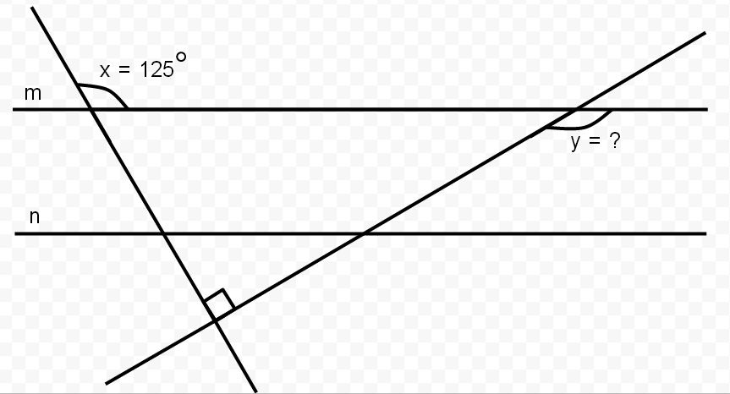
Lines m and n are parallel. What is the value of y?

