Slide 1
Overview of GRE: Analytical Writing Section

Slide 2
Grand Overview
2 Tasks: Argument Task and Issue Task
30 minutes each
Exam interface (Prompt and processor)
Scoring is between 1 (low) and 6 (high)

Slide 3
Rules and Resources
No talking
Do not write on the scratch paper until the exam begins
No personal items (cell phones, food, or jewelry, etc.)
Noise reducing headphones and scratch paper
10-min. break after third section

Slide 4
Exam Interface
Prompt and Processor
No auto-correct, spell check, or thesaurus
Basic processor capabilities:
Copy, Cut, and Paste
Delete
Undo

Slide 5
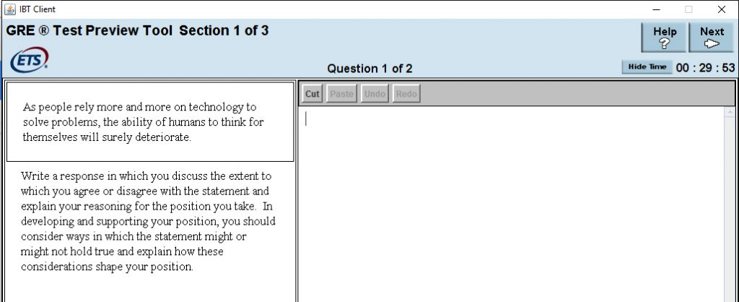
Exam Interface
Prompt and Processor
No auto-correct, spell check, or thesaurus
Basic processor capabilities:
Copy, Cut, and Paste
Delete
Undo

Slide 6
Time and Strategy
30 minutes for each exam, including
Time to read the task prompt
Time to write a response
Time to revise and edit your response

Slide 7
Strategy
2 mins (2:00): Breaking down the task
5 mins (7:00): Creating and prioritizing points
1 min (8:00): Organizing
20 mins (28:00): Drafting
2 mins (30:00): Proofing

Slide 8
Scoring
Scores are on a 0 – 6 scale. 6 is the highest.
Holistic, emphasizing the effective interrelationship of content, organization, and syntax.
One human and one computer. A third if needed.
Scores returned after 10 – 15 days.

Slide 9
Task: Argument
The "Analyze an Argument" task will present a short argument and instructions on how to respond to it. You will assess the cogency of the argument, analyzing the author’s chain of reasoning, and evaluating the use of evidence. For this essay, you will not develop your own argument but instead will critique the argument presented in the prompt.

Slide 10
Task: Argument EXAMPLE
In surveys Mason City residents rank water sports (swimming, boating and fishing) among their favorite recreational activities. The Mason River flowing through the city is rarely used for these pursuits, however, and the city park department devotes little of its budget to maintaining riverside recreational facilities. For years there have been complaints from residents about the quality of the river's water and the river's smell. In response, the state has recently announced plans to clean up Mason River. Use of the river for water sports is therefore sure to increase. The city government should for that reason devote more money in this year's budget to riverside recreational facilities.
Write a response in which you examine the stated and/or unstated assumptions of the argument. Be sure to explain how the argument depends on the assumptions and what the implications are if the assumptions prove unwarranted.

Slide 11
Task: Issue
The "Analyze an Issue" task assesses your ability to think critically about a topic of general interest and instructions on how to respond to the issue. You can discuss the issue from any perspective, making use of your own educational and personal background, examples from current or historical events, material that you’ve read, or even hypothetical situations. For this essay, you will develop your own argument.

Slide 12
Task: Issue EXAMPLE
As people rely more and more on technology to solve problems, the ability of humans to think for themselves will surely deteriorate.
Discuss the extent to which you agree or disagree with the statement and explain your reasoning for the position you take. In developing and supporting your position, you should consider ways in which the statement might or might not hold true and explain how these considerations shape your position.

