Slide 1
Introduction to Integrative Healthcare: Focus on Chronic Pain
Linnea Axman
DrPH, MSN, FNP-BC, FAANP

Slide 2
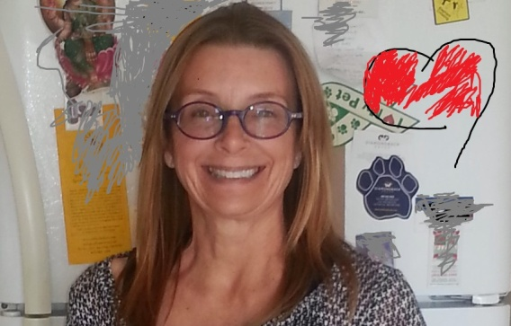
Introductions
Contact Information
laxman@csusm.edu
or at 619-813-5732
Notes:
Linnea Axman is a Family Nurse Practitioner, Lecturer …CMP, Reiki II Practitioner, RYT 200, AyurYoga 200, Ordained minister, and is currently working on Life Purpose counseling certificate (year long)
Karen Heine Zlatic has been a leader in Holistic Health, Healing, and Wellness for nearly three decades. She began her private practice in 1987. She uses her knowledge and training in massage, nutritional counseling, and natural medicine to assist others in attaining optimal health.
In 1983, she graduated from Old Dominion University in Virginia with a B.A.
Karen received her certification as a Holistic Health Practitioner from the Institute of Health Sciences in 1987, now known as the School of Healing Arts. She then became an instructor in their Massage Trainee Program. Through the integration of bodywork, communication, and the application of essential oils, Karen finds many compliments to healing.
One of Karen’s highest priorities is being a single mother to her three children. They are honored scholars and highly achieving athletes. She attributes these successes to the environment of wellness that has been present since their days in the womb.
Currently, Karen continues her private practice as a Holistic Health Practitioner and Natural Healthcare Educator in San Diego, CA. She is an part-time teacher to children in the San Diego Unified School District, to adults in the School of Healing Arts, and to families, groups, or anyone needs assistance in health through the natural protection of essential oils.
For appointments or classes feel free to contact Karen @ kshz@mac.com or 858-366-3994
PIC

Slide 3
Disclosures
Linnea Axman is a Wellness Advocate for doTERRA International and currently uses essential oils at the CSUSM Free Clinics
…bringing a new standard of therapeutic-grade essential oils to the world...
http://www.doterra.com/#/en/ourCompany/aboutUs/ourStory

Slide 4
Learning Outcomes
By the end of this class period, the learner will be able to:
Define Integrative Healthcare.
Identify the California BRN position on CAM in Registered Nursing Practice
Explain the history of Integrative Healthcare.
Discuss Five Questions to consider before prescribing any therapy.

Slide 5
Learning Outcomes
Identify at least three chronic pain conditions that incorporate Integrative Healthcare as part of health promotion, disease prevention, treatment, cure, and/or healing.
Describe evidence-based Integrative Healthcare therapies for Chronic Pain and conditions that lead to decreased mobility.
Talk about some of the current research related to integrative therapies for chronic pain.

Slide 6
Definitions
Allopathic Model
CAM Model
Used synonymously with “Western Medicine” or “Conventional Medicine”
"A method of treating disease with remedies that produce effects antagonistic to those caused by the disease itself.“ (Tabor, 2001).
Complementary generally refers to using a non-mainstream approach with conventional medicine.
Alternative refers to using a non-mainstream approach in place of conventional medicine.

Slide 7
CA BRN Position on CAM

Slide 8
Integrative Healthcare
Integrative Medicine (IM) or Integrative Healthcare (IH), as defined by the National Center for Complementary and Alternative Medicine (NCCAM) at the National Institutes of Health "combines mainstream therapies and CAM therapies for which there is some high-quality scientific evidence of safety and effectiveness”. (NIH, 2009).

Slide 9
Institute of Medicine (2005)
Healing oriented [healthcare]) that re-emphasizes the relationship between patient and [healthcare provider] and integrates the best of complimentary and alternative medicine with the best of conventional medicine (Maizes, Schneider, Bell, & Weil (2002).

Slide 10
Defining Integrative Healthcare
Oriented towards Health and Healing
Emphasizes relationship-centered care
Integrates evidence-based methods for prevention and treatment
Uses natural less invasive methods when possible
Engages body, mind, spirit, and community to facilitate healing; Recognizes that we are part of a greater ecological system (ecological models of care)
Encourages HCPs to act as educators, role models, and mentors
Maintains healing is always possible when cure is not (*so important in chronic disease)
Notes:
Healing facilitates change that reduces stress, improves diet, promotes exercise, and increases a person’s sense of community; whereas curing refers to something done to alleviate a troublesome condition or disease. In doing these things, the balance of the body (mind and spirit) may be improved to the point that it may be able to heal itself (less need for a pharmaceutical such as a HTN med or hypoglycemic like Metformin). Healing does not equal curing and becomes particularly important when we are discussing chronic disease.

Slide 11
Integrative Therapies
Include [but are not limited to]
Mind/body practices (such as meditation, yoga, and biofeeback)
Natural products (such as vitamins and dietary supplements like fish oil; botanicals)
Traditional or cultural healing practices (such as Traditional Chinese Medicine and Ayurvedic Medicine)
Energy-based therapies (such as Healing Touch and Reiki) (Meadows, 2015)

Slide 12
Towards a system of Integrative Healthcare
The job of the [healthcare provider] is to cure sometimes, heal often, support always - Hippocrates

Slide 13
History of Integrative Healthcare
Hippocrates (born 460 BCE)
Father of Medicine
“Let food be thy medicine and medicine be thy food”
Aristotle (384-322 BCE)
Father of logic
First holistic physician
Every person was a combination of physical and spiritual; no mind/body separation

Slide 14
History of Integrative Healthcare
Erasistratus (born 304 BCE)
Father of Physiology
Promoted diet, exercise, and hygiene in medical care
Descartes (1596-1650 CE)
Separated mind and body to protect the spiritual (“Cartesian split” and mind-body duality)
Notes:
Dualism is closely associated with the philosophy of René Descartes (1641), which holds that the mind is a nonphysical substance. Descartes clearly identified the mind with consciousness and self-awareness and distinguished this from the brain as the seat of intelligence.^{[6]} Hence, he was the first to formulate the mind–body problem in the form in which it exists today.^{[7]}

Slide 15
History of Integrative Medicine
Locke ( 1632-1704) and Hume (1711-1776)
Reductionism
Every concept , body part, disease reduced to its smallest part
The Flexner Report (1910)
Development of allopathic academic institutions
Research
Education
Clinical practice
Notes:
Locke and Hume
Let us imagine each of these theorists giving us advice about how we should be scientific in our pursuit of knowledge. What would that advice be?
Locke would tell us that we must reason carefully about sense data so as to build up sure knowledge that is not distorted by fantasy or passion
Hume would agree with Locke, but would tell us sadly that science is very limited and that reason is the slave of our passions.
Impact on alternative medicine[edit]
Flexner clearly doubted the scientific validity of all forms of medicine other than that based on scientific research, deeming any approach to medicine that did not advocate the use of treatments such as vaccines to prevent and cure illness as tantamount to quackery and charlatanism. Medical schools that offered training in various disciplines including electromagnetic field therapy, phototherapy, eclectic medicine, physiomedicalism, naturopathy, and homeopathy, were told either to drop these courses from their curriculum or lose their accreditation and underwriting support. A few schools resisted for a time, but eventually all complied with the Report or shut their doors.^{[citation needed]}
Impact on osteopathic medicine[edit]
Although almost all the alternative medical schools listed in Flexner's report were closed, the American Osteopathic Association (AOA) was able to bring a number of osteopathic medical schools into compliance with Flexner's recommendations and produce an evidence-based practice.^{[citation needed]} The curricula of DO and MD awarding medical schools are now nearly identical, the chief difference being the additional instruction in osteopathic schools of osteopathic manipulative medicine. This dramatic convergence of osteopathic and biomedical training demonstrates the sweeping effect of the Flexner Report, not only in the closure of inadequate schools, but also in the standardization of the curricula of surviving schools.

Slide 16
History of Integrative Healthcare
NIH (1993)
Office of Alternative Medicine, later became the National Center for Complimentary and Alternative Medicine (NCCAM)
Allowed for much needed research that started with botanicals
IOM Report (2004/2005)
Recommended health profession schools incorporate sufficient info about CAM into their standard curriculum to enable them to advise their patients competently about CAM

Slide 17
Five Questions to Consider (before prescribing any therapy)
Does the therapy result in symptom resolution or suppression?
What is the evidence?
What is the potential harm?
What is the cost?
Does the therapy match the patient’s culture and belief system?

Slide 18
[just a few of the] Chronic conditions that incorporate Integrative Healthcare
Asthma
Breast Cancer
Cataracts
Depression
Dyslipidemias
Erectile Dysfunction
Fibromyalgia
GERD
Hypertension
Insomnia
Low Back Pain
Multiple Sclerosis
Osteoporosis
Premenstrual Syndrome
Rheumatoid Arthritis
Sinusitis
Type II Diabetes
Urinary Tract Infections
Vaginal Dryness
Warts including HPV

Slide 19
Potential for Interactions
Botanicals
Pharmaceuticals
Garlic
Valerian
Kava
Ginkgo
St John's wort
Above account for 68% of clinically significant interactions
Anti thrombotics
Sedatives
Antidepressants
Anti diabetics
Above accounted for 94% of all clinically significant interactions
No patient was harmed seriously from any interaction
(Sood, Sood, Brinker, Mann, et al, 2008)

Slide 20
Pain
Note. The Scream by Edvard Munch

Slide 21
What we know
ALL PAIN IS REAL.
Pain can originate in the absence of a tissue disorder.
Pain initiated by the brain is identical to pain originating in peripheral tissues.
The amygdala, anterior cingulate cortex (ACC) and the autonomic nervous system (ANS) are involved in the activation of pain pathways.
Pain pathways are strongly influenced by thoughts and emotions.
Built-in central mechanism for reducing pain exist.

Slide 22
Chronic Pain
A nocioreceptive sensation that persists for months (> 6 months) or even years beyond the usual healing time and is out of proportion to the pathologic stressors causing it.
$65B a year in healthcare costs
50% chance of becoming addicted to drugs
Women affected more than men by 2:1
Onset usually 4th, 5th, or 6th decade of life

Slide 23
The psychophysiology of pain
Notes:
MBS – mind-body syndrome

Slide 24
Anterior Cingulate Cortex
Notes:
The anterior cingulate cortex (ACC) is the frontal part of the cingulate cortex that resembles a "collar" surrounding the frontal part of the corpus callosum. It consists of Brodmann areas 24, 32, and 33.
It appears to play a role in a wide variety of autonomic functions, such as regulating blood pressure and heart rate.
It is also involved in rational cognitive functions, such as reward anticipation, decision-making, empathy, impulse control,^{[1]} and emotion.^{[2][3]}
Social isolation pain felt here; heartbreak felt here

Slide 25
Dorsolateral Prefrontal Cortex (DLPFC)
Notes:
Executive decision-making

Slide 26
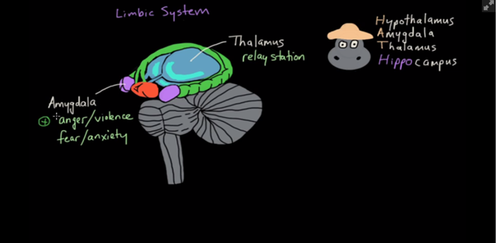
The Amygdala and Pain

Slide 27
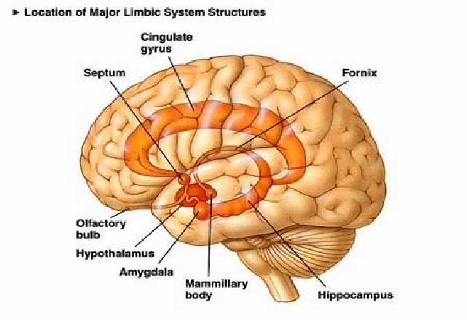
The Brain’s Major Divisions

Slide 28
The Autonomic Nervous System

Slide 29
Chronic Pain Syndromes Commonly Caused by Psychophysiologic Disorders (PPD )
Tension headaches
Migraine headaches
Back pain
Neck pain
Whiplash
Fibromyalgia
TMJ syndrome
Myofascial pain syndromes
Chronic abdominal and/or pelvic pain syndromes
Chronic tendonitis
Vulvodynia
Piriformis syndrome
Sciatic pain syndrome
Repetitive stress injury
Foot Pain syndromes
Do not necessarily cause tissue destruction and can be reversed

Slide 30
Integrative Therapeutic Approaches

Slide 31
The Integrative Healthcare Plan R/O Structural Conditions
PPD should be suspected in most patients presenting to a primary care provider with [chronic] pain.
A medical workup should be conducted to rule out structural conditions (tumors, fractures, infections, or inflammatory conditions).
Bulging disks, mild spondylolisthesis, or spinal stenosis do not exclude a diagnosis of PPD.
A physical examination to rule out evidence of nerve root compression or signs of other disease processes is mandatory.
Notes:
Ensure that you have inquired about supplements (botanicals including herbs and vitamins) that patient may be taking

Slide 32
Example: Low Back Pain
Diagnostic tests might include:
Lab: CBC, sed rate, serum Ca+, alk phos, urinalysis, serum immunoelectrophoresis when inflammatory, neoplastic , diffuse bone disease or renal disease is sspected
Imaging: Radiograph of spine; consider MRI to R/O disk disease and tumors, bone scan to R/O cancer (imaging of limited value in most patients with LBP)

Slide 33
The Integrative Healthcare Plan Talk with your patient
Talk with your patient/client about PPD; emphasizes that their pain is real
Empathize with their situation and their frustration with not achieving remission of symptoms
Teach your patient. Introduce the concept of “learned nerve pathways helps”. This helps patients to connect their symptoms to central nervous system processes
Notes:
- Talking with patients about PPDs should be done in a way that emphasizes that their symptoms are real and empathizes with their situation and their frustration with not achieving remission of symptoms.

Slide 34
The Integrative Healthcare Plan Talk with your patient
Reassure
Offer Hope
Notes:
This educational process is extremely important to allay fears of a disease process, explain the reason for the symptoms, and offer hope and the expectation that these symptoms can be resolved. Treatment of PPDs in the absence of understanding and accepting these principles is typically not effective.

Slide 35
The Integrative Healthcare Plan The Diagnostic Interview
Have patient complete checklist of symptoms and syndromes (next slide) prior to interview
Perform a complete psychological diagnostic interview. For more information refer to Schubiner H., Betzold M.(2010). Unlearn Your Pain. 2010 Mind Body Publishing Pleasant Ridge, MI
Notes:
40Schubiner H., Betzold M.: Unlearn Your Pain. 2010 Mind Body Publishing Pleasant Ridge, MI

Slide 36
Symptom and syndrome checklist

Slide 37
Symptoms and syndrome checklist

Slide 38
The diagnostic interview
Gather data on the patient’s family of origin, ask probing questions about parents, siblings, and any other important individuals in childhood
Gently inquire about episodes or patterns of the following: emotional, physical, or sexual abuse; criticism, taunting, teasing, blame, humiliation, or judging; and overly high expectations or conditional love

Slide 39
The diagnostic interview
Ask about parental relationships, alcohol or drug abuse, divorce or extramarital affairs, unequal treatment of siblings, and family psychological and physical illnesses
Ask about sibling relationships, with special regard to episodes of cruel behaviors, psychological or physical illness, or acting-out behaviors

Slide 40
The diagnostic interview
Inquire about events that trigger PPD syndromes
Complete this process with each symptoms that may have been triggered in the lifetime of the patient/client

Slide 41
Common Personality Traits for PPD
Notes:
Most people with PPDs have a set of personality traits that include an overly developed conscience (superego) and a deficiency of self-esteem, self-worth, and assertiveness (Box 100-3). Typically, one finds events and responses that prime the ANS and thereby set the stage for the development of PPDs later in life. Some of the common patterns are those of loss, abandonment, fear, guilt, resentment, and anger. In some instances, people with PPDs had very healthy childhoods, and when they are exposed to stressful situations later in life that contradict the values learned in childhood, PPD symptoms can develop.

Slide 42
Conclude the PPD Interview
If appropriate, the interview may be concluded with the following clear messages:
“You have a form of PPD, rather than a structural disease process. PPD is caused by learned nerve pathways that have been triggered by the particular set of stressors that you have encountered. It is not your fault. Almost everyone gets PPD at some time in their life, and anyone would likely develop these symptoms given the events that occurred. You can get better because learned nerve pathways can be reversed. A path for unlearning your pain and other PPD symptoms exists if you are willing to do the work.”

Slide 43
The Integrative Healthcare Plan Treatment for (PPD) Chronic Pain
Therapeutic Writing

Slide 44
Treatment for (PPD) Chronic Pain
Meditations and Visualizations
Mindfulness meditation has been shown to reduce reactivity to emotional issues and reduce pain
Guided imagery is an effective tool to create the images of health and well-being that are essential to this therapeutic model

Slide 45
Treatment for (PPD) Chronic Pain
Affirmations are a key element of therapy
The conscious production of positive thoughts about one’s health and well-being activates the DLPFC and deactivates the ACC. These processes, in turn, act to reduce pain
Strong assertions can often reverse pain within minutes!

Slide 46
Treatment for (PPD) Chronic Pain

Slide 47
Treatment for (PPD) Chronic Pain
Challenge Triggers
Weather changes, bright lighting, foods, wine or other alcoholic drinks, family gatherings, visits to certain people, places, movements, driving, and many others
Avoiding triggers allows them to exert even greater effects, so patients should be encouraged to seek out these triggers* and expose themselves to them to overcome them
The patient/client should R/0 allergies and structural causes before exposing self to triggers

Slide 49
Treatment for (PPD) Chronic Pain
Encourage patients to deal with traumas using appropriate referrals
CBT
Operant conditioning
Notes:
Operant conditioning: positive and negative reinforcement

Slide 50
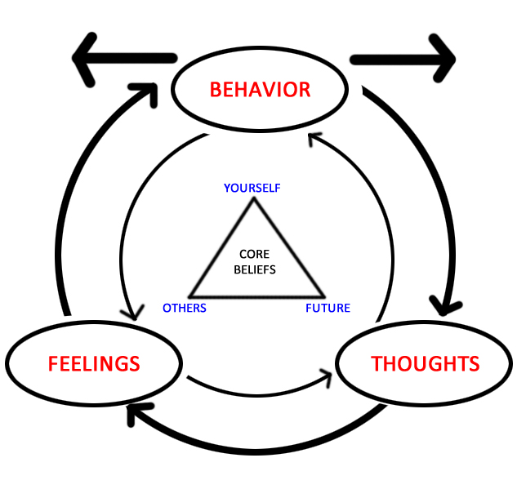
Cognitive Behavioral Therpay

Slide 51
Operant Conditioning

Slide 52
Chronic Low Back Pain (CLBP)

Slide 53
Low Back Pain
The lifetime prevalence of LBP ranges between 60% and 85%
LBP is the fifth most common reason for visits to primary care providers
The single most common reason that U.S. adults use CAM
Manipulation, massage, acupuncture, and mind-body approaches such as yoga are frequently used
Most episodes resolve within 6 weeks, regardless of treatment given
Recurrence rates are high (20% to 35%)
Approximately 5% to 20% of patients will go on to develop chronic LBP (CLBP).

Slide 54
Prevention of CLBP
Education: Most not progressive; will not disable
Maintain physical activity
Lift Properly: Bend knees, back straight
Take regular 5-minute breaks from sitting/standing
Strengthen trunk (core)
Walk regularly (30 minutes most days)
Regular stretching or yoga routine
Healthy body weight
Notes:
Tekur and collegues (2012)performed a seven day randomized control single blind active study in an residential Holistic Health Centre in Bangalore, India (N=80 patients (37 female, 43 male) This Seven day intensive residential Yoga program reduces pain, anxiety, and depression, and improves spinal mobility in patients with CLBP more effectively than physiotherapy exercises. Copyright © 2012 by Elsevier Inc.

Slide 55
Low Back Pain: Causes
Definitive pathoanatomic cause of [Acute and Chronic] LBP can be identified only in approximately 15% of cases
Definitive causes include disk herniation with suspected radiculopathy or spinal stenosis (5%), osteoporotic compression fracture (4%), and inflammatory arthropathies (3%), cancer and infection (1%), cauda equina syndrome (less than 1%) and visceral disorders (less than 2%) such as aortic aneurysm and pelvic, gastrointestinal, and renal disease

Slide 56
Low Back Pain
Nonspecific back pain may emanate from ligaments, facet joints, muscle, fascia, nerve roots, the vertebral periosteum, or the outer portion of the disk
Precise identification of a specific diagnosis is not necessary to manage LBP patients effectively

Slide 57
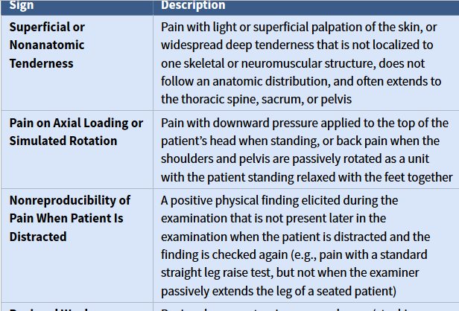
Waddell’s Nonorganic Signs*
Note. Adapted from Chou R, Shekelle P. Will this patient develop persistent disabling low back pain? JAMA. 2010;303:1295–1302.

Slide 58
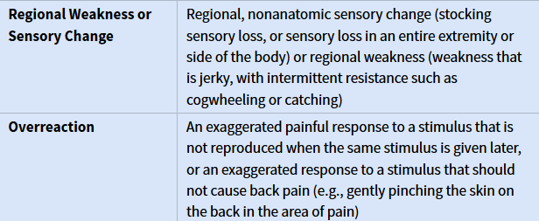
Waddell’s Nonorganic Signs*

Slide 59
Evaluation of LBP
Current Complaint and History
Pattern and nature of any lower extremity symptoms
Presence of significant neurologic deficits, gait abnormalities, or bowel or bladder dysfunction.
History of trauma, immunosuppression, constitutional symptoms, substance use, comorbidities, and previous history of back troubles including spinal surgery
Postures or spinal loading strategies (e.g., flexion, extension) that aggravate or palliate the patient’s symptoms

Slide 60
Evaluation of LBP
Physical Exam
Back inspection, palpation, range-of-motion testing, orthopedic maneuvers, and a comprehensive neurologic evaluation
Observe for antalgic posture, the Gower sign (using hands to “walk” up the thighs from a flexed position because of proximal leg weakness), or reverse lumbopelvic rhythm (bending knees to return from flexed position)
Range-of-motion testing, especially repetitive flexion and extension: repetitive movements that centralize the pain or cause it to move from a more peripheral location (e.g., buttocks) to a more central location (midline of the lumbar spine)
Notes:
Antalgic: posture or gait assumed to lessen pain

Slide 61
Evaluation of LBP
Physical Exam
Orthopedic tests such as the straight leg raise and slump test (the seated Lasègue test) may be useful in identifying nerve root tension
The neurologic examination should focus on the L4, L5, and S1 myotomes (heel and toe walking), dermatomes (light touch or pin prick sensation), and deep tendon reflexes (knee and ankle)
Notes:
s orthopedic consultant to a disability-evaluation agency, I analyze medical reports from physicians, specialists, and generalists throughout the country. The Lasègue test is commonly used in the physical examination of patients with low back impairments. It is evident that the method of performance of this diagnostic maneuver varies with the physician.Reference to the original literature revealed the following facts.The Lasègue test consists of two maneuvers. First, a passive straight-leg-raising test is carried out (Fig 1). Then as the second, and "verification" maneuver, the leg is again raised (jack-knifed) but with the knee flexed (Fig 2). Whereas the first maneuver will produce back and/or leg pain in the presence of low back pathology, the second maneuver can be carried out without the production of pain.A positive Lasègue sign therefore consists of (1) the production of an anatomically proper pain on straight-leg raising and (2) absence

Slide 62
Evaluation of CLBP

Slide 63
Care and Treatment of LBP
Education and Self-Care
Stay active and carry on as normally as possible
Staying active may “hurt” but will not cause “harm”
Perform physical activities in manageable, graded stages
Track your own functional progress, and do more each day

Slide 64
Care and Treatment of CLBP
Mind-Body Therapies
Behavioral Therapies
CBT
Operant Conditioning (carrot and stick)
Yoga
Hatha, Vinyasa, Iyengar, Kripalu, Anusara. Others
Instructors should have experience working with patients with chronic pain
Multidisciplinary Functional Restoration Programs
Physicians, exercise instructors, physical and occupational therapists, and mental health professionals

Slide 65
Yoga

Slide 66
Care and Treatment of CLBP
First Line Pharmaceuticals
Acetaminophen 500 mg tabs i-ii po 2-4 x per day AND/OR
Ibuprofen 400-800 mgs po TID OR
Naproxen 375-500 po BID
Second Line Pharmaceuticals
Weak opioids
Codeine 15 to 30 mg up to 4 x per day OR
hydrocodone 5 to 10 mg up to 4 x per day OR
tramadol 50 to 100 mg up to 4 x per day

Slide 67
Care and Treatment of CLBP
Muscle Relaxants
Benzodiazepines
Non benzodiazepines
Tricyclic Antidepressants

Slide 68
Care and Treatment for CLBP
Botanicals and supplements
Devil’s Claw
Devil’s claw (Harpagophytum procumbens)belongs to the Pedaliaceae family and is also known as grapple plant, wood spider, and harpago.
A Cochrane Review found two high-quality trials that examined the analgesic effects of devil’s claw for back pain and showed strong evidence that this botanical was better than placebo for short-term improvements in pain.
Daily use of 2400 mg, divided three times per day and ingested by tablet or capsule standardized to 2% harpagosides and 3% total iridoid glycosides, is recommended.
Devil’s claw extract may inhibit certain cytochrome P-450 enzymes; caution with statins, imidazoles, protease inhibitors, and warfarin

Slide 69
Devil’s Claw
Capsules
Seed Pods

Slide 70
Care and Treatment for CLBP
Botanicals and supplements
Willow Bark
Willow bark comes from white willow or European willow (Salix alba) and purple willow (Salix purpurea).
Willow bark contains salicylates and is the botanical precursor to aspirin. Willow bark has been shown to be better than placebo for short-term improvements in pain.
Dosage
The three routes of administration of willow bark are tea, capsule, and tincture. Willow bark containing 240 mg of salicin taken once daily is recommended.
Precautions
Willow bark should be avoided in patients who are allergic or sensitive to salicylates.
Willow bark can cause dyspepsia
Concomitant use of willow bark and anticoagulants and antiplatelet drugs should be avoided.⁼

Slide 71
Willow’s Bark
White Willow Tree
Willow’s Bark Tinctture
Notes:
Capsicum

Slide 72
Spinal Manipulation
High-velocity, low-amplitude forces to the joints of the spine through long or short levers.
Spinal manipulation is primarily performed by chiropractors, but it also can be provided by osteopaths, physical therapists, and physicians.

Slide 73
Patients with LBP most likely to respond to manipulation
Duration of current episode less than 16 days
Extremity symptoms not distal to the knee
Low fear avoidance
Palpation of one or more hypomobile lumbar segments
One or both hips with internal rotation range of motion greater than 35 degrees

Slide 74
Nonthrust Manual Therapies
Nonthrust manual therapies encompass various techniques directed at the joints and soft tissues
Techniques include mobilization, muscle energy techniques, myofascial release, strain and counterstrain and craniosacral therapy
Procedures use both active and passive movements and are distinct from spinal manipulation in that high-velocity, low-amplitude forces are not used
Nonthrust manual therapies are primarily performed by osteopaths, but they are also commonly delivered by physical therapists and chiropractors
Massage therapists may be trained to perform craniosacral therapy

Slide 75
Exercise
Major clinical practice guidelines recommend that exercise therapy be offered according to patients’ preferences
Individually designed, supervised, high-intensity programs are recommended
Adverse events associated with back exercise programs are rare
Usually designed by physical therapists, but may be designed by physicians

Slide 76
Massage
Massage produces similar improvement in pain and function as exercise therapy
Provides better short-term outcomes compared with mobilization, relaxation therapy, physical therapy, acupuncture, and self-care education
Acupressure massage (gently pressing specific points) produces better results than Swedish massage
Work with a licensed massage therapist

Slide 77
Bioenergetic Modalities
Acupuncture is considered more effective than no treatment at all
Acupuncture may achieve its effects by three proposed mechanisms:
(1) release of endorphins and other neurotransmitters as a result of nervous system stimulation
(2) the gate control theory of pain
(3) stimulation of vascular and immunomodulatory mediators of inflammation

Slide 78
References
Agins, A. (2011). ADA quick guide to drug-supplement interactions. USA: American Dietetic Association.
Amsterdam, J.D., Shulta, J., Soeller, I., Mao, J.J., Rockwell, K., & Newberg, A.B. (2012). Chamomile (Matricaria recitita) may have antidepressnat activity in anxious depressed humans – An exploratory study. Alternative Therapy Health Medicine, 18(5), pp. 44-49.
Bio-Medicine (2013). Allopathic medicine. Retrieved from http://www.bio-medicine.org/medicine-definition/Allopathic_medicine/#_note-tcmd/
sse WR, Juretzek W, Koch E. Hawthorn (Crataegus). In: Coates P, Blackman M, Cragg G, et al., eds. Encyclopedia of Dietary Supplements. New York, NY: Marcel Dekker; 2005:337–347.
Faqs.org (2014). Erasistratus Biography (304 B.C.-250 B.C.). Retrieved from http://www.faqs.org/health/bios/12/Erasistratus.html

Slide 79
References
Natural Medicines Comprehensive Database Web site (2003). Natural Medicines. Retrieved from www.naturaldatabase.com on July 23, 2009.
Meadows, C. (2015). Taking charge of your health & wellbeing. University of Minnesota. Retrieved from http://www.takingcharge.csh.umn.edu/explore-healing-practices/aromatherapy/what-does-research-say-about-essential-oils
Rakel, D. (2012). Integrative medicine (3rd Ed.). Philadelphia: Elsevier Saunders.

Slide 80
Questions

