Slide 1
Women and Integrative Healthcare
Focus on Hormone Replacement

Slide 2
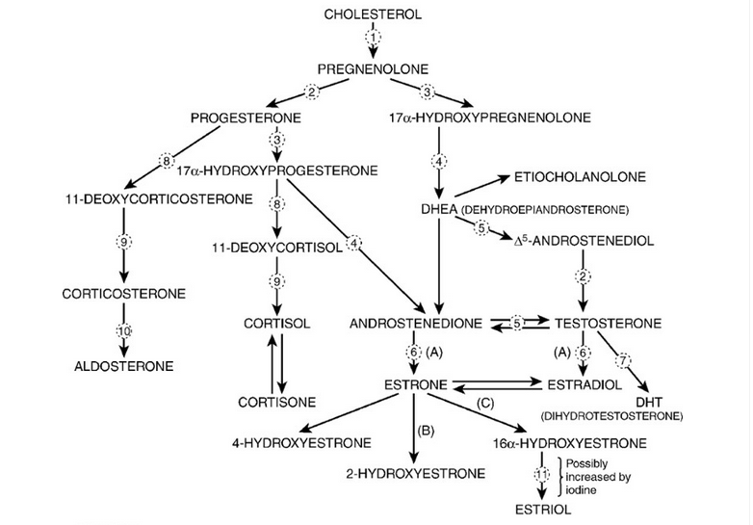
Steroid Hormone Metabolism
E1 = Estrone
E2 = Estradiol
E3 = Estriol

Slide 3
Estrogen Metabolism
Two major competing pathways:
2-Hydroxyestrone (“The good estrogen”; cancer blocking properties)
16-Hydroxyestrone (More stimulatory effect, associated with increased risk of cancer; decreases risk of osteoporosis)
Ratio of 2-Hydroxyestrone to 16-Hydroxyestrone very important in cancer prevention (ideally > 4)
One minor pathway:
4-Hydroxyestrone (may enhance cancer risk; high in women deficient in folic acid and in women with uterine fibroids)
Notes:
E1 = Estrone
E2 = Estradiol
E3 = Estriol

Slide 4
Perimenopause and Menopause
Hormonal dysfunction can occur at any age.
Menopause is defined as no menstrual cycle for 12 months.
If a woman’s hormones are out of balance, symptoms may begin many years before menopause.
The symptoms of both perimenopause and menopause are similar (Box 35-1).
The normal age for a woman to go through menopause ranges from 35 to 55 years.

Slide 5
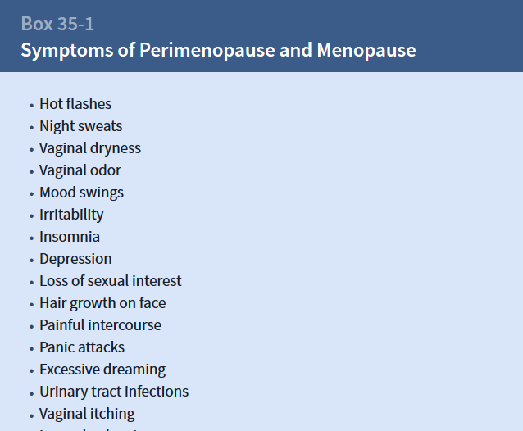

Slide 6
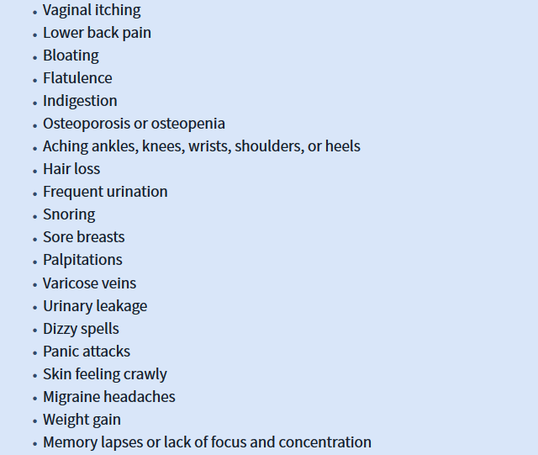

Slide 7
Premature Ovarian Failure
Premature ovarian failure is defined as the ovaries stop producing an adequate amount of sex hormones before the age of 35 years. Causes for premature ovarian failure may be found in Box 35 – 1.e.

Slide 9
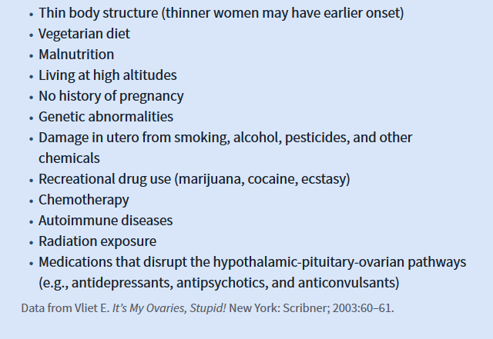

Slide 10
Estrogen
Estrogen has 400 crucial functions in the body (Box 35-2).
The body has receptor sites for estrogen in many locations: brain, muscles, bone, bladder, gut, uterus, ovaries, vagina, breast, eyes, heart, lungs, and blood vessels (Box 35-2e)

Slide 12
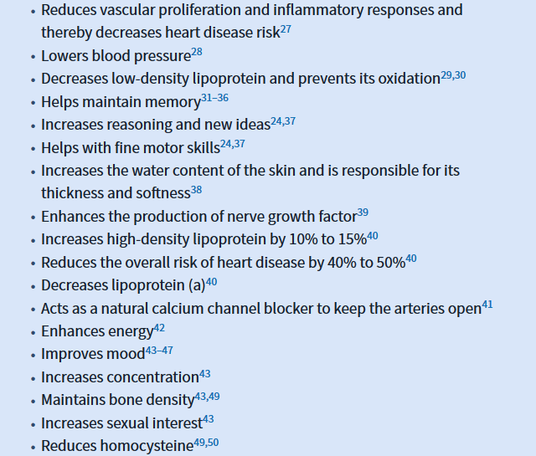

Slide 13
Estrogen: The “pretty” hormone

Slide 14
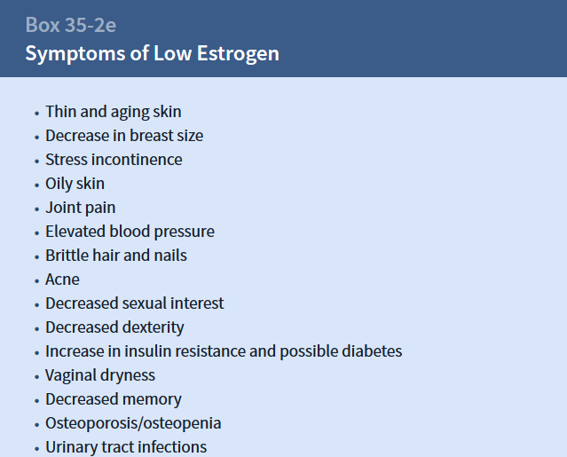

Slide 15
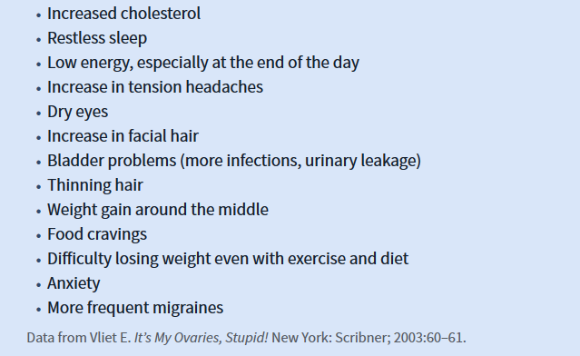

Slide 16
Estrogen
The patient can have excess estrogen levels in the body in relation to progesterone. This condition is called estrogen dominance.

Slide 18
Progesterone
Progesterone is made in the ovaries before menopause. After menopause, some progesterone is made in the adrenal glands (Boxes 35-5 & 35-4e).

Slide 19
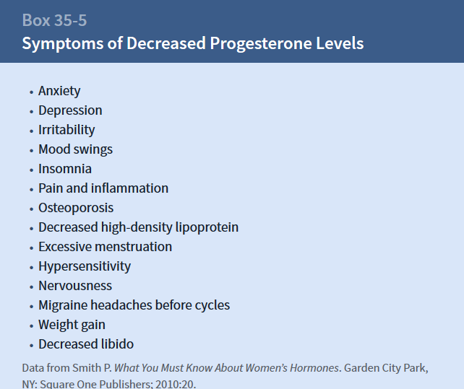

Slide 20
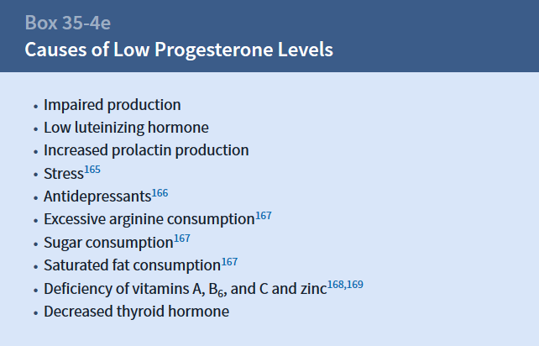

Slide 21
Progesterone
Natural progesterone is biologically identical to what the patient’s own body produces. Progesterone (bio-identical) does not share the same risk seen with progestins (Box 35-6).^{67,164,187,188,194–217}

Slide 22
Progestin
Synthetic progesterone, called progestin:
Does not have the same chemical structure as natural progesterone.
Do not reproduce the actions of natural progesterone.¹⁷⁰
Have been shown to increase the risk of breast cancer by as much as 800% as compared with the use of estrogen alone.^{190–193}
The risk of breast cancer has been predicted to rise by nearly 80% after 10 years of use of estrogen-progestin HRT and 160% after 20 years.¹⁹²
Can lead to serious cardiac side effects in patients, including shortness of breath, fatigue, chest pain, and high blood pressure.¹⁷⁷

Slide 23
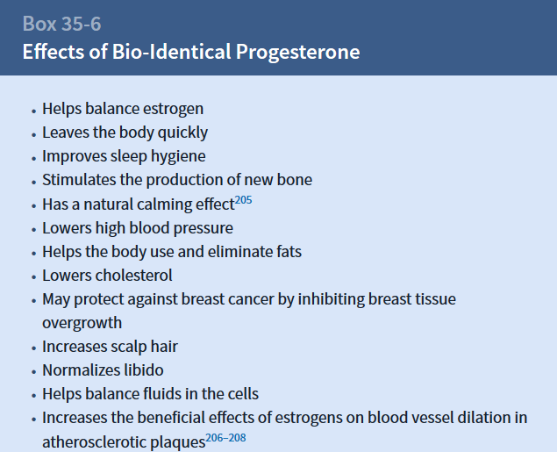

Slide 24
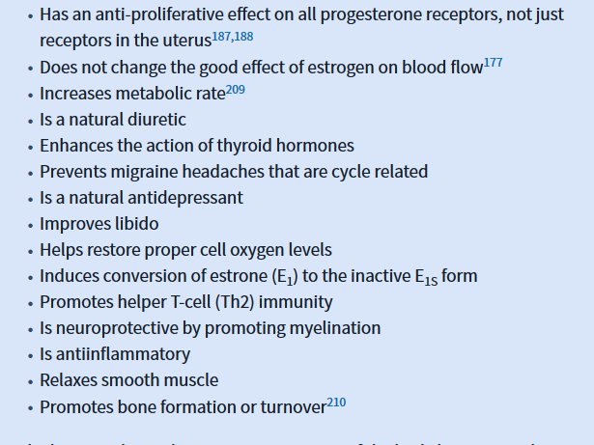

Slide 25
Progesterone
The hormonal symphony is very important. If the body has too much synthetic or natural progesterone, then some of the following effects can occur^{206,211,212}:
Progesterone is sometimes called the “witchy hormone” due to these side effects

Slide 26
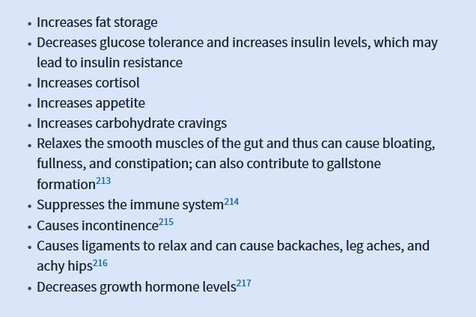

Slide 27
Estrogen-to-Progesterone Ratio
The risk of breast cancer is increased when estrogen metabolism favors the 16-hydroxyestrone or 4-hydroxyestrone pathway.
Patients with a low progesterone-to-estrogen ratio, otherwise known as estrogen dominance, also have a higher risk of breast cancer.²²³

Slide 28
Progesterone-to-Estrogen Ratio
A progesterone-to-estrogen ratio that is too high in progesterone breaks down protein and muscle tissue.²²⁶
This process may worsen symptoms of diseases such as fibromyalgia.

Slide 29
Estrogen-to-Progesterone Ratio
Progesterone and E₂ (estrogen) work together in the body.
E₂ lowers body fat by decreasing lipoprotein lipase.
Progesterone increases body fat storage by increasing lipoprotein lipase.²²⁴
Estrogen and progesterone work together to control the body’s release of insulin.
Women with diabetes must be prescribed the smallest amount of progesterone that will balance E₂.²²⁵
E₂ increases insulin sensitivity and improves glucose tolerance, whereas excess progesterone decreases insulin sensitivity.
Notes:
E1 = Estrone
E2 = Estradiol
E3 = Estriol

Slide 30
Prolonged use of progesterone without adequate estrogen can have the following effects:
Increased weight gain
Increased total cholesterol
Decreased HDL
Increased LDL
Increased triglycerides
Increased risk of developing insulin resistance
Depression
Fatigue
Decreased libido

Slide 31
Testosterone
Testosterone is made in the adrenal glands and ovaries.
As women age, their ovaries produce less testosterone.
Of testosterone women produce, 1% is unbound, and the remainder is bound to sex hormone–binding globulin.
Women with increased androgens have more free testosterone available for the body to use. Therefore, measuring hormone levels is important (Box 35-7 ).^{227–233}

Slide 33
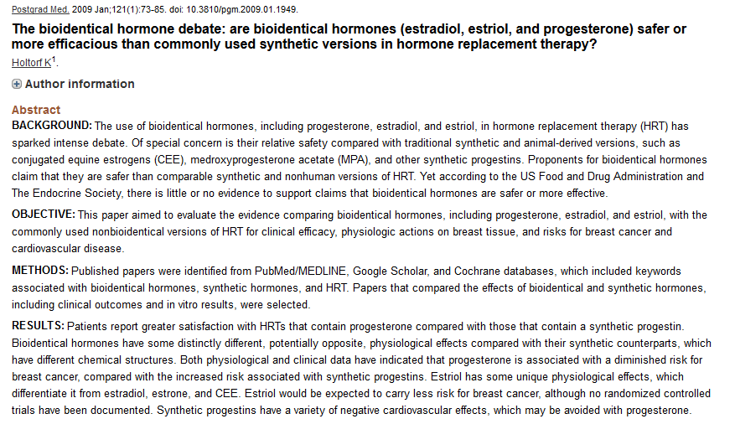

Slide 34
Conclusion

Slide 35
Evidence-Based Therapies
See next slide!
Refer to page 343 of text book, Integrative Medicine (3rd Edition)

Slide 36
What can elevate 2-hydroxyestrone levels (good estrogen)?
Cruciferous vegetables^{105,126–135}
Flax^{136,137}
Soy¹³⁸
Kudzu (source of isoflavones)
Rosemary
Turmeric
Exercise
Weight loss
Broccoli derivatives^{130,139–146}
High-protein diet¹⁴⁷
Omega-3 fatty acids^{101,108,148}
Vitamins B₆ and B₁₂ and folate^{149,150}

Slide 37
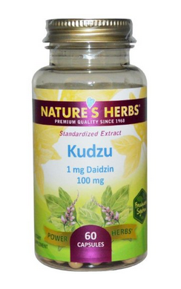
Kudzu
Common Name Kudzu
Botanical Name Pueraria lobata
Family FABACEAE
Kudzu has spread across millions of acres of the southwestern United States where it was imported from it's native Japan to protect against erosion.
Kudzu is a climbing, woody or semi-woody, perennial vine, that seems to swallow everything it comes in contact with.
Used mainly today as a starch thickener in prepared foods, recently it has been found to hold some very promising medicinal properties. (the dried root)

Slide 38
Children and Integrative Healthcare
Photo by Bryan Ewsichek at https://nccih.nih.gov/health/children

Slide 40
