Slide 1
Vista Unified School District Meaningful Algebra
Brian R. Lawler, Ph.D.
spring 2013

Slide 2
Meaningful Algebra
Some Educational Principles
Knowledge is not passively received, rather must be actively built upon and connected to current ways of knowing
What does this imply for teaching mathematics?
People learn mathematics by thinking and interacting
What does this imply for teaching mathematics?
Notes:
Doing-Undoing --- REVERSIBILITY
Building Rules --- RECOGNIZE PATTERNS to define how OUT depends on IN by well-defined functional rules
Abstracting from Computation --- THINK about COMPUTATIONS INDEPENDENTLY of PARTICULAR NUMBERS used

Slide 3
Meaningful Algebra
Workshop Goals
Enhance repertoire for mathematics teaching strategies.
Shift from teaching as explain to teaching as educe
Consider the difference between thinking about How to Teach Algebra vs. How to Develop Algebraic Thinking
What is Algebraic Thinking?
Notes:
Doing-Undoing --- REVERSIBILITY
Building Rules --- RECOGNIZE PATTERNS to define how OUT depends on IN by well-defined functional rules
Abstracting from Computation --- THINK about COMPUTATIONS INDEPENDENTLY of PARTICULAR NUMBERS used

Slide 4
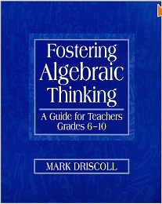
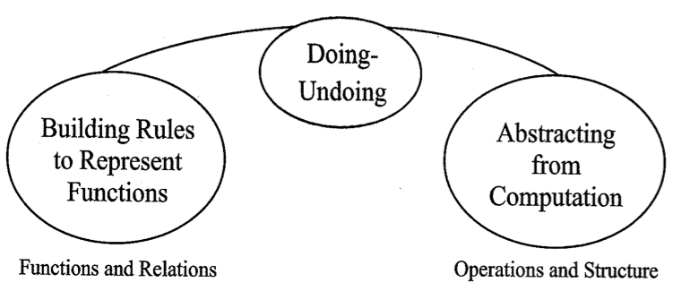
Fostering Algebraic Thinking
Algebraic Thinking
being able to think about functions and how they work
the impact that a system’s structure has on calculations.
Algebraic Habits of Mind
doing-undoing
building rules to represent functions
abstracting from computation
Notes:
Doing-Undoing --- REVERSIBILITY
Building Rules --- RECOGNIZE PATTERNS to define how OUT depends on IN by well-defined functional rules
Abstracting from Computation --- THINK about COMPUTATIONS INDEPENDENTLY of PARTICULAR NUMBERS used

Slide 5
GUIDING QUESTIONS
Doing & Undoing Building Rules Abstracting Computation
How is this number in the sequence related to the one that came before?
What if I start at the end?
Which process reverses the one I am using?
Can I decompose this number or expression into helpful components?
Is there a rule or relationship here?
How does the rule work, and how is it helpful?
Why does the rule work the way it does?
How are things changing?
Is there information here that lets me predict what’s going to happen?
Does my rule work for all cases?
What steps am I doing over and over?
Can I write down a mechanical rule that will do this job once and for all?
How can I describe the steps without using specific inputs?
When I do the same thing with different numbers, what still holds true? What changes?
Now that I have an equation, how do the numbers (parameters) in the equation relate to the problem context?
How is this calculating situation like/unlike that one?
How can I predict what’s going to happen without doing all the calculations?
What are my operation shortcut options for getting from here to there?
When I do the same thing with different umbers, what still holds true? What changes?
What are other ways to write that expression that will bring out hidden meaning?
How can I write the expression in terms of things I care about?
How does this expression behave like that one?
Notes:
Doing-Undoing --- REVERSIBILITY
Building Rules --- RECOGNIZE PATTERNS to define how OUT depends on IN by well-defined functional rules
Abstracting from Computation --- THINK about COMPUTATIONS INDEPENDENTLY of PARTICULAR NUMBERS used

Slide 6
Consecutive Sums
AHOM: Abstract from Computation
Thinks about calculations independently of the particular numbers used
“A sum of five consecutive whole numbers is the same as five times the middle number.”
“No matter where the starting number is, to get the sum of four consecutive numbers, just add 6 on to four times the starting number—like 9 + 10 + 11 + 12 is 4 x 9 + 6.”
Recognizes Equivalence between expressions
“Instead of writing the consecutive numbers 10, 11, 12, and 13, I could write them as 10, 10 + 1, 10 + 2, and 10 + 3.”

Slide 7
Consecutive Sums
AHOM: Doing / Undoing
May occur when the problem solver works the steps of a rule or procedure backward
“34 can be expressed as a sum of four consecutive numbers because it fits the form 4n + 6 with 7 as n. So 7 is the first number of the four consecutive numbers.”

Slide 8
Consecutive Sums
AHOM: Building Rules to Represent Functions
Organizes information in ways useful for uncovering patterns and the rules that define the patterns
Notices a rule at work and tries to predict how it works

Slide 9
Consecutive Sums

Slide 10
TIMSS (1995)
Video Study
James Stigler concludes:
American classrooms focus on How To
Japanese classrooms focus on Understanding

Slide 11
Example
Solve for x
3x + 7 = 22
- 7 - 7
3x = 15
÷ 3 ÷ 3
x = 5
Why do the equations 3x + 7 = 22 and 3x = 15 have the same solution?
What are all the solutions for 3x + 7 as x varies?
Be less helpful.
-Dan Meyer

Slide 12
Teaching Meaningful Algebra
Teaching the “How To” and teaching for “Understanding”
Which first?
Vendlinski (2009) found:
conceptual instruction followed by instruction that integrates both concepts and procedures was the most efficacious in helping students learn to begin writing linear equations.
data suggested concepts should be introduced before procedures and that, instead of introducing procedures with formal instruction, students should be encouraged to arrive at procedures to improve accuracy and speed.
Notes:
“Students taught to write linear equations conceptually, with instruction based on intuition and instruction that attempted to relate mathematical operations to their real world meaning, were significantly more able to write linear equations of a direct variation than were their counterparts taught with a more procedural method.”

