Slide 1
Communication Skills Building:
Active Listening & Interviews
Global Tourism & Communication
Day 1

Slide 2
Agenda
Warm-Up: Active Listening Examples
Communicating & Active Listening
Elements of Listening
Empathy & Interest
Responding
Clarifying
Talk Show Interview
Mini-Activity
After this class you will be able to:
Utilize principles of active listening
Interview a classmate and share what you learned
Notes:
50 minutes
Warm-Up: 15’
Slides 4-6 Listening 5
Slides 7-8 Empathy 3
Slides 9-12 Responding 7
Slides 13-15 (Optional) 5
Interview example + Assignment: 15

Slide 3
Introductions
Introduce yourself to classmates.
Name
Hobbies
Interests
Future plans
Classmates: Listen carefully to remember, then decide what to share with the class

Slide 4
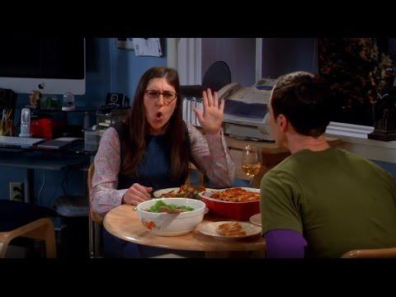
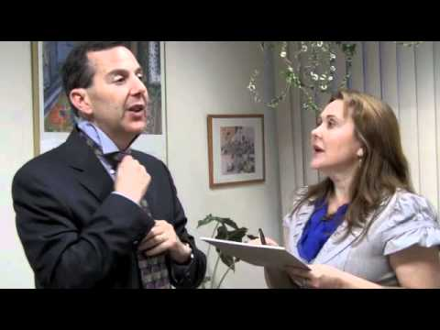
Active Listening Examples
Listen & Discuss: What does active listening look like?
Notes:
Active Listening Video 1: https://www.youtube.com/watch?v=bO-a-Yz4xA8&list=PL6MeBinkeg3t40rTTb8PrFhRfNQ-LABn5&index=2
Active Listening Video 2:
https://www.youtube.com/watch?v=3_dAkDsBQyk

Slide 5
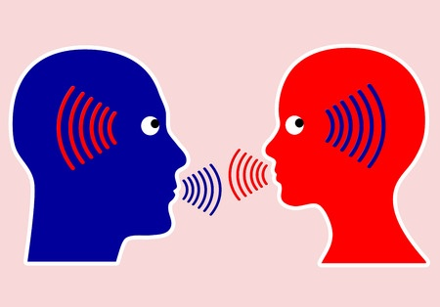
Communicating
How to be an active speaker - Speak up and ask questions
How to be an active listener - Give full attention to speaker
Active listeners should…
Show Empathy & Interest
Listen Carefully
Respond Appropriately
Ask Follow-Up Questions

Slide 6
Active Listening
Here are some tips for better active listening:
Ignore outside noises
Put away distractions
Concentrate
Keep eye contact
Be prepared to paraphrase
Be prepared to offer feedback
Notes:
[Communicating Effectively in English P. 35]
Benefits of active listening:
Learn new things
Understand others better
Change your mind
Understand meaning by observing nonverbal communication
Learn gestures and facial expressions

Slide 7
Show Empathy and Interest
Empathy is understanding and sharing someone else’s feelings
Ways to show empathy & interest:
Facial expressions
Backchanneling (uh-huh, mm-hmmm, okay, yeah, right, yes)
Eye contact
If you don’t do these things, it may seem like you are not interested.
Try it out yourself!

Slide 8
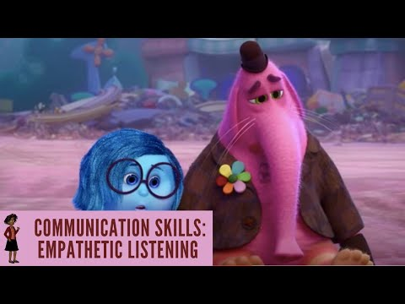
Empathetic Listening Example
What does empathetic listening look like?

Slide 9
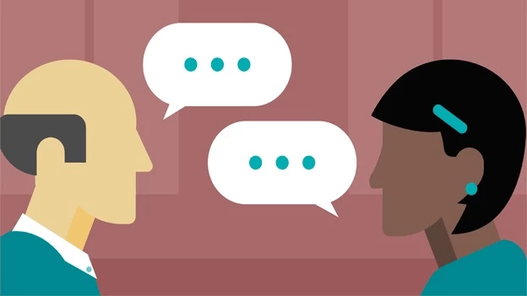
Responding
Active listening also means taking action to show you are listening or to understand. You can…
Ask for additional information
Ask for clarification
Interrupt when necessary
Ask follow up questions

Slide 10
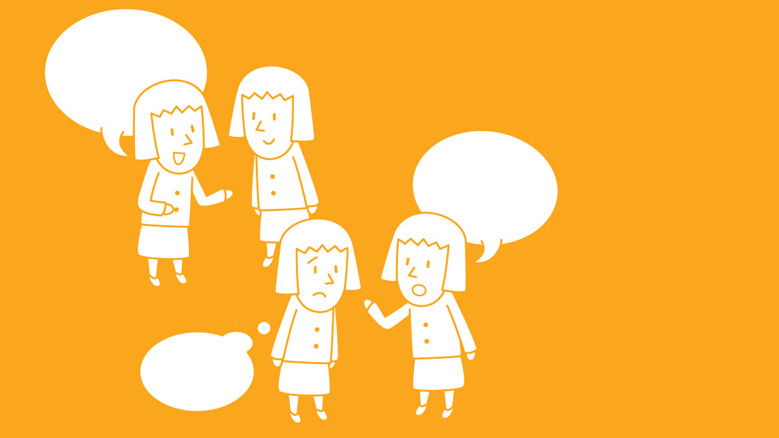
Rejoinders
Do you remember what a rejoinder is?
Rejoinders are short responses to show you are listening
Interest: Oh really?
Happiness: That’s Amazing!
Sadness: That’s too bad.
Surprise: No way!
Agreement: Absolutely!
Not Understanding: Pardon?
There are many more types. Here’s a list of rejoinders in English
Notes:
Rejoinders: http://morksensei.com/rejoinders#:~:text=A%20rejoinder%EF%BC%88%E3%81%82%E3%81%84%E3%81%A5%E3%81%A1%EF%BC%89is,will%20see%20what%20I%20mean
List of Rejoinders (with japanese translation):
http://morksensei.com/the-ultimate-rejoinder-list

Slide 11
Follow-Up Questions
Follow-Up Questions will help keep a conversation going
Repeat what they said as a question:
“I’m excited about my next vacation.”; “You’re excited about your next vacation?”
Ask for more information:
“I want to travel to California.”; “What do you want to see?”
Wh- Questions:
What…? Where…? Why…? When…? Who…? How…?
Notes:
Rejoinders (includes follow up questions): http://morksensei.com/rejoinders#:~:text=A%20rejoinder%EF%BC%88%E3%81%82%E3%81%84%E3%81%A5%E3%81%A1%EF%BC%89is,will%20see%20what%20I%20mean
List of rejoinders (with Japanese translation)
http://morksensei.com/the-ultimate-rejoinder-list

Slide 12
Responding
Improve your active listening by using both response types!
Notes:
https://www.google.com/amp/s/commonsense-esl.com/2017/02/23/esl-conversation-class-if-your-students-only-learn-two-conversational-techniques-these-are-the-two-part-2/amp/

Slide 13
Getting Additional Information
“I think a good visual aid is important when you present.”
Expressions to elicit information:
Could you be more specific?
Could you give me an example? Could you explain what you mean?
Could you add to that?
What are some other questions you can ask to get more information?

Slide 14
Asking for clarification
What can you say if you don’t understand or didn’t hear something?
Pardon me?
Could you say that again please?
Would you mind repeating that?
Sorry, I didn’t get that, could you repeat what you said?
I’m not sure what you mean by ____, could you please explain?
Restate - repeat what they said to make sure you understand “So you’re saying...”; “If I understand you correctly, you’re saying...”
Avoid informal questions like “Huh?” and “What?” They are impolite.

Slide 15
Interrupting
Interrupting is often considered rude, but not always!
When is it okay to interrupt?
When you didn’t understand
When they didn’t answer a question
How can you interrupt a person speaking?
Sorry, could you repeat that?
Sorry to interrupt, but I wanted to ask you more about...
Note: Only a few words of overlapping speech are allowed in English
Notes:
Times it’s okay to interrupt:
if you don’t understand a word or sentence;
if they are not answering or changing the subject;

Slide 16
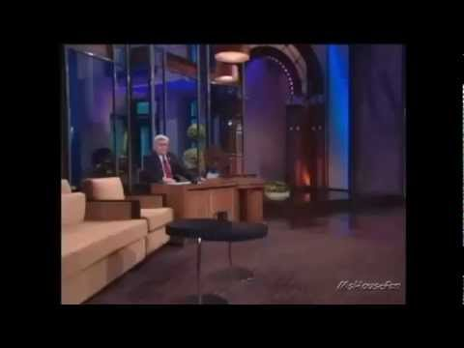
Sample Interview
Have you ever been interviewed?
Have you ever interviewed anyone?
Notes:
NOTE: Play at 75% speed. 5:34-5:43

Slide 17
Recipe for a good interview
Choose a topic
Pick a good person to interview
Prepare appropriate questions
Open Ended Questions:
What are some traditions in your country?
Which customs are still popular today?
Closed Questions:
How old is the president of your country?
Do you like traditional or modern things?
What’s the difference between open and closed questions?
4. Begin with open ended questions
5. Ask additional questions
6. Elicit information
Notes:
https://busyteacher.org/6367-can-we-talk-conducting-and-using-interviews-in.html

Slide 18
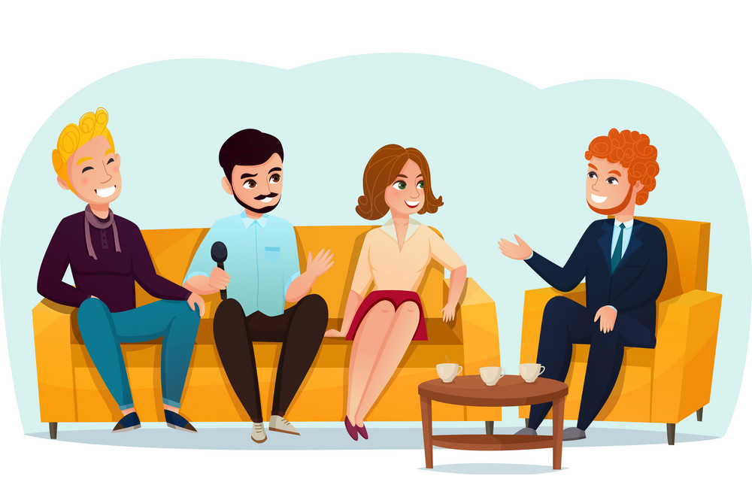
Talk Show Interview
Interview your classmates using active listening and note their thoughts on a topic (pick one per person):
Why they are interested in their field of study
The best advice for giving speaking to large groups
What you need to know about when visiting Japan
The latest news (local, world, etc.)
Share the results with the class

Slide 19
Mini-Activity

