Slide 1
Area Studies: SDG#7 Ideas Forum
Speaking
Notes:
Plan is to talk a bit about presenting as a group
Have them talk about a topic and plan something to share
Can use ‘design a club’ activity

Slide 2
Agenda
Agenda
Homework Review
Refresher: SDG#7
Directions for small groups
Share ideas in small groups & Reply to Posts
Call on students
During this class you will look at your classmates’ ideas for supporting SDG#7: “Clean and Affordable Energy” and share your own ideas
Notes:
Time: 50” 6:15-7:05
Agenda
5” Refresher: SDG#7
5” Directions for small groups
20” Share ideas in small groups & Reply to Posts
15”-20” Call on as many students as possible to *briefly* present
5” Homework Explanation*

Slide 3
HOMEWORK REVIEW
Now you've seen examples of student projects at CSUSM. What project could you do to support SDG#7 over the next 3 months.
1. Post in the forum before class on day 9:
Something you can do to support SDG#7
Try a creative solution
Minimum 100 words
2. Reply to at least two classmates by Friday
3. We will share in groups on day 9
Notes:
5 minutes homework review

Slide 4
UN SUSTAINABLE DEVELOPMENT GOALS
SDG's were developed in 2015 after many years after decades of work
Roadmap for global action for people and planet
The 17 Goals were adopted by all UN Member States as part of the 2030 Agenda for Sustainable Development which set out a 15-year plan to achieve the Goals.

Slide 5
GOALS FOR #7
By 2030, ensure universal access to affordable, reliable and modern energy services
By 2030, increase substantially the share of renewable energy in the global energy mix
By 2030, double the global rate of improvement in energy efficiency
By 2030, enhance international cooperation to facilitate access to clean energy research and technology, including renewable energy, energy efficiency and advanced and cleaner fossil-fuel technology, and promote investment in energy infrastructure and clean energy technology
By 2030, expand infrastructure and upgrade technology for supplying modern and sustainable energy services for all in developing countries, in particular least developed countries, small island developing States, and land-locked developing countries, in accordance with their respective programmes of support

Slide 6
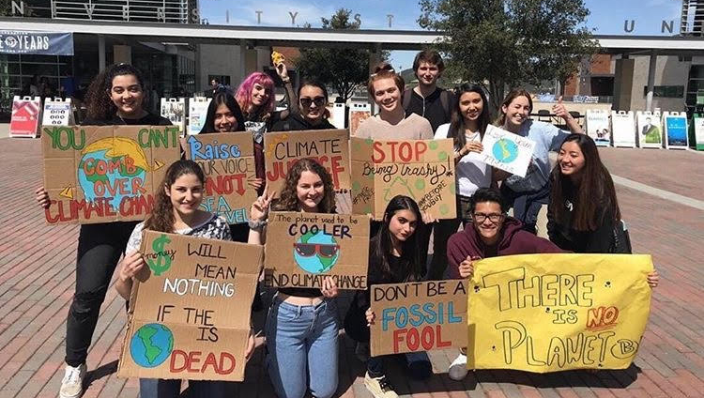
STUDENT INITIATIVE EXAMPLES
- Climate Strikes
- Thrift Shops
- Meetings on Sustainable Practices
- Clean up Days
- Awareness on Environmental Issues
- Social Media Posts
- Taking climate action outside of campus

Slide 7
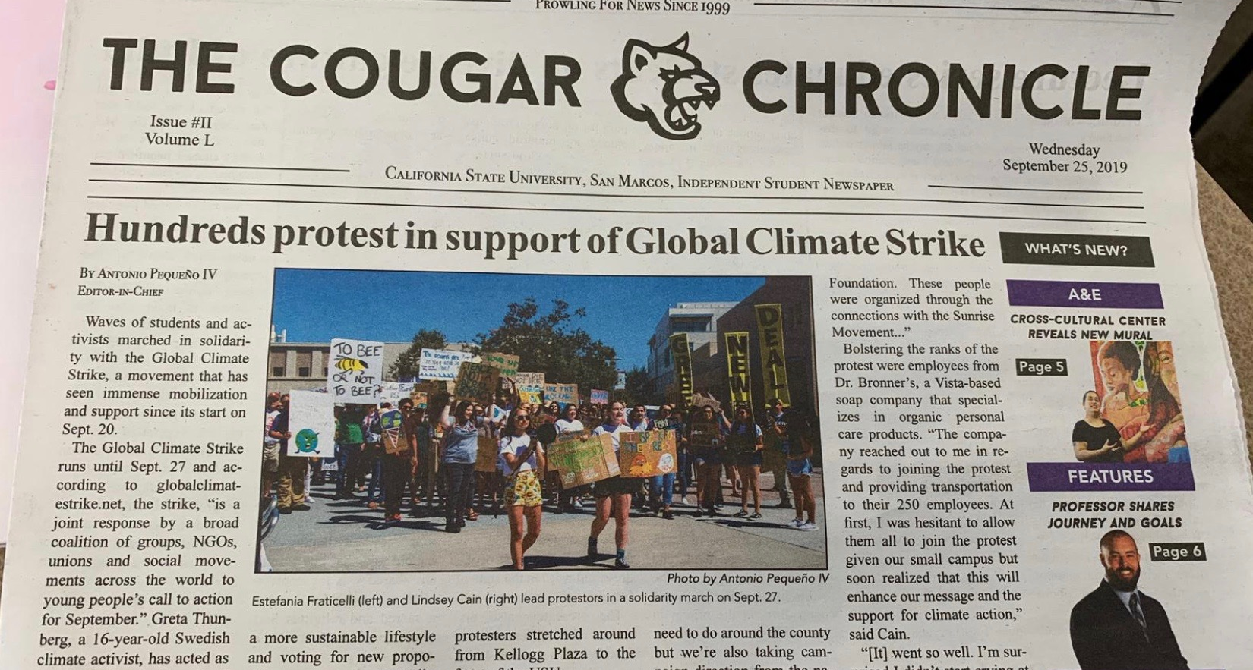
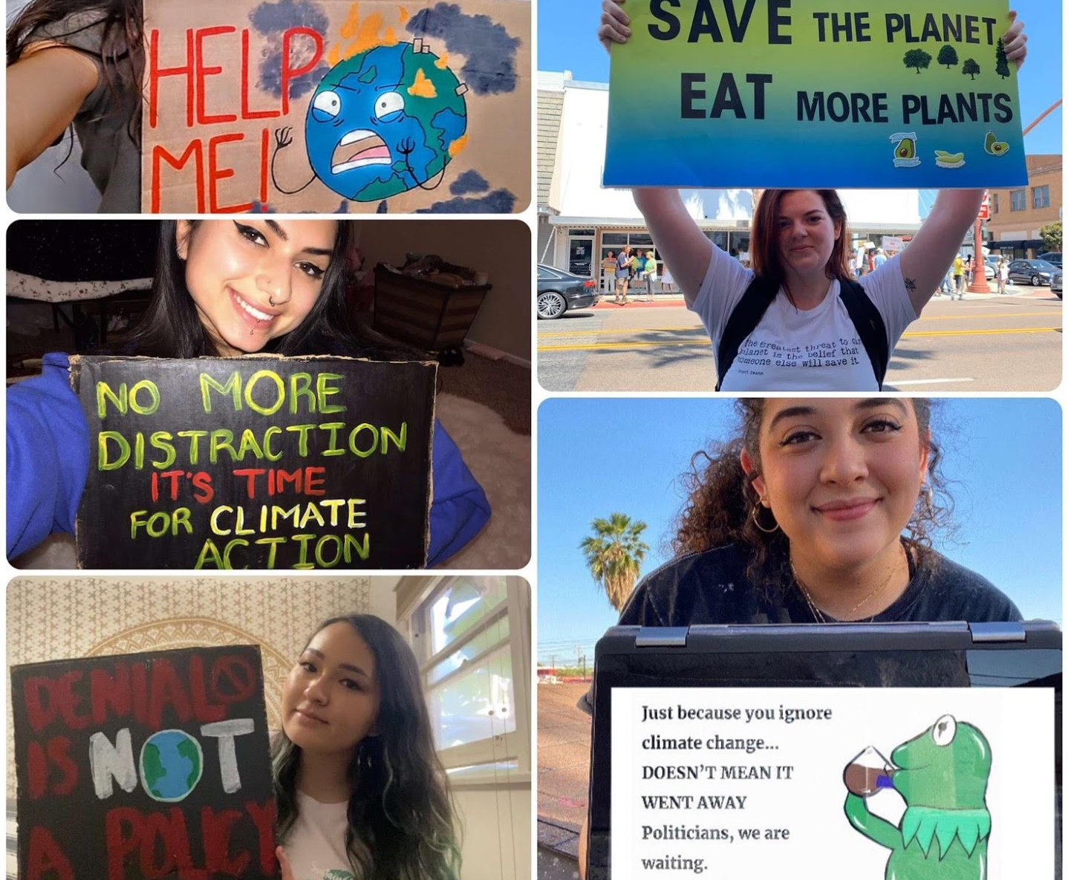
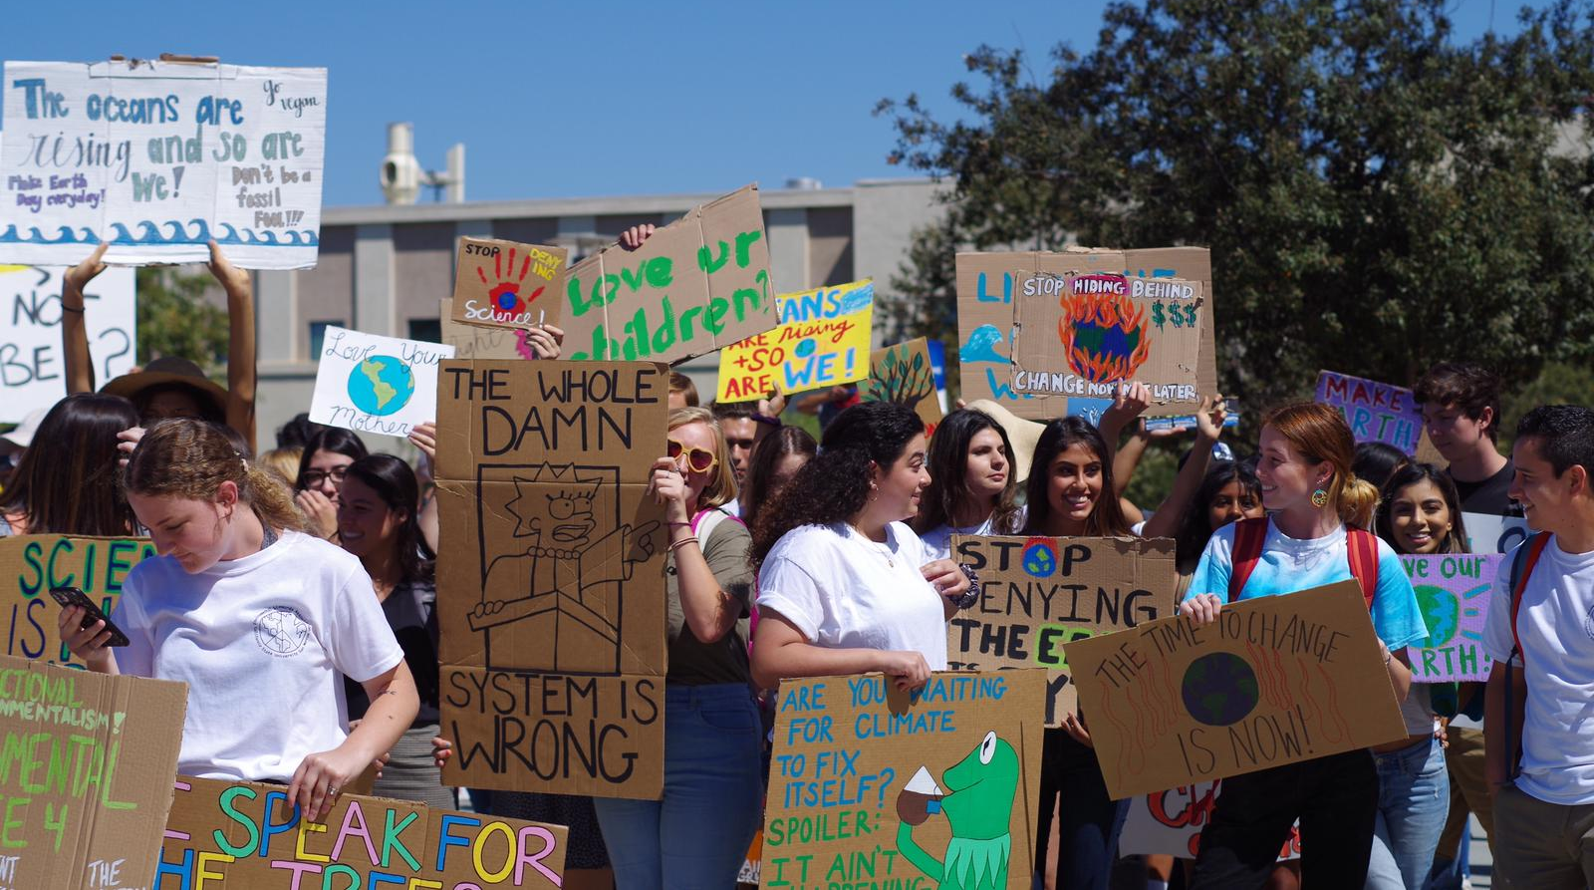
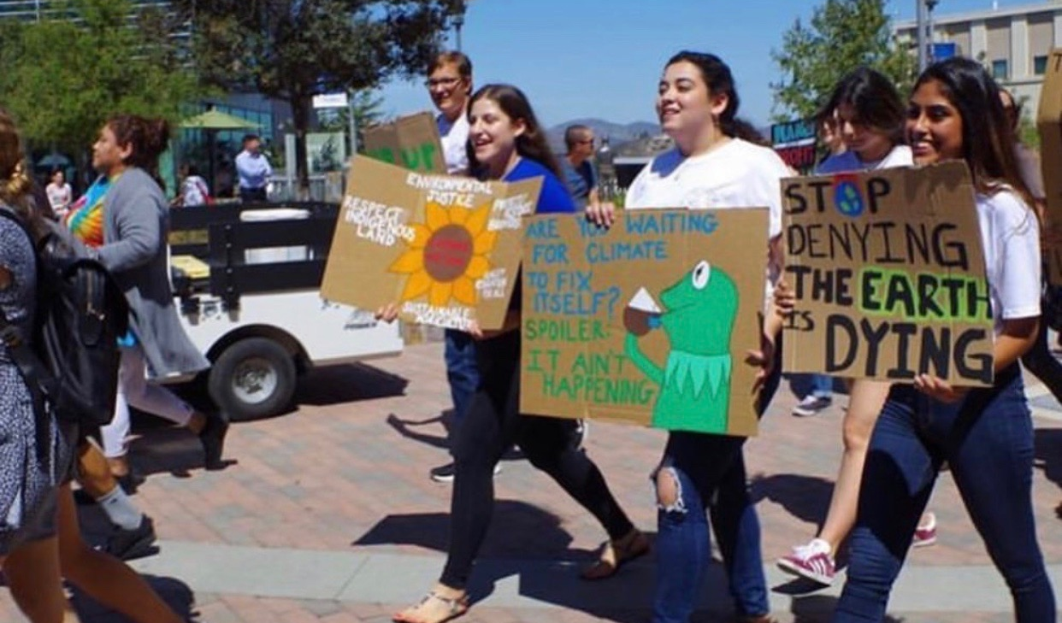

Slide 8
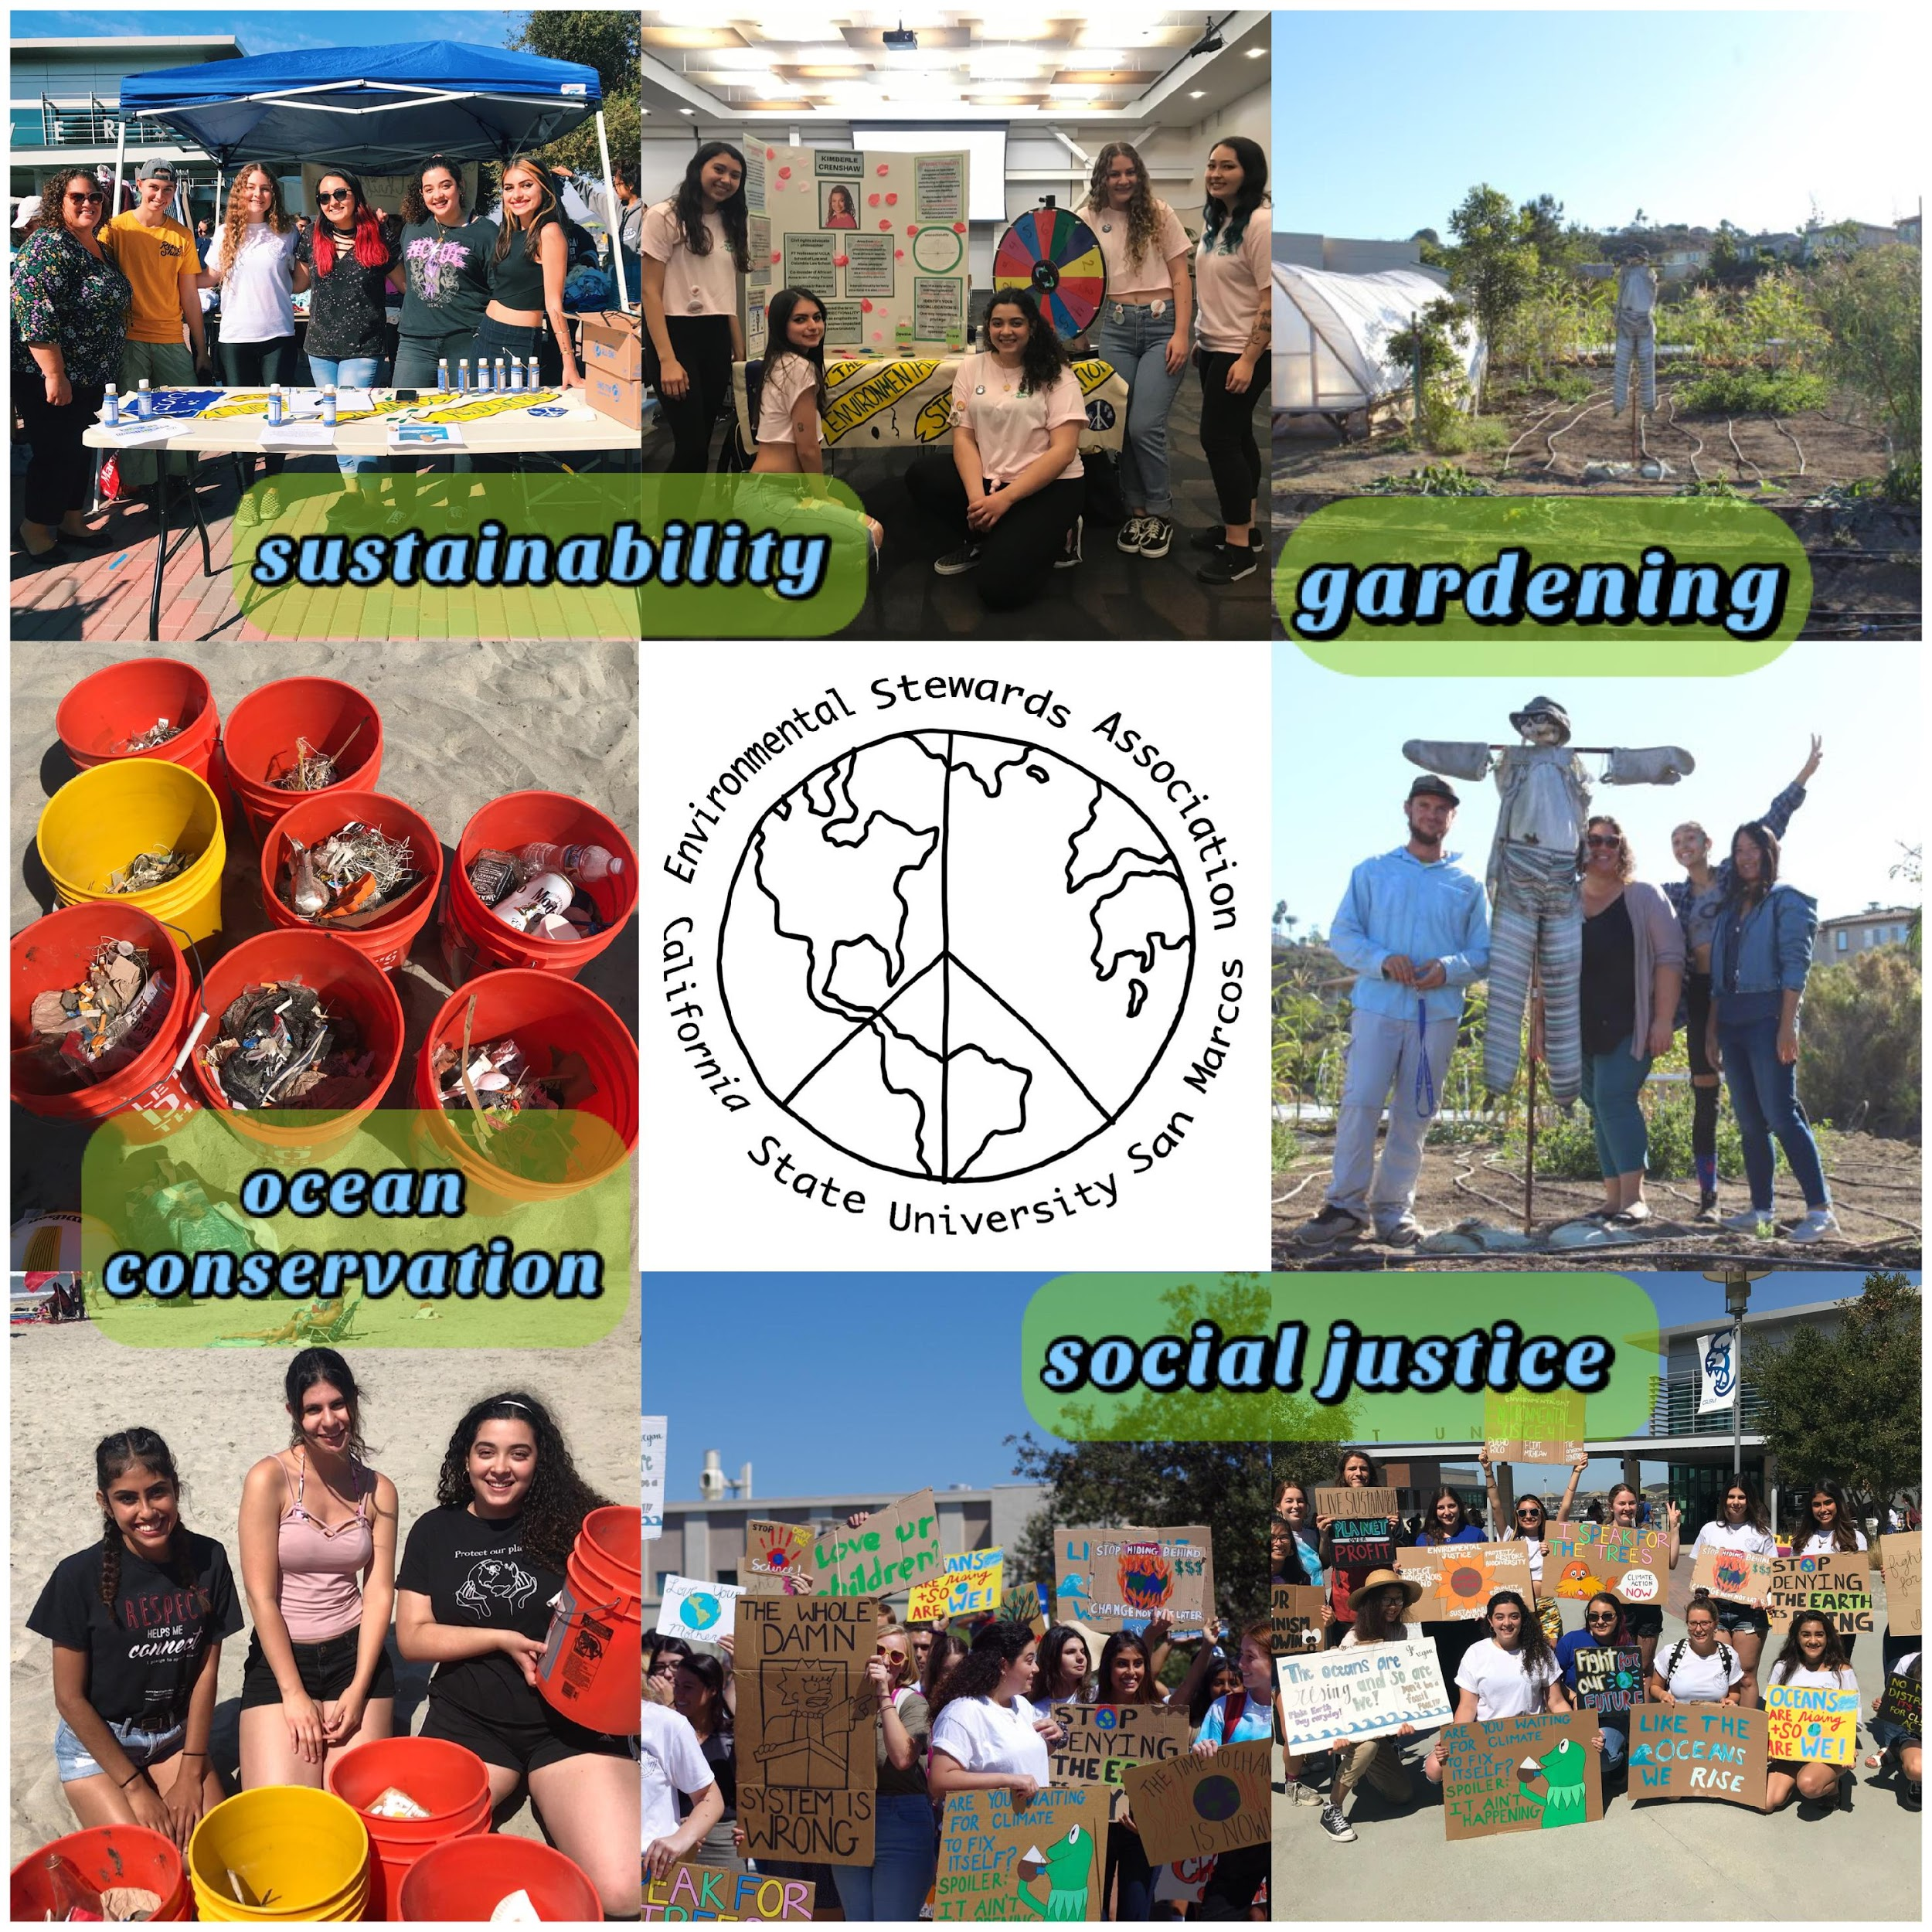

Slide 9
Group Discussion: Our Ideas
Look at the forum and share with your group:
What is your idea?
What questions do you have about other students’ ideas?
Reply to 2 group mates’ posts
Be prepared to share your ideas briefly with the class (1 min max)
Notes:
https://community.csusm.edu/mod/forum/view.php?id=243850
Students must be logged into community courses to access forum

Slide 10
Group Share
Share your idea briefly to the class (no more than one minute)

Slide 11
After you present, let’s reflect…
Do you think it is important for young people to learn about the SDGs? Why?
What are some things you learned from doing the SDG7 Ideas Forum activity?
Of all the 17 SDGs you heard about, which one would you most like to work on in the future?

Slide 12
Don’t forget! Upcoming Certificate Ceremony
Please send 1 photo + short (1-2 sentence) explanation about:
Something new you learned in the program
Something Surprising from the program OR
Something you have experienced during the program and want to do or learn more about
Be prepared to say a few sentences about your image during the ceremony

