Slide 1
Teacher Preparation
CSUSM, Palomar, MiraCosta Pathways

Slide 2
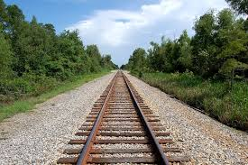
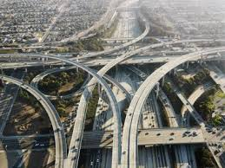
Metaphor for our work
One Track
(aka 19th century)
Multiple Pathways
(aka 20th century)

Slide 3
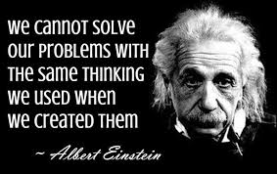

Slide 4
Keep the End in Mind
Preliminary Teaching Credentials Offered at CSUSM
Multiple Subjects (MS)(Elementary)
Single Subject (SS)(Secondary)
Middle Level (MS + SS)
Special Education (MS + Spec. Ed.)

Slide 5
Elementary Teachers Advising Considerations
Can be done in 4 years!
Elementary Teachers are more marketable when they have an added authorization, e.g. bilingual and/or special education.
Early advising for bilingual teacher may include more formal preparation in Spanish.

Slide 6
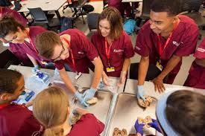
Secondary Teachers Advising Considerations
Can be done in 5 years
Social Studies teachers are not in high demand.
Consider subject matter preparation in more than one area e.g. physics and mathematics, social studies and English.
Math and Science have lots of opportunities for scholarships and grants

Slide 7
Middle Level Advising Considerations
Can be done in 4 years!
Includes a multiple subjects and single subject credential.
Foundational math (ability to teach Alg. I, II and Geometry)
Foundational Science (ability to teach earth, life and physical sciences)
Repeat…Math and Science have lots of opportunities for scholarships and grants

Slide 8
Teacher Shortage Areas
What are some advising strategies to steer prospective teachers to consider these high need areas?
Special Education
Bilingual
Mathematics
Science

Slide 9
Beginning Salaries https://www.indeed.com/salaries, http://city-salaries.careertrends.com/
Special Education Teachers - $61,185
Mathematics Teacher - $55,553
Ambulance Driver - $22,490
Food Service Managers - $55,790
Youth Social Workers - $59,320
Receptionist - $23,000
Law Enforcement - $46,102
Firefighter - $41,156

Slide 10
Report Out
What conversations have you had with colleagues regarding the Teacher Education Pathway we are creating?
As a result of those conversations how aware of the teacher shortage do you think your colleagues are?
How invested is your institution?

Slide 11
As a result of those conversations what issues do we need to address?

Slide 12
What concerns do we need to address?

Slide 13
Goals
Benchmarks
ESM Waiver/P-2
-Degree Planners
-Depth of Studies
Fdn Math
Fdn Science
Bilingual
Spec. Ed.
CC Teacher Education Transfer Agreement
ITEP Organizational Support
Dates

Slide 14
Overview of Current Integrated Credential Program (ICP)
See ITEP Community Moodle:
“Integrated Credential Program (ICP) Curriculum”
Conversion to ITEP
Remove CSET Subtests
Summer school
Clinical practice earlier?
Move to co-requisite model?

Slide 15
New Resources on ITEP Community Moodle
Pending Legislation
Liberal Studies Lower-Division Transfer Pattern
ICP pamphlet
ITEP Community Moodle
http://community.csusm.edu/course/view.php?id=3105

Slide 16
Work Groups by Task
Increased Visibility of Lower Division Transfer Pattern for Liberal Studies
Seats in Classes
Teacher Preparation Information
ESM Waiver
Foundational Math Depth of Studies
Foundational Science Depth of Studies
Bilingual Preparation (Spanish Depth of Studies?)
Special Education, Bilingual Degree Planners
Overall ITEP Degree Planner
Recruitment Pipeline

Slide 17
Conversations with our Colleagues
What updates, new information, ideas do you need to share with your colleagues?
What questions do you need to ask?
Who do you need to talk to that you haven’t talked to yet?

Slide 18
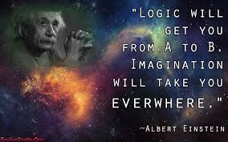
As we continue building the teacher pathways reviewing curriculum, let’s do so with a 21st Century Mindset

Slide 19
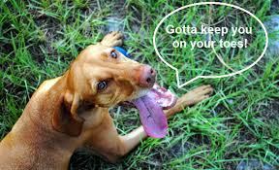
Next meeting
February 16, 2017
9:30-12:00
SBSB 3219
Note that this
Is different
Room!

