Slide 1
Case Presentation: The Integrative Care of a Patient with lower back pain
Phoebe Cinco
11/26/18

Slide 2
Objectives
After attending this case presentation, participants will be able to:
Explain the pathophysiology of chronic muscular back pain
Describe the Epidemiology of chronic muscular back pain
Identify the risk factor of chronic muscular back pain
Evaluate evidence-based CAM into the plan of care for patient diagnosed with chronic back pain
Analyze a case presentation of a 34 years old female diagnosed with chronic back pain.

Slide 3
Patient
A 34 year old Hispanic female c/o chronic back pain x5 years.
HPI:
She is c/o lower back pain for approximately 5 years. Her back pain was a slow onset but is progressively getting worst. Aggravating factors are sitting for a long period of time and bad posture. At night pain is worst. Alleviating factors are when she moves around and moderate relief with NSAIDs. She is a nurse. Her occupation requires a lot of bending over, lifting, and pushing to perform task. She work a 12 hour shift. Pain worsening at the end of her shift. She denies of injuries or trauma.

Slide 4
History: Alleriges: NKDA, no food or environmental allergies
Medical Hx: allergic rhinitis, chronic low back pain
Surgical Hx: none
OB: G0, LMP, 11/03/2018
Family Hx: Father unknown hx of father’s side
Mother: HTN
Siblings none
Medications:
She has attempted tylenol 1000 mg as needed alternating with Ibuprofen 600mg as needed
CAM:
-She has tried and currently using belt back support, warm packs, massage, gel patches, TENS
-She is exercising x2 a week
-She is currently under care of chiropractic treatment

Slide 5
ROS
Constitutional: Denies: fever, night sweats, significant weight gain or weight loss exercise intolerance, malaise, chills.
Neurologic/Head: Denies loss of consciousness, weakness, numbness, dizziness, headaches, or tremors.
Eyes: Denies vision changes, eyes pain, or irritation
Ears: Denies hearing changes, pain or tinnitus.
Nose: Denies nosebleeds, drainage, nasal congestion
Mouth/Throat: Denies mouth or throat pain and difficulty swallowing.
Cardiovascular: Denies chest pain, pressure, or palpitation
Respiratory: Denies of cough and shortness of breath
GI/GU: Denies abdominal pain, nausea, vomiting, diarrhea, constipation, dysuria or incontinence.
Musculoskeletal: Positive for lower back pain
Integument: Denies of rashes, laceration, non-healing wounds, Psychiatric: Denies depression, SI/HI
Hematologic: Denies bleeding or bruising

Slide 6
Physical exam
General: Well groomed. Sitting in position of comfort
Skin: PWD, no pallor
Head: Normocephalic, atraumatic
Eyes: PERRLA, conjunctivae pink, EOMI, no ptosis or nystagmus
Ear: canals clear, TMs & bone landmarks normal, hearing normal.
Nares: atraumatic, patent.
Throat/Mouth: MMM, normal rise of soft palate, posterior pharynx clear, tonsil 1+ without erythema or discharge
Neck: Supple, FROM, no lymphadenopathy or meningismus, trachea midline
Chest/Resp: CTA, RRR, no murmur, rub, or gallop
Abd: soft, BSA, NT
Musculoskeletal: Thoracolumbar tenderness with deep palpation but with FROM. Moves all extremities with good strength 5/5, distal motor/sensory intact and symmetrical, no spinal or CVA tenderness, good pulses.
Neuro: A/O x4, GCS 15, CNII-XII intact, no focal neuro deficits.

Slide 7
Assessment
Diagnosis: Chronic lower back pain (M54.5)
Differential Diagnosis: Spinal Stenosis, Radiculopathy, Spinal neoplasia, Pyelonephritis, Spinal neoplasia.
Medication: Continue with NSAIDs and acetaminophen
Take with food to decrease stomach upset
Diagnostic: CBC, CMP, UA, HCG quantitative, XR thoracic and lumbar 2 views.
Plan: Obtain labs. May continue using heat packs, exercise and chiropractic care
Referral to Physical Therapy
Educate: Lifestyle modifications such as good posture
Suggested other non pharmaceutical therapies (accupunture, massage, and yoga).

Slide 8
Epidimeology
Most adults will experience back pain once. It is the fifth most common reason for primary visit
Annual cost estimated $86 billion
The World Health Association (WHO) declared Low back pain 6th most burdensome condition in 2010
Back pain is the top morbidity in the Unite States.
Back pain is the leading opioid prescription for noncancerous pain

Slide 9
Etiology/Pathophysiology
Acute low back pain is pain occurring less than 6 weeks of duration in the lumbosacral region.
Chronic low back pain is pain lasting more than 3 months
Causes of back pain: disk herniation, radiculopathy, spinal stenosis, osteoporosis.
Referred pain from visceral pain, pelvic or gastrointestinal diseases.
The back pain may emanate from facet joints, ligaments, fascia, vertebral periosteum, nerve roots, or muscle.
In the Chinese tradition, the cause of the back pain is due to a blockage in the flow of qi and imbalance of yin and yang.

Slide 10
Risk Factors
Age
Lack of exercise
Excess weight
Improper body mechanics
Psychological conditions
Diseases
Injuries
Keene Start Tool:

Slide 11
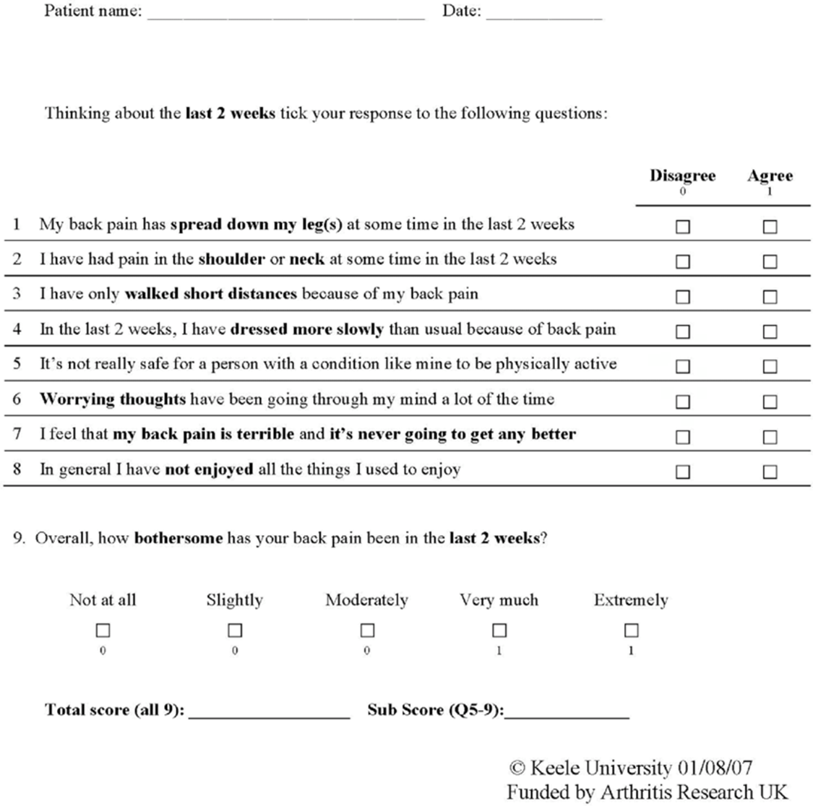
Keene Start Tool

Slide 12
Sign and symptoms
Muscle ache
Shooting or stabbing pain
Pain that radiates down the legs
Pain worsens with movement: bending, walking, etc.

Slide 13
Treatments
1st line: Acetaminophen and NSAIDs are the fist line pharmaceutical treatment for back pain recommended by World Health Organization.
Acetaminophen has the fewest side effects. While NSAIDs have fewer side effects compared to second line medications (opiods/muscle relaxants)
2nd line: Opiods & Muscle Relaxants
-On average opiod resulted in a small pain relief and causes less functional improvement than other analgesics.
-Some patients, opiods may even cause hyper analgesia
S/E: lowers testosterone in men, constipation

Slide 14
treatments
Skeletal Muscle Relexants
An older systematic review found that muscle relaxants are on effective on short-term pain relief and not effective on chronic back pain. S/E (dizziness, sedation)
Tricyclic Antidepressants
-Recommended as an adjunctive treatment
-Additional benefits as a sleep aid. S/E: sleepiness.

Slide 15
Botanicals & supplements
Devils claw: common use treatment for pain but not inferior to NSAIDs. May be used before NSAID treatment.
Willow Bark: contains Salicin related to aspirin but w/o effecting GI mucosa or blood clotting.
Vitamin D: A correlation with low vitamin D and chronic back pain. Evidence showed Vitamin D supplements improved quality of life, sleep, and, pain.
Topical Capsaicin: for short-term analgesics.

Slide 16
Biomechanical interventions
Exercise therapy: Increase activity, strength muscle tone. Evidence show higher exercise intensity the better pain control.
Spinal Manipulation: Stimulates cascade of central and peripheral events resulting in pain relief.
-The only nonpharmacological therapy recommended by American Pain Society for acute lower back pain.
Massage: Recommended for subacute and chronic back pain. There is a higher pain relief in conjunction with exercise.
Yoga: Addresses physical, mental, emotional, and spiritual components. Yoga is moderately effective in chronic low back pain that improves back function and reduces pain.
Tai Chi: low impact exercise that may reduce back pain. Recommended for sedentary or elderly individuals. Evidence shown it improves balance.

Slide 17
Biomechanical interventions
Acupuncture: A Traditional Chinese Medicine (TCM) that uses needles to stimulate endorphins and alters pain sensation. Research concluded multiple chemicals released (interleukins, substance P, and adenosine) attributed to acupuncture analgesia.

Slide 18
Return to the Patient: The Plan
What did you try
- The plans that was listed and discussed
What worked
- The chiropractic treatment with acupuncture along with NSAIDs
What didn’t work
- Physical therapy
Current Plan
- Continue with chiropractic, acupuncture and NSAIDs
- Practice daily good posture and body mechanics
Future Plan
- Add yoga in the regimen

Slide 19
Summary
Back pain is the top reason for morbidity in United States
The first line pharmaceutical therapy are NSAIDs and acetaminophen
Treatment such as acupuncture in conjunction with NSAIDs, exercise, chiropractic treatment can lead to better pain relief
Botanicals such as Willows bark and Devils claw can help alleviate pain

Slide 20
Reference
Keele University (2018). Start back tool. Retrieved from https://www.keele.ac.uk/sbst/startbacktool/
Rakel, D. (2018) Integrative medicine (4th Ed.). Elsevier Saunders: Philadelphia.

