Slide 1
CASE PRESENTATION
THE INTEGRATIVE CARE OF A PATIENT WITH TYPE II DIABETES MELLITUS
Pushpa Sengupta
CSUSM
MSN Cohort-9

Slide 2
OBJECTIVES
Describe the epidemiology of Diabetes Mellitus .
Explain the pathophysiology of Diabetes mellitus.
Identify the risk factors for Diabetes.
List the possible differential diagnosis.
Incorporate evidence-based CAM into the care plan of a diabetic patient.
Analyze a case presentation of a 45-year-old male diagnosed with diabetes mellitus.

Slide 3
Demographics
A 45-year-old Asian male working in a software company with a sedentary lifestyle presents to the clinic with fatigue and generalized weakness, increased frequency of urination and always feeling hungry.
History
Apparently healthy, married for last 18 years.
Personal history of hypertension & hyperlipidemia diagnosed 2 years back.
Does smoke ½ pack daily, drinks alcohol socially or on weekends in moderate amount.
Family hx significant for diabetes, hypertension and hyperlipidemia in his mother and diabetes in his siblings. Father expired due to GB syndrome.

Slide 4
Present the patient
List of medications:
Metoprolol 50 mg P.O. BID.
Atorvastatin 40 mg P.O. daily.
Vit-D 5000 units daily.
Use of CAM (after initial visit)
Started taking Fenugreek 1 tspful in the morning on empty stomach. (3 months ago)
Started to drink 30 oz of Bitter gourd juice daily ( not so consistent due to bitter taste).
Recommended change in diet, exercise or yoga daily (advised on initial visit)

Slide 5
Review of systems: (Subjective)
Middle aged male with complaints of generalized weakness and fatigue most of the day.
Always feeling hungry.
Denies weight loss, constipation, diarrhea.
Denies shortness of breath, chest pain, numbness or tingling in the extremities.
Does state increased frequency of urination and drinking almost 2 gallons of water.
Feels depressed as he has low energy.
Physical Examination (Objective)
Physical exam reveals Ht-5ft 8 inches; weight 175 lbs, bmi-26.6. Abd girth-40 inches
BP-130/80, HR-88/min. Labs: HgbA1C- 6.2%; 3 months later 7.4%;
Urine positive for Glucose.

Slide 6
PHYSICAL EXAMINATION
General: Well groomed. Sitting in comfortable position.
Skin: PWD, no pallor, no lesions noted.
Head: Normocephalic, atraumatic.
Eyes: PERRLA, conjunctivae pink, EOMI, fundoscopic exam: WNL.
Ear: Canals clear, TMs & bone landmarks normal, hearing normal.
Nares: atraumatic, patent.
Throat/Mouth: Mouth moist, tongue midline, normal rise of soft palate, posterior pharynx clear, tonsil 1+.
Neck: Supple, FROM, no lymphadenopathy, trachea midline.
Chest/Resp: CTA, RRR, no murmur, rub, or gallop.
Abd: soft, BS x 4, no tenderness noted on palpation.
Musculoskeletal: Moves all extremities. No joint deformity, good pulses.
Neuro: A/O x4, GCS 15, CNII-XII intact, no focal neuro deficits. Microfilament test intact.

Slide 7
Assessment
Diagnosis: Type II Diabetes Mellitus
Differential Diagnosis:
Diabetes Insipidus.
Stress Hyperglycemia
Diabetes secondary to drugs, hormonal excess or pancreatic disease.
Medication: Started on Metformin 500 mg P.O. BID.
Diagnostic: Will recheck HgbA1C and lipid panel in 3 months.
Plan: Educated on 40/30/30 diet plan.
Low CHO, low fat diet, to include more vegetables and low sweetened fruits in diet.
Daily exercise at least 30 min walking, may start yoga or other forms of exercise.

Slide 8
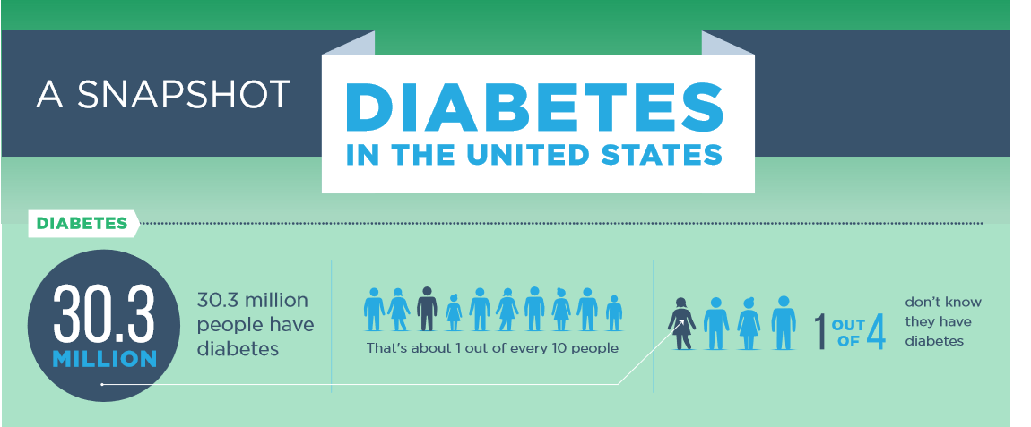
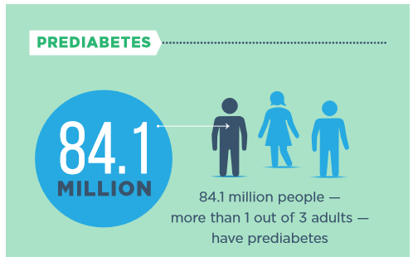
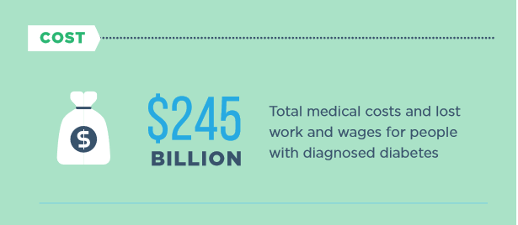
Epidemiology
Diabetes is the seventh leading cause of death in the US.
In the last 20 years, the number of adults diagnosed with diabetes has more than tripled as the American population has aged and become more overweight or obese.

Slide 9
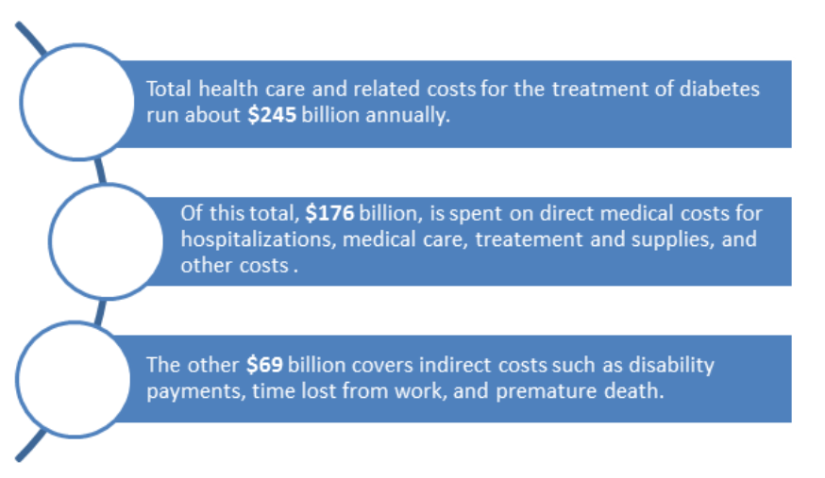
Epidemiology: Racial and Ethnic Differences/Cost.

Slide 10
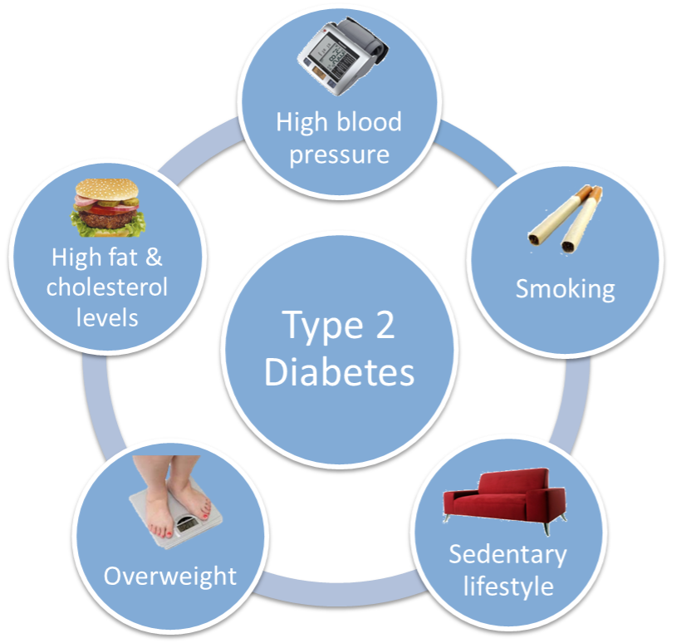
Risk Factors
More ADA Risk Factors:
>45 years of age
Parent or sibling with diabetes
African American, American Indian, Hispanic/Latino, Asian American, or Pacific Islander
Had Gestational Diabetes
Delivered >9 pound
Polycystic ovarian disease

Slide 11
Pathophysiology
Insulin
Promotes glucose transport from bloodstream across cell membrane to cytoplasm of cell.
Decreases glucose in the bloodstream

Slide 12
Pathophysiology
Insulin
↑ insulin after a meal
Stimulates storage of glucose as glycogen in liver and muscle
Inhibits gluconeogenesis
Enhances fat deposition
↑ protein synthesis

Slide 13
Multiorgan Regulation of Blood Glucose

Slide 14
Signs & Symptoms

Slide 15
Diagnostics
Fasting plasma glucose (FPG)
Specimen collected after 8 hours w/ no caloric intake
Value over 126 mg/dl indicates DM Type 2 (ADA, 2018)
Two-hour plasma glucose (2-h PG)
Patient consumes 75 grams of anhydrous glucose
Value of 200 mg/dl indicates DM Type 2 (ADA, 2018)
A1C (glycosylated hemoglobin)
Attachment of glucose to hemoglobin molecules in red blood cell over time (120 days)
Value greater than 6.5% indicates DM Type 2 (ADA, 2018)

Slide 16
Therapeutic intervention goals
Optimize blood glucose control.
Decrease BMI.
Increase physical activity.
Medicate as appropriate.
Reduce risk of complications.
Identify organ-system complications/treat comorbidities.

Slide 17
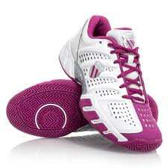
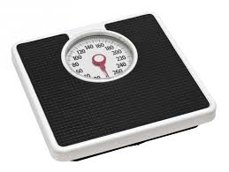
Therapeutic interventions
Diet and exercise (obesity management)
Weight Management
Oral hypoglycemic such as biguanides, sulfonylureas, meglitinides, alpha-glucosidase inhibitors
Insulin which improves glycemic control and decreases need for glucose-lowering medications

Slide 18
Treatment of T2DM Based on Pathophysiology

Slide 19
Antihyperglycemic agents for T2DM: Recommendations

Slide 20
CAM Therapies useful in management of T2 DM
Life style changes and cessation of smoking.
Addition of exercises in daily regimen in any form.
Low CHO, low fat, increased proteins like pulses,
lentils, chickpeas beans and dietary fibers such as
oats, beans and psyllium lower glucose levels.
4. Moderate alcohol consumption
5. Mediterranean diet has shown less requirements
of diabetic medications.
6. Sleep hygiene.
7. Meditation, Yoga, CBT, Reiki, and Naturopathy.
8. Ayurvedic/TCM herbs like coccina cordifolia,
fenugreek, cinnamon, milk thistle, momordica
charantia, Touchi, have shown to lower glucose levels.
9. Supplements like Vit D, Alpha-Lipoic acid, Omega 3 fatty acids, magnesium, chromium, Vit E, Antioxidants, and L Carnitine have found to be useful.

Slide 21
Return to the patient:
What did you try:
Patient on initial encounter was given a chance to control his blood glucose by diet, cessation of smoking, and inclusion of exercises as he was a prediabetic.
What didn’t work:
The initial advice did not work in spite of patient trying certain things like control of diet portion, eating healthy and inclusion of exercises as patient was not compliant on a daily basis due to stress of work.
What worked:
So patient had to be started on oral antihypoglycemic like Metformin which brought his HgbA1C levels under control along with diet and exercise.

Slide 22
Return to the patient:
Current Plan
Continue oral antihypoglycemic medication, antihypertensive and statin medications.
Emphasis on diet was done, nutritional consult was set up with dietician.
Emphasis on exercise was done, patient joined a yoga club and is walking daily.
Trying to quit smoking by using nicorette gum.
Patient wanted to restart bitter gourd juice daily and fenugreek, was allowed.
Future Plan
Maintenance of HgbA1C levels below 7%.
Routine follow up to prevent complications.

Slide 23
Summary
Diabetes is a worldwide problem, and 1 out of 2 people do not know they have diabetes.
Diabetes is a progressive metabolic disorder and becomes a life long chronic disease with multiple complications if not controlled and can lead to CAD, kidney failure, stroke, and loss of limbs.
It can be prevented early by modifying lifestyle, avoiding smoking, eating healthy, inclusion of exercise in daily living, maintaining healthy weight and healthy mind to stay healthy lifelong.

Slide 24
Reference
American Diabetes Association. (2016). Classification and diagnosis of diabetes. Diabetes care 2016, 39(1). doi: 10.2337/dc16-S005
Centers for Disease Control and Prevention. (2018). National diabetes statistics report, 2018. Retrieved from http://www.cdc.gov/diabetes/pubs/statsreport14/national-diabetes-report-web.pdf
McCance, K. L., & Huether, S. E. (2014). Pathophysiology: The biologic basis for disease in adults and children (7th ed.). St. Louis, MO: Elsevier Mosby
Nair, R. (2016). Emphasis of Naturopathy in the Management of Type 2 Diabetes Mellitus. Journal of Medical Science and Clinical Research, 04(12), 14987-14993
Pal, D. K., Bhalla, A., Bammidi, S., Telles, S., Kohli, A., Kumar, S., ... & Malik, N. (2017). Can Yoga-Based Diabetes Management Studies Facilitate Integrative Medicine in India Current Status and Future Directions. Integrative Medicine International, 4(3-4), 125-141.
Rakel, D. (2018) Integrative medicine (4th Ed.). Elsevier Saunders: Philadelphia.
Wang Z, Wang J, Chan P. Treating Type 2 Diabetes Mellitus with Traditional Chinese and Indian Medicinal Herbs. Evidence-based Complementary and Alternative Medicine: eCAM. 2013; 2013:343594. doi:10.1155/2013/343594.

