Slide 1
CSB: Visual Aids
Global Tourism & Communication
Daily Question: How do you choose visuals for your presentation?

Slide 2
Agenda
Objectives:
After this lesson students will be able to
Evaluate how effective a visual aid is
Use language for visual aids
Understand the benefits of using visual aids
Warm-Up
Visual Aids
Types
Comparing Visuals
Tips
Useful Language
Practice
Notes:
Class Time 55”
Warm up 15”
Visual Aids 20” (5” per slide)
Practice 20”

Slide 3
Warm-Up - Describe a well-known object or site
Pick a well known place or thing related to travel (1 per group)
Write or think silently for a minute
Discuss how you will describe it (don’t tell us the name!)
Describe it to the class (classmates guess)
Examples:
Material: It’s made of stone
Shape: It’s cylindrical
Characteristics: It’s very tall and leans
Use: It was created as part of a church
5 Senses: It’s light in color and rings out the time every day
Notes:
Note: This can connect to the group activity later by being the SAME assigned object/concept in both activities. This is without visual and the next one is with visual (see slide 13)
Materials: Descriptive adjectives handout
What place did I describe? The leaning tower of Pisa
Other ideas: Look at some visuals. Which one would you use in a presentation/speech? Why?
Purpose of activity: 1. Can show that sometimes visuals are easier to use than descriptions;

Slide 5
Notes:
To make it more difficult, we could choose abstract concepts instead

Slide 6
Visual Aids
We often have to make presentations for school and at some jobs visual aids can make a presentation or speech:
More interesting
Easier to understand
There are many types of visual aid:
Discuss: What type of visual aid would you use in a speech?
Computer Images
Graphs and Charts
Posters and Drawn Images
Handouts
Physical Objects
Audience Members
Notes:
Can discuss in groups; can also vote in a poll
Group Discussion: Look at the next three slides and discuss the questions below
Groups can share about:
Which aids are good?
Which ones are bad?
Which would you use?
How could you improve them?
Poll:
Physical Objects
Handouts
Posters and Drawn Images
Projector*/Computer images
Graphs and Charts
Volunteers from the Audience
Chalkboard/Whiteboard*
*Usually available in classrooms

Slide 7
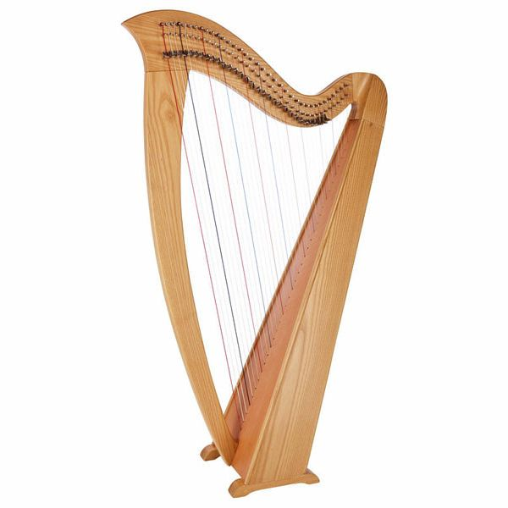
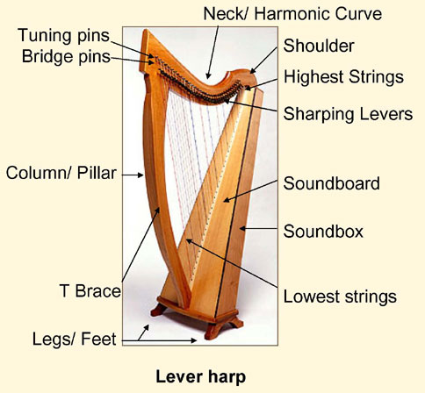
Compare the two visuals for a presentation. Which would be more effective for a presentation? Why?
Notes:
Students work in pairs, or just post thoughts in the chat

Slide 8
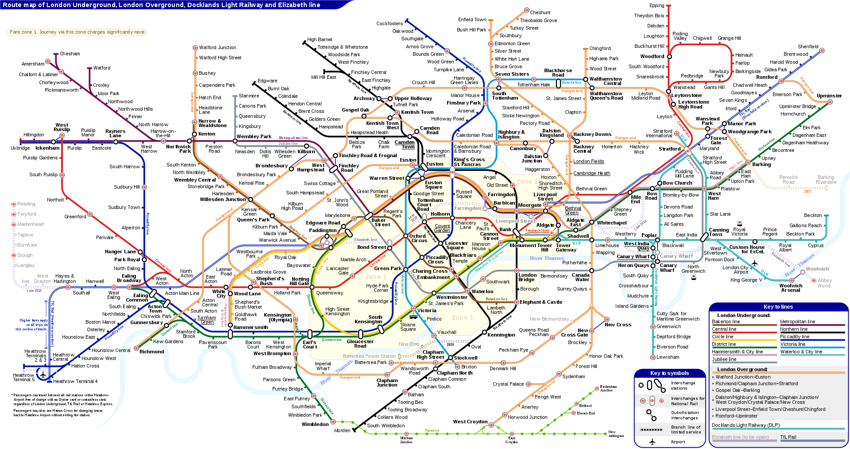
Would this make a good visual for your presentation? Why or why not? How could it be improved?
Notes:
Students discuss in pairs or put answer in chat
Answer: This is not a good visual because it is not simple enough; it will be hard to see anything in this visual

Slide 9
Would this make a good visual for your presentation? Why or why not? How could it be improved?
Notes:
Students discuss in pairs or put answer in chat
Answer: This is not a good visual because it is not simple enough; it will be hard to see anything in this visual

Slide 10
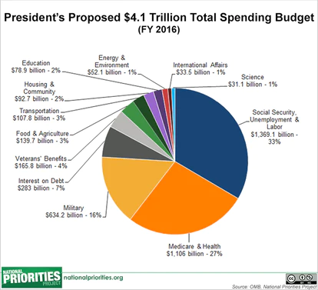
Compare these two visuals. Which is better?
Notes:
Students discuss in pairs or put answer in chat
Answer: This is not a good visual because it is not simple enough; it will be hard to see anything in this visual

Slide 11
Tips for visuals
Attractive but simple
Large and easy to read
Eye-catching, colorful
Colorful
Easy to read
Remove unneeded wording
Include a title
Label major parts
Include the source (where you got the visual)
Does this visual aid follow any of these tips? How can we improve this visual aid?
Notes:
Answer: Good: This visual is colorful, large, and eye catching Bad: There are too many labels, it is hard to read, there is no title; they can remove unneeded wording, label only the major parts, and make the part we need to focus on large

Slide 12
Useful Language
This is a lever harp
These are the strings
Here you have the tuning pins
This is a column here, and that is a soundbox there.
This is called a T Brace
Propositions show location: Next, after that, behind, underneath, in back of, next to, inside of…
In groups: Find an image for a well known object or site and prepare a short 1-minute presentation to share with the class
Notes:
Introduce the parts of a harp using pointer and example sentences; then students practice describing their own object in groups [can be assigned or they find a picture?]
Students will practice describing the image to group members; OPTIONAL: students choose their own image
Purpose: to practice using visuals in English; students think about what visual is most useful
Share out: what was easy? What was hard? What image did you choose/How useful was the image you received/would you use it in a presentation What would you change?
One object: This is a harp
First time, use ‘a’; after, use ‘a’, ‘the’, or -s ending
Parts of objects: These are the strings
‘The’ is often used instead of ‘a’ to describe parts of an object
Here you have the pins, which are used to tune the strings.
When location is important: That is (That’s) the pupil of the eye.
When things are farther apart: This is… here and that is… there
...is/are called…
Connectors & Prepositions can introduce and relate parts to each other: next, after that, behind, underneath, in back of, next to, inside of…
New information: This is the outer bark, and behind it is the inner bark

Slide 13
Short Presentation
Now, it’s your turn! Please…
Share your visual
Tell us about it using language we reviewed
We encourage all group members to participate!

Slide 14
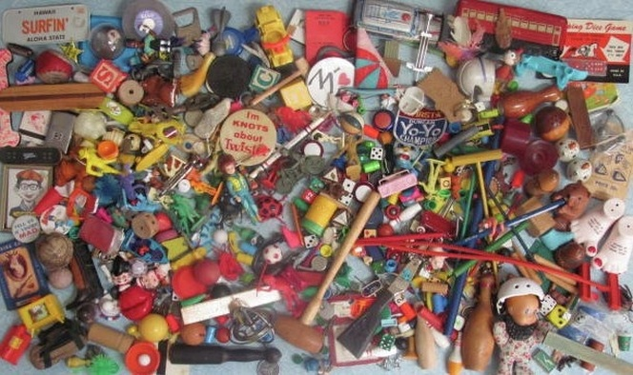
Notes:
Bonus group activity: Students take turns describing until their group-mates guess the objects in the photo
Ok to use prepositions
No using the name of the object to describe the object

Slide 15
Notes:
Bonus group activity: Students take turns describing until their group-mates guess the objects in the photo
Ok to use prepositions
No using the name of the object to describe the object

