Slide 1
Area Studies: Surfing in San Diego

Slide 2
Agenda
Warm Up Questions
Surfing Today
Surfing Research
Surfer Culture
Surfer Stereotypes
Surfer Slang
Objectives: After this lesson you will be able to...
Describe the history of surfing in San Diego
Understand the significance of surfing in San Diego
Use San Diego surfer slang vocabulary
Notes:
Additional Resources:
Video: History of surfing( link)
Video Links: Surfing Music: (x)
Video: Documentary "The Endless Summer" (link)
Articles: Surfing San Diego (1)(2)(3)
Video: About the beach party movies (link)
Website: CSUSM Surfing Research (link)
Video: CSUSM Surfing Research (1)(2)

Slide 3
Warm-Up Questions:
1. Would you ever try surfing? Why or why not?
2. Where does surfing originally come from?
3. Why do you think surfing is popular in San Diego?
Think about these questions for a minute, then share. You can review the lesson below to look for ideas.

Slide 4
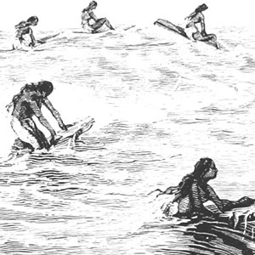
History of Surfing
Done in Polynesia since ancient times
Boards were flat pieces of wood
Had spiritual and religious significance in Hawai'ian culture
Became Popular in Hawaii, Australia, and California in the 1960's

Slide 5
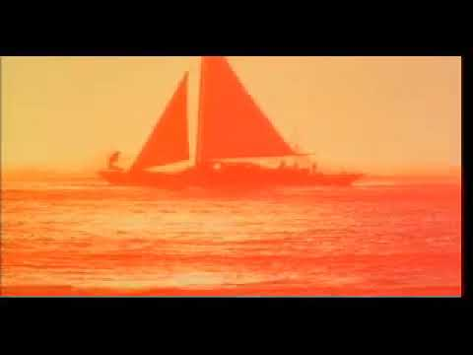
The Endless Summer (1966)
The 1966 movie, "The Endless Summer" (LINK), helped start a culture of surfing and travel
Notes:
The 1966 movie, "The Endless Summer" (LINK), helped start a culture of surfing and travel

Slide 6
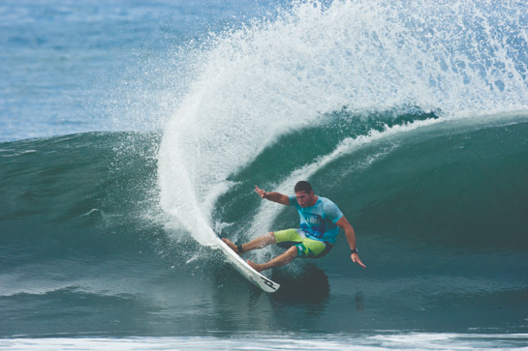
Surfing Today
$10 billion industry
High tech boards and equipment
Worldwide Competitions
Development of ‘surfer culture’
San Diego has surf-themed restaurants, bars, and fashion. There is even a surf report as part of the news.

Slide 7
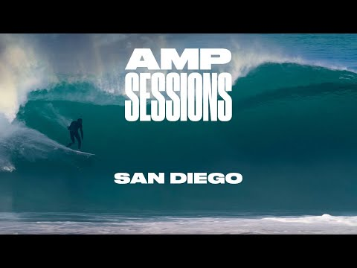
Surfing In San Diego
Example of surfing in San Diego: (video)

Slide 8
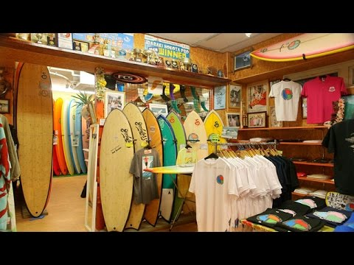
Surfing In Japan
Example of surfing in Japan: (video)

Slide 9
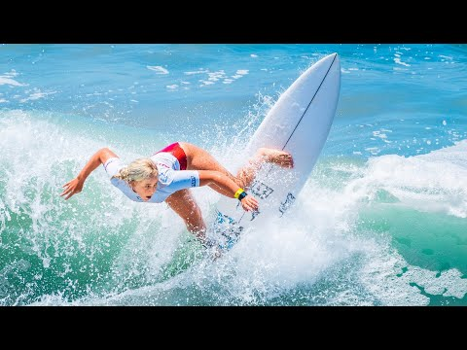
Olympic Training at Oceanside

Slide 10
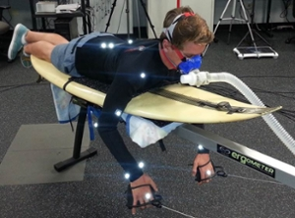
CSUSM Surfing Research
CSUSM Researchers combine mechanics and physiology to study surfing
CSUSM students help with the research as part of courses like 'surfing science'
They test many products such as wetsuits and boards for sports companies
Notes:
[[add more from Website Links: (1)(2)]

Slide 11
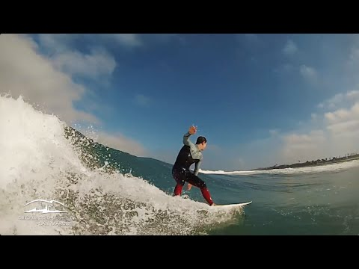
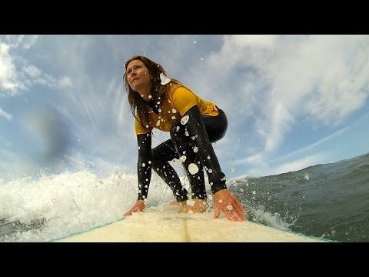
Surfing Research at CSUSM
CSUSM has the only research facilities that combine mechanics and kinesiology
Notes:
Web links: (1)(2)

Slide 12
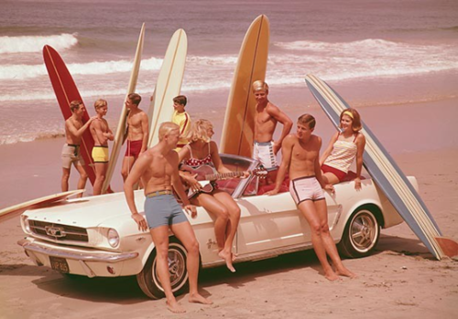
Surfer Culture
Became popular from the 60's on
Often portrayed as young, fun-loving
Influenced by Hawai'ian and Polynesian culture
'Tribal tattoos'
Puka shell necklaces
Increasing diversity over time as surfing spreads around the world
Portrayed In popular culture like movies, and TV shows
Music associated with surfer culture includes Beach Boys and Surfer Rock (Surfing USA) (Pipeline)
The Beach Party movies of the 1960's portrayed Surfer Culture as an escape from the strict lifestyle many youth endured

Slide 13
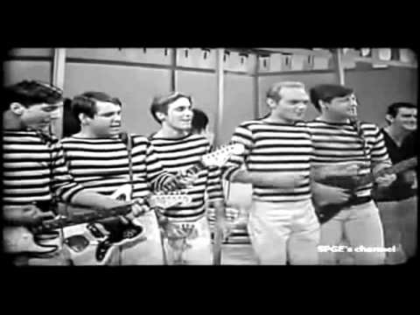
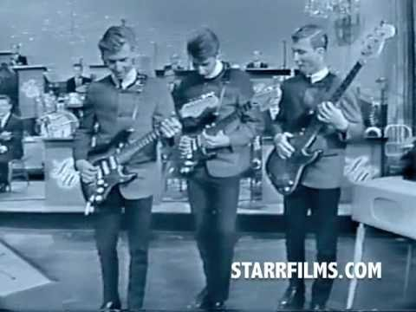
Surfer Music
Surfing USA
Pipeline
Notes:
(Surfing USA) (Pipeline)

Slide 14
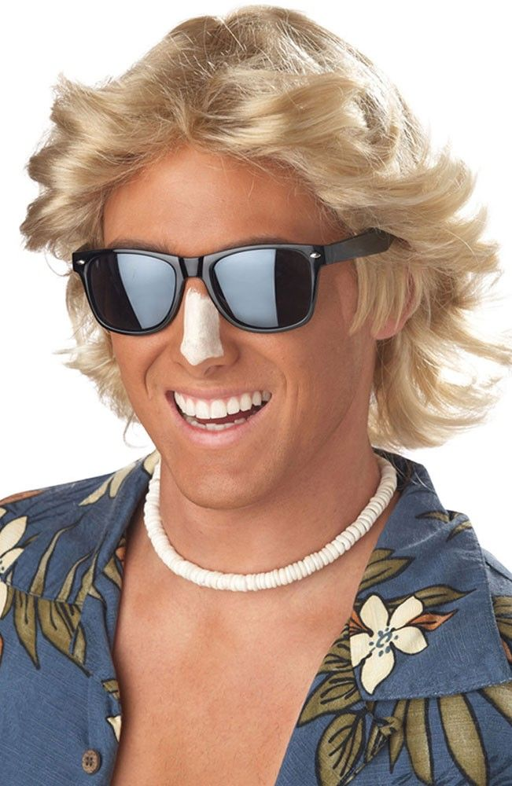
Surfer Stereotypes
Some stereotypes include: relaxed, not very smart, frivolous, fun-loving, doesn't like rules
Young
Influenced by Hawai'ian and Polynesian culture
'Tribal tattoos'
Puka shell necklaces
A Stereotypical Surfer

Slide 15
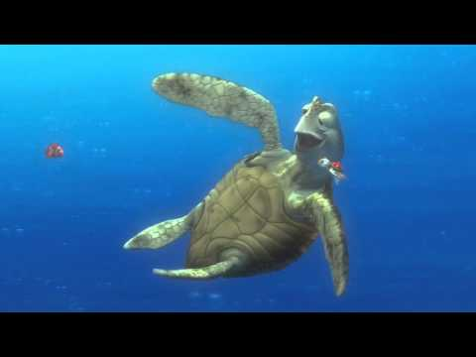
Finding Nemo (2003)
The turtle character is an example of a surfer stereotype
Notes:
[finding nemo turtle]

Slide 16
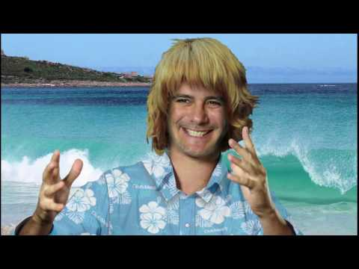
Surfer Slang
Watch the video
Do you recognize any words?
What are some new words
Get into groups
Take turns - Pick a word to use in a sentence

Slide 17
Slang Definitions
1. Dude - A fellow surfer; friend; companion; can be male of female
2. Stoked - pumped, extremely happy, excited
3. Gnarly - This refers to something that is intense, crazy, dangerous, or risky
4. Sick - A term applied to anything that is really good Your surfboard is sick!
5. Shortie - A wetsuit with short legs and short arms; a spring or summer suit Put on your shortie because it’s warm today.
6. Amped - feeling excited, similar to “stoked” We’re going to Hawaii. I’m so amped!

Slide 18
Additional Activity
Reflect:
One thing you know about surfing
One thing you learned about surfing
One question you have

